Slide 1
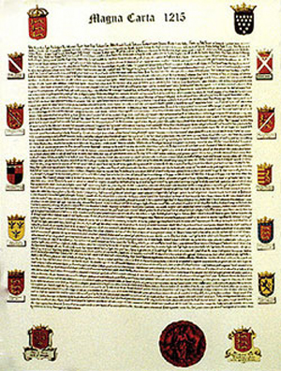
Chapter 9: Emerging Europe and the Byzantine Empire

Slide 2
Important Dates
Clovis est. the Frankish Kingdom: c. 510
Justinian Codifies Roman Law: 534
Charlemagne is Crowned Emperor of the Romans: Christmas Day 800
The Schism begins between the Catholic and Orthodox Churches: 1054
Battle of Hastings: 1066
Beginning of the Crusades: 1096
Signing of the Magna Carta: 1215

Slide 3
Transforming the Roman World
Clovis Converts to Christianity c. 500
Est. Frankish Kingdom: 510
The New Germanic Kingdoms
Visigoths: Occupied Spain and Italy until the fifth century when the
Ostrogoths took over Italy.
These groups ruled as kings, but kept the governmental organization and infrastructure of Rome.

Slide 4
Britain
Roman influence was weaker in Britain because the Romans had left that area at the beginning of the fifth century
Two groups, the Angles and Saxons moved in after the Romans left. These groups later became known as the Anglo-Saxons.

Slide 5
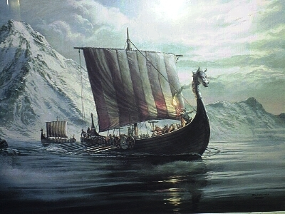
Scandinavia
A group known as the Vikings settled in Scandinavia. They were great sailors and explorers who eventually spread throughout Europe.

Slide 6
The Vikings
The Vikings, or Norsemen, were a group which originated in Scandinavia.
The Vikings were master ship builders and left their homeland to invade mainland Europe.
They used their ships to sail up the rivers of Europe, raiding and terrorizing along the way

Slide 7
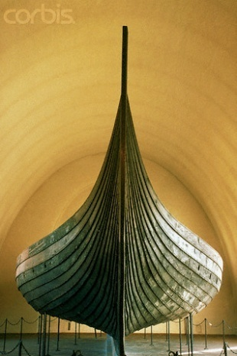
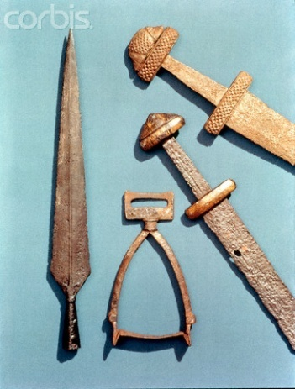
The Vikings used their long, open, wooden ships to sail as far as North America.
They had a rich culture which included poetry and mythology. They were excellent craftsmen working and contributed to trade in the Late, or High, Middle Ages.
The Vikings virtually destroyed the areas they invaded at the time and their invasions heightened the insecurity which helped lead to the development of Feudalism.

Slide 8
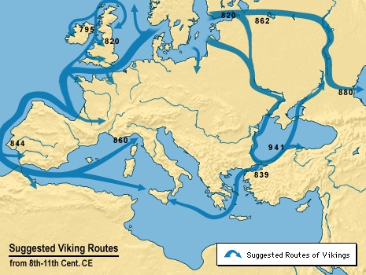

Slide 9
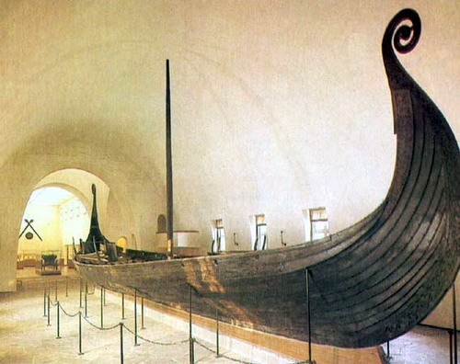
Viking Ships
Viking ships had a shallow keel, or bottom of the ship. This allowed them to sail in both deep and shallow water.
The Vikings also developed a square sail which allowed them to both row and use wind to power their vessels.

Slide 10
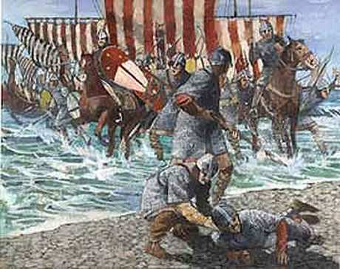
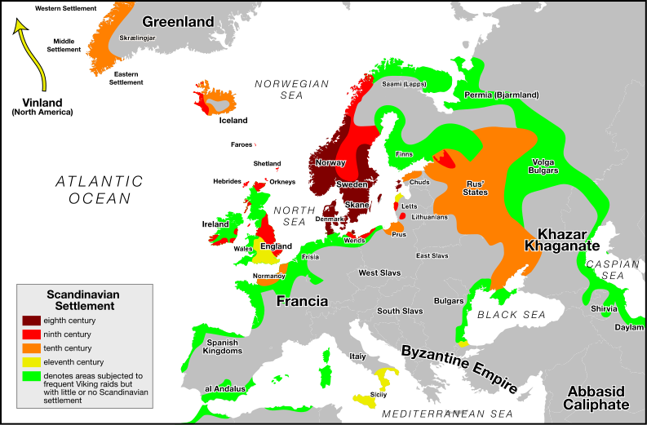
Normandy
The Vikings landed in France.
Rather than fight the Vikings, the
French gave them
a bit of
territory
which
came to be
known as
Normandy.

Slide 11
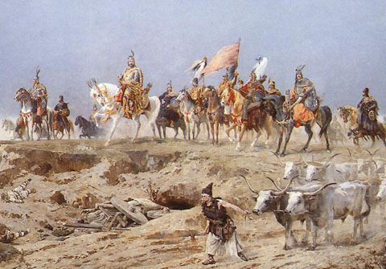
Hungary
A group known as the Magyars settled in Hungary

Slide 12
Who were the Magyars?
A nomadic group which migrated from the region of the Ural Mountains and settled into what is now modern-day Hungary.

Slide 13
Germanic Society
The most crucial social bond among the Germanic people was family
This created a problem with blood feuds.
-When someone killed a member of another family, that family had the right to seek revenge, this would escalate and lead to warfare between families.

Slide 14
Germanic Law
Germanic Law was different than Roman Law.
Roman Law was based upon reason and evidence.
Germanic Law was based on blood, family, and revenge-there wasn’t any logic or reason involved.

Slide 15
Wergild
To deal with the problem of blood feuds the Germanic tribes established the idea of the Wergild.
This literally meant, “Money for a Man”
If a person was killed or wronged in some way the person responsible would have to pay a fine equal to the value of that person. Upper class people were “worth” more than those from the lower class.

Slide 16
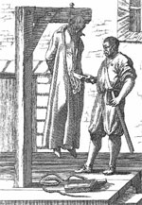
Ordeal
In Germanic law the way that they decided guilt or innocence was through an ordeal.
An Ordeal was a physical test to determine guilt or innocence.
If you could survive this physical
test then you would be innocent,
if you died or were wounded you
would be guilty and probably die
anyway

Slide 17
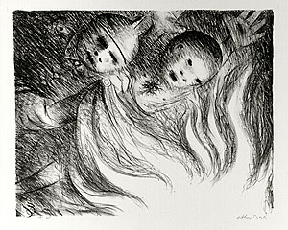
Different types of Ordeals
Ordeal by Combat: Two people would fight and the winner would be innocent
Ordeal of Fire: Accused would walk over red-hot ploughshares or holding a red-hot iron, if you escaped injury or infection, then you were innocent
  A variation on this was reaching
  into a pot of boiling water, oil,
  or lead and removing an object
  unharmed.

Slide 18
More Ordeals
Ordeal of Hot Water: Accused dips his hand in a kettle of boiling water.
Ordeal of Cold Water: Accused is submerged in a barrel three times and is guilty if he sinks to the bottom.
Ordeal of the Cross: Accuser had to undergo the ordeal with the accused. The two men would stand and stretch out their hands horizontally, the one to lower their arms first lost.

Slide 19
The Kingdom of the Franks
The Frankish kingdom was est. by Clovis
Clovis converts to Christianity
This helps him politically because he gains the backing of the Catholic Church
Clovis builds a large kingdom extending from the Pyrenees to Germany and modern-day France, but after his death, according to Germanic custom, his sons divided up his lands

Slide 20
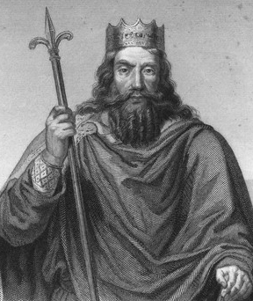
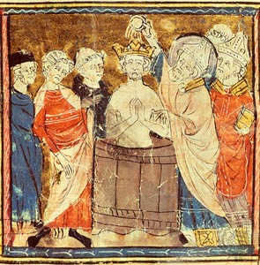
Clovis

Slide 21
Charlemagne and the Carolingians
The grandfather of Charlemagne, Charles (the Hammer) Martel led the Christian Franks against the Muslim forces at the Battle of Tours in 732.
His father, Pepin (the Short) became a chief officer, or Mayor of the Palace for his king of the Frankish realm. Pepin was basically running the show and got the Pope to acknowledge that he was running the kingdom and declare him leader.

Slide 22
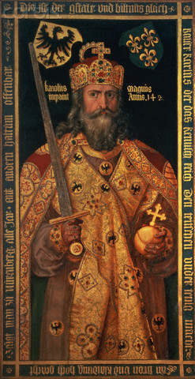
Charlemagne
Charlemagne became king of the Carolingian Empire.
He was a very tall man for his time. He was a fierce warrior, a strong statesman, and a pious Christian. He was a great promoter of learning even though he never learned to read and write himself.

Slide 23
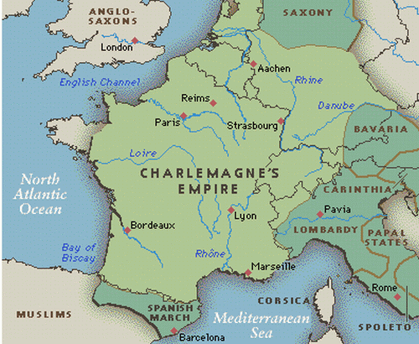
Carolingian Empire
The empire of Charlemagne, it came to include most of what is now Western Europe.

Slide 24
Missi Dominici
Charlemagne set up a great administration to help rule his empire.
He wanted his lands to be a “New Rome”
The Missi Dominici “messengers of the lord king.” These were two men from each of Charlemagne’s territory that reported to Charlemagne to make sure people were obeying his orders.

Slide 25
The Crowning of Charlemagne
Charlemagne was called upon by Pope Leo III to help put down a revolt in Rome.
After he helped the Pope, Leo III invited him to attend mass on Christmas Day AD 800. At the Mass Charlemagne was crowned Emperor of the Romans or “Holy Roman Emperor”

Slide 26
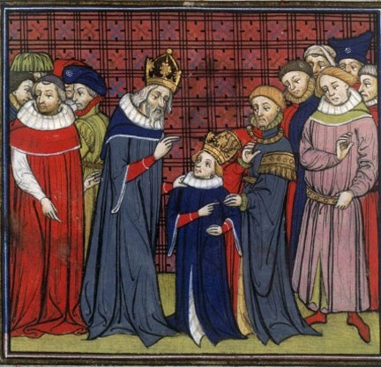
Crowning of Charlemagne

Slide 27
The Caroliginian Renaissance
Charlemagne wanted to revive Latin (Roman) learning within his empire.
He set up schools and organized the church in his empire.
Aachen: was his capital city, which he vowed to make a “New Rome”
He set up scriptoria, where he had monks copy books to revive Roman learning.

Slide 29
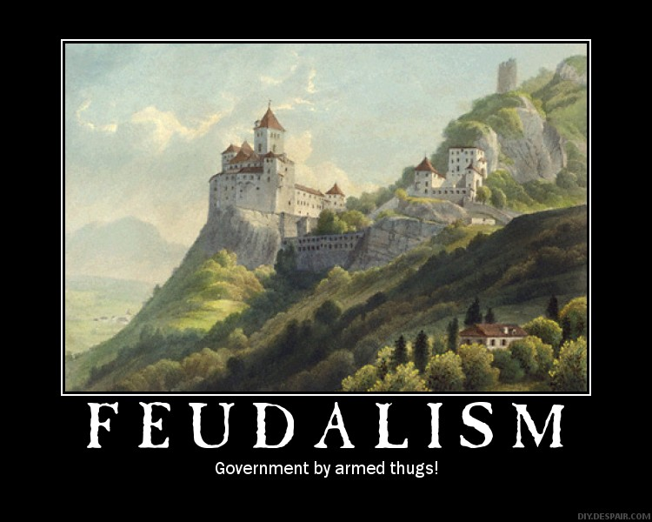
Section 2

Slide 30
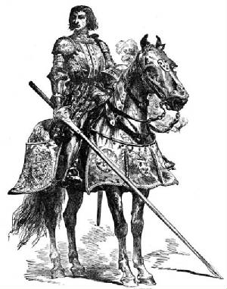
Important Dates
Charlemagne Dies: 814
Feudalism spreads
throughout
Western Europe: 1050

Slide 31
The Invaders
After Charlemagne died in 814, Germanic custom said that the empire should pass to his son. Because he only had one son, his empire stayed together.
After that son died, the Treaty of Verdun (in 843) divided the empire between his three grandsons. This is when a split develops between the eastern empire which became Germany and the West which became France. Another brother gained the middle which extended from Italy up to the North Sea.

Slide 32
Feudalism
Government by Armed Thugs!
Feudalism was a governmental system based on the ownership of land.

Slide 33
Loyalty
Military Service
Advice and
Tax Collection
The lord gave a parcel of land to a vassal
Controlled all of the land
Feudal relationships could become very complicated.
A man could end up being both a Lord and Vassal at the same time.
Promised to be loyal to his lord-took a public oath to the effect
Included land and everything on it
Considered part of the land

Slide 34
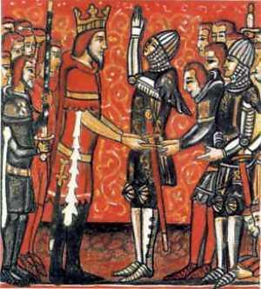
Lord/Vassal Relationship
A Lord gave land to a Vassal
This land was called a Fief
The Vassal Promised:
Loyalty
Military Service
Advice
Collection of Taxes (Rent)
(Your Lord became your
Landlord)

Slide 35
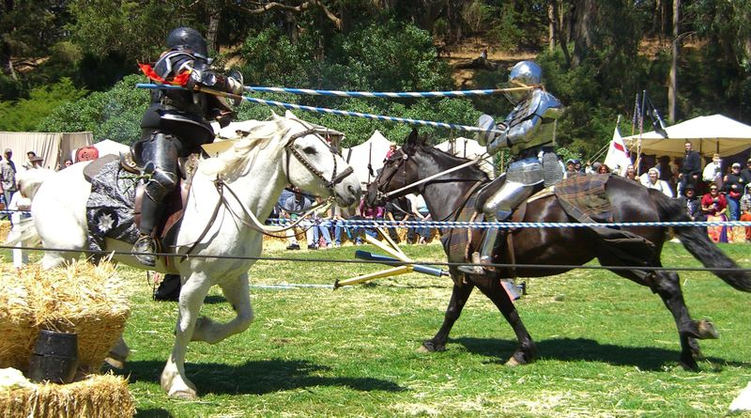
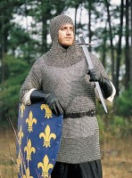
Knights
A Knight was a gentlemen soldier
and a member of the warrior class.

Slide 36
Becoming a Knight
There was a process to becoming a knight
Paige
A boy would become a page at the age of 7 and serve until he was 14
Squire
At 14 a boy would become a squire.
Knight
At the age of 21 a young man could become a knight.
He was knighted in a special ceremony by his lord where he agreed to serve his lord.
The Page was a servant to the knight.
A Squire was an assistant to a knight and would help him prepare for battle as well as care for his armour and weapons

Slide 37
Armour
A knight had many different parts to his armour when he prepared for battle.
He also used a variety of weapons to fight.

Slide 38
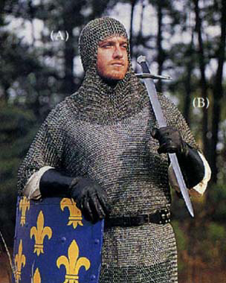
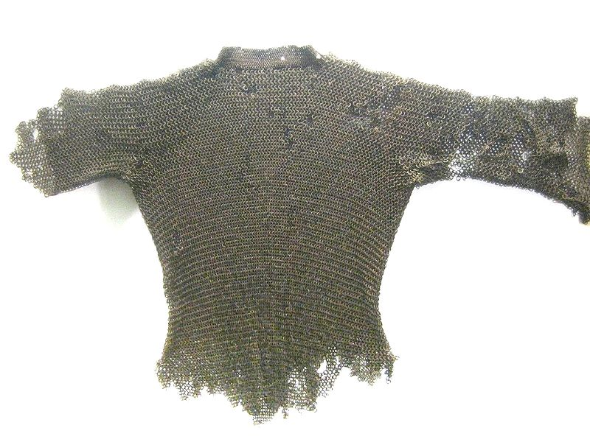
Chainmail
Chainmail was made by linking small rings of metal together.
Mail armour provided an effective defense against slashing blows by an edged weapon and penetration by thrusting and piercing weapons

Slide 39
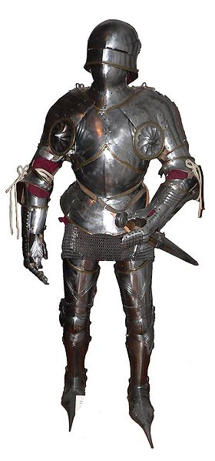
Plate Armour
By the 14th Century, Plate Armour was used to supplement Chain Mail.
A full suit of Plate Armour in addition to the Chain Mail underneath of it could weight up from 45 to 70 lbs.

Slide 40
Tournaments
During times of peace knights would practice their skills by competing in tournaments.
There would be various contests where knights would practice their fighting skills against each other.

Slide 41
Jousting
Jousting was a competition where knights on horseback would attempt to knock their opponent off their horse using a lance.
In battle this was an important skill because it was much easier to kill a man once he was off of his horse.

Slide 42
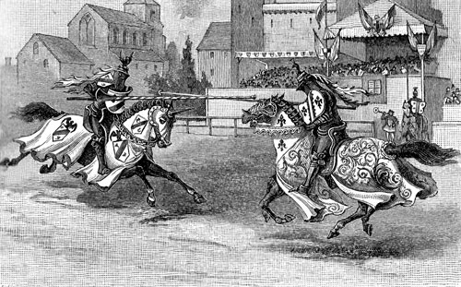
Jousting

Slide 43
Chivalry
Chivalry was a code of behavior which developed for Knights.
A true knight was expected to fight bravely, to demonstrate loyalty to his lord, and to treat other knights with respect and courtesy.
Knights also served as soldiers for the church, they were to serve in the service of God and protect women and children.

Slide 44
Feudal Contract
The Feudal contract was the agreement that a vassal made with his lord.
The Fief: Was land that was given to the vassal by the lord.

Slide 45
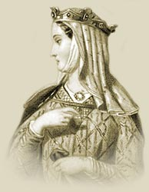
Eleanor of Aquitaine
Eleanor of Aquitaine was an exception
to the women of this time.
She was a strong-willed, independent woman who made her views known.
She was originally married to Louis VII of France, that marriage was annulled and she married Henry II of England.
She had two sons with Henry who went on to become English Kings: King John and King Richard the Lion-Hearted, making her the “Grandmother of Europe”

Slide 46
Castles
Castles were designed to be a place of protection and a place of retreat in the event of an attack.
They were offensive weapons built to control surrounding lands.
They evolved into residences for the King or Lord who built them.

Slide 47
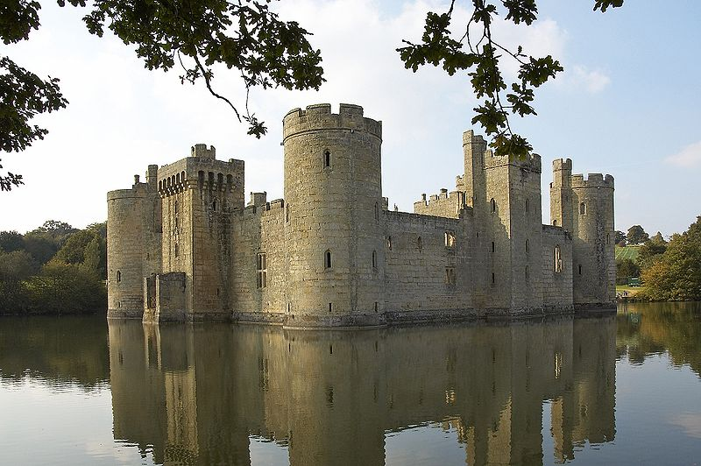
Bodiam Castle in Sussex UK

Slide 48
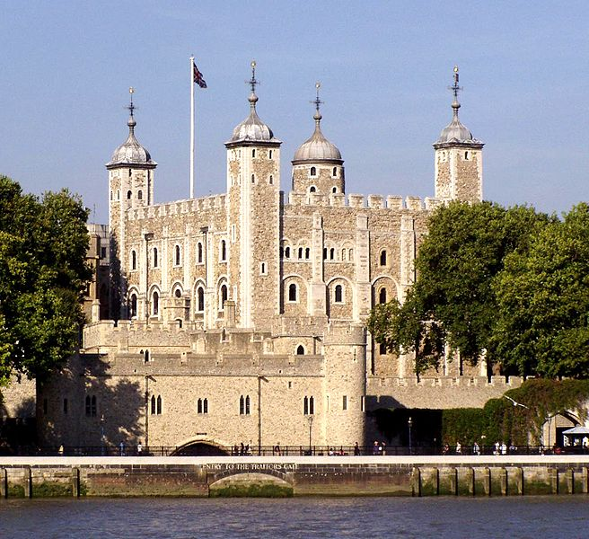
The White Tower built by William the Conqueror in London, England.

Slide 49
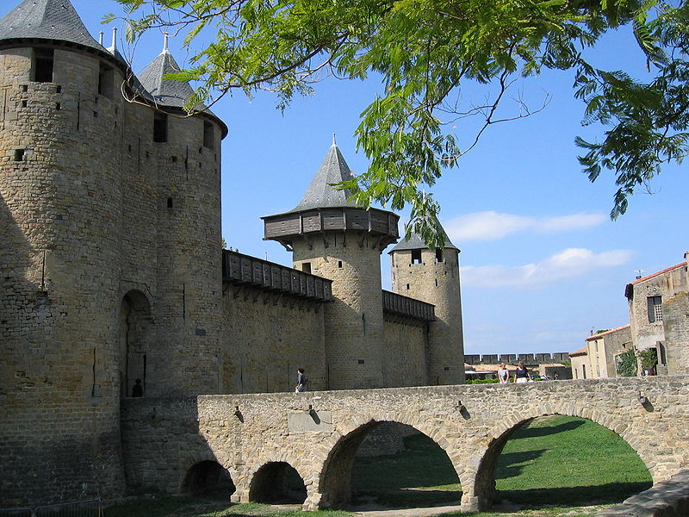
Carcassonne, France

Slide 50
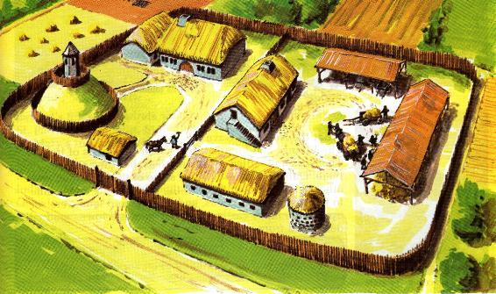
The Manorial System
A Manor was a self-sufficient agricultural estate run by a lord and worked by peasants and serfs.

Slide 51
Many peasants at this time became serfs. A serf was a peasant who was bound to the land and didn’t really own any land of their own.
  As the population of Europe increased during this time there was less land to go around. Many peasants lost their holdings and became serfs.
  Serfs could not leave the manor, they had to work to pay rent, and had to pay fines and fees for various services on the manor. Serfs also could not marry without the Lord’s permission.
In exchange for their labor, the lords of the Manors did owe the serfs protection in the event of invasion.
They also were able to keep a percentage of the crops they produced on the manor for their own families.

Slide 52
Daily Life of Peasants
Peasants lived a hard-working simple life.
They lived in houses which had thatched roofs resting on timber framework with the spaces filled with mud and straw. There were few, if any windows.
Many houses only had one to two rooms, there was little privacy.
Often their animals slept inside the house with serfs to provide warmth

Slide 53
Section 3
The Medieval Church

Slide 54
The Role of the Church
After the fall of Rome the Church took over the central role in society.
The Church, despite its faults, did a lot of work in Medieval communities. The Church helped the poor and helped provide a sense of unity for the people through a common religion

Slide 55
The Papacy
The head of the Catholic Church was the Pope.
The Pope, (from the Latin word “papa” –father- was the Bishop of the city of Rome.
This Bishop claimed that they were descended from St. Peter who was the “Rock” upon which Jesus built his church.

Slide 56
Hierarchy of the Catholic Church
The Pope: Head of All the Church. Was centered in Rome
Arch Bishops and Cardinals
Bishops who ruled over a Diocese
Priests who ruled over a Parish

Slide 57
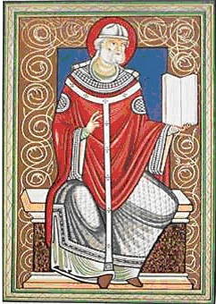
Pope Gregory I
Pope came to be accepted as leader of the Church—but to what extent?
Pope Gregory I wanted to strengthen the power of the Papacy.
He insisted that all bishops and the Byzantine Church were subject to his authority.
He established monasteries and made their ties to the Church stronger, converting non-Christians

Slide 58
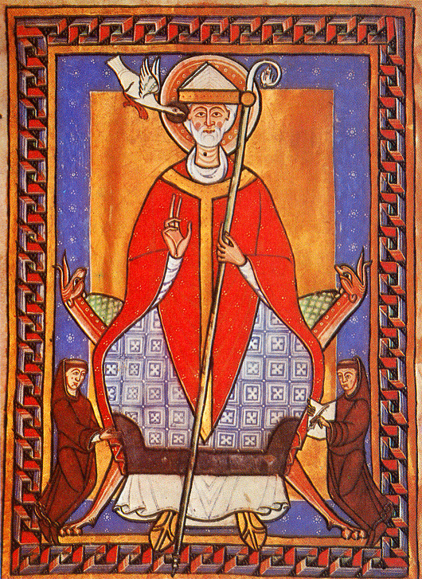
Gregory not only strengthened the spiritual power of the church, but also its political power.
He served as leader of the city of Rome and its surrounding territories which became known as the Papal States
The Papal States were the political territory of the Catholic Church.

Slide 59
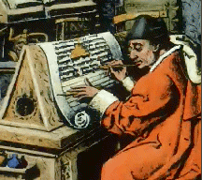
Monks and Their Missions
A Monk was a person who dedicated their life to the Church
Monasticism: The practice of living the life of a monk.

Slide 60
Monks were seen as the heroes of the Christian civilization.
They took care of the poor and provided the “social services” for the time.
They were seen as living the Christian ideal, a lifestyle that only a few could aspire to live.
Many monks were missionaries, they would go out and attempt to convert new groups or peoples to the Christian faith.

Slide 61
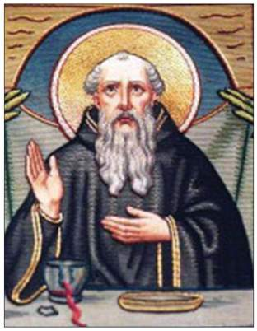
The original ideal of Monastic life was for a Monk to withdraw from secular (non-religious or worldly) life and live alone focusing on prayer and meditation.
A monk came along who
changed this structure,
this man was St. Benedict.
St. Benedict organized a
set of rules and regulations
for the establishment and
running of monasteries.

Slide 62
Benedictine Rules
St. Benedict called for Monks to live in poverty.
They were to study, do labor, and obey the abbot, or head of the monastery.
They had to pray often, work hard, talk as little as possible, and give up all of their private property to the Monastery.
His ideal was for monks to no longer be isolated, but to live in communities where they could perform more good.

Slide 63
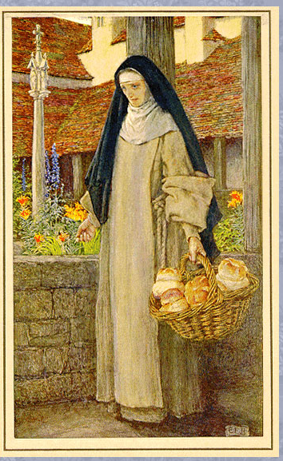
What about Women?
Women could also dedicate their lives to the church and its spiritual mission.
Women who dedicated their lives to the church were known as Nuns.
Nuns lived in convents which were headed by an Abbess.
Convents offered women opportunities they would not have if they stayed home and became wives and mothers. In convents women could get an education and be involved in a community.

Slide 64
Sect. 4
Economic Expansion and Trade

Slide 65
Peasants, Trade, and Cities
Between 1000 and 1300 the population of Europe grew dramatically, the population grew from about 38 million to 74 million people.
  Conditions were more peaceful and people felt more secure.
  There was a warming trend in Europe’s climate.
  There were vast improvement in agricultural technology which allowed them to grow more food.

Slide 66
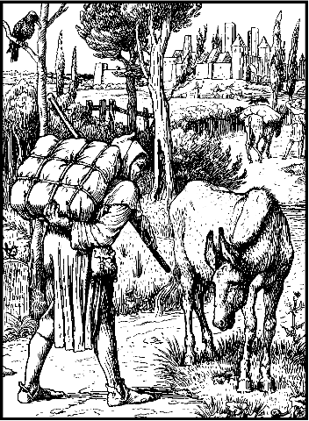
Improvement in Agricultural Technology
Windmills
Water Wheels
Iron tools
Iron plow (could go down
much deeper into the soil)
Horse collar
System of crop rotation

Slide 67
The Three Field System
The method of crop rotation, or the three field system, was developed during the middle ages.
Originally half the land would be planted and the other half would be fallow (unplanted)
Under the new system the land was divided into three fields. Two were planted and one would be left fallow. Crops which used different nutrients would be planted in the two fields and would rotate to let the soil rest.

Slide 68
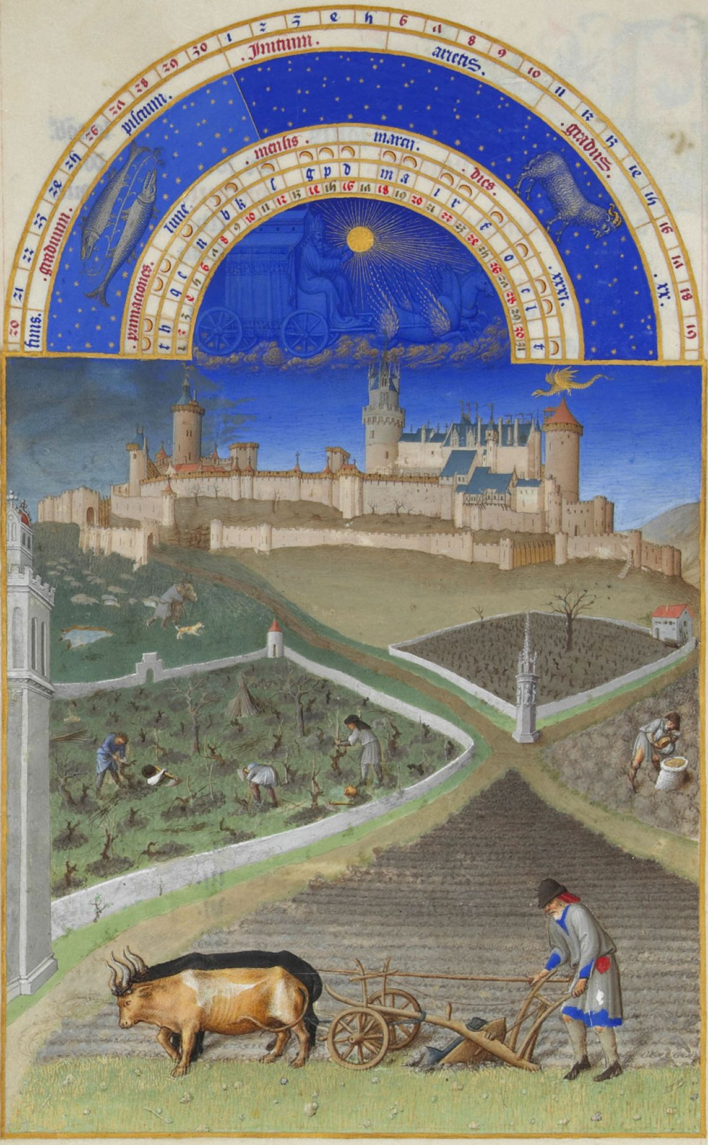

Slide 69
Crops
In the three field system one was planted with grains which were harvested in the summer.
The second was planted in the spring with grains such as oats and barley and vegetables such as peas and beans. Which were harvested in the fall.
The third field was left fallow, or unplanted.

Slide 70
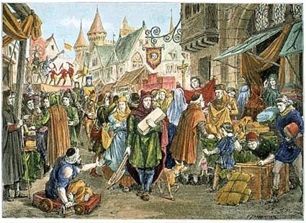
The Revival of Trade
Medieval Europe was a mostly agrarian society, but during the eleventh and twelfth centuries Europe experienced a growth in towns and cities.
The increase in agricultural output allowed for the development of trade. By the end of the tenth century people emerged with skills and products for trade. Invasions were also diminishing during this time and the increased stability helped to foster trade.

Slide 71
Cities has been around since Roman times, and many of the old Roman cities began to reemerge as trade centers.
There were also new trading centers.
Some of these cities included:
  Venice in Northern Italy was a center with ties to the Byzantine Empire and the Middle East.
  Flanders in Northern France was famous for its wool industry.

Slide 72
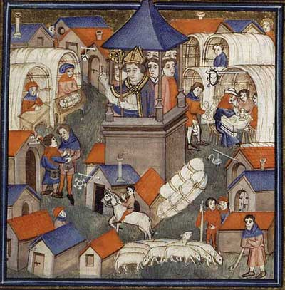
Trade Fairs
Fairs were large markets where merchants got together to exchange their goods.
As trade increased, there was a demand for gold and silver instead of bartered goods. This led to the development of a money economy based on the exchange of coins for goods.
This increase in trade led to commercial capitalism, an economic system in which people invest in trade and goods in order to make profits.

Slide 73
The Growth of Cities
Increased trade led to merchants settling in old Roman cities, they were later joined by craftspeople and artisans. This influx of people revitalized these old cities.
There were also new cities founded by the same groups. Merchants would build near and castle or along a trade route where a lord offered them protection, if things went well a wall was built around the new city to offer protection.

Slide 74
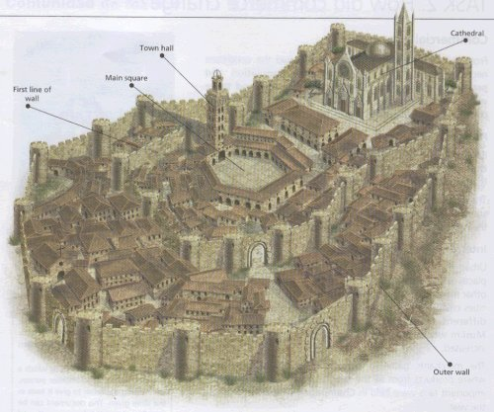
Medieval Cities
Medieval cities were smaller than other ancient cities. They were limited by the wall which surrounded them.
Medieval London had a population of around 40,000.

Slide 75
Residents of these cities would attempt to gain independence for the lords of the manor near them so they would have more control over their money and trade.
Townspeople began to buy or win rights from their local lords, a city could gain a charter, or rights and freedoms, from their local lord which would allow them to run their own affairs for a fee.

Slide 76
City Government
Medieval cities developed their own governmental systems.
There would usually be a city council which would serve as judges and city officials and also passed laws.
The Patrician, or upper, class tended to dominate the politics of the towns and cities.

Slide 77
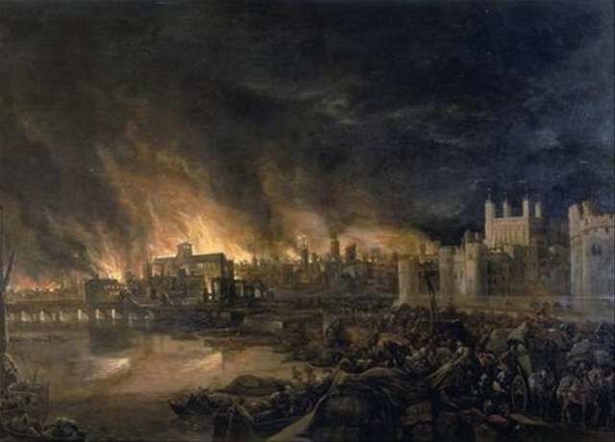
Dangers
Aside from poor sanitation, the crowded conditions of cities made fire a constant danger. Many structures were made of wood and the people used fire to both heat and light their homes.

Slide 78
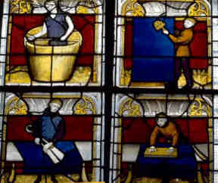
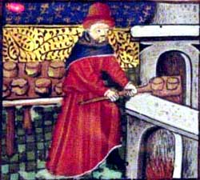
Guilds
Merchants in medieval cities formed guilds, or business associations.
Guilds managed tanners, carpenters, bankers as well as merchants of silk, spices, wool and the banking industry. .
Guilds regulated every aspect of a business. The set quality standards, specified methods of production, and fixed prices.
In order to operate a business, one had to belong to a guild.

Slide 79
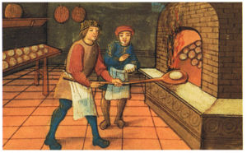
Joining a Guild
There was a process to becoming a member of a guild.
The first step was to be an apprentice: A young boy, around the age of 10, would go and work for a craftsman without pay to help learn the craft.
Later apprentices became journeymen, who worked for a wages for craftsmen.

Slide 80
The Masterpiece
For a journeyman to become a master craftsman, he had to complete a Masterpiece.
This was their audition for the guild to determined if their work made the qualified enough to join the guild and start their own business.
Then they could become a Master Craftsman and own their own business.

Slide 81
High Middle Ages CH 9
William of Normandy Invades England: 1066
King John Signs the Magna Carta: 1215

Slide 82
What Groups Invaded England?
England has a long history of invasion.
During the time of the Romans, southern Britain (south of Hadrian’s Wall) was ruled by the Romans. As Rome’s difficulties increased they withdrew from England.
In the Fifth Century the Angles and Saxons invaded England.

Slide 83
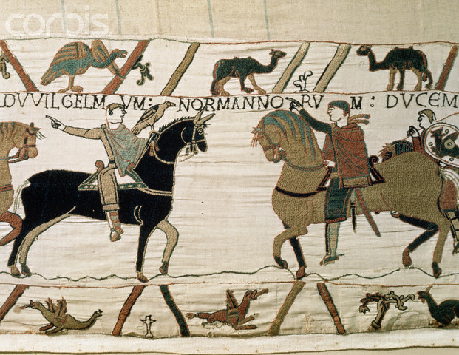
England faced invasion from the Angles and Saxons and Vikings.
In 1066 The Normans (led by William the Conqueror) raided and then settled in England.
William battled the English
King Harold at the
Battle of Hastings.

Slide 84
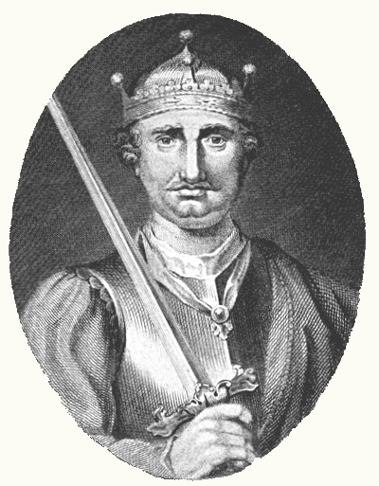
William won the Battle of Hastings and Harold was killed.
William asserted his power and changed English culture. Words and customs which had belonged to the Saxons became taboo and were no longer allowed, or became insults
The Normans spoke French, but the two cultures eventually merged.

Slide 85
Vocabulary
The vocabulary of England took on new words which came from the Norman people.
The English language evolved to include Latin as well as Germanic influences.

Slide 86
Government
William wanted to establish firm control over his new territory. He used a feudal form of government, distributing lands to his nobles and making them swear loyalty to him. He made sure none of them was powerful enough to defeat him.
He maintained the Anglo-Saxon divisions of Shires which were ruled by a Sheriff.

Slide 87
The Domesday Book
William wanted to know just what he had conquered.
He ordered a Census of every person, animal, piece of farm equipment and piece of land.
This census was called the Domesday Book because no one could escape from it.

Slide 88
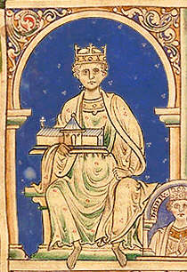
Henry II
At the time of Henry II, each region or kingdom in England had its own set of laws. Henry wanted to establish a common law throughout England.
He established a royal court which traveled throughout England hearing court cases and applying the same law at each one

Slide 89
Common Law
When Henry’s judges heard cases they recorded their decisions which established legal precedent. Later decisions were based on that precedent, similar to what our courts do today.
Having a common set of laws provided a sense of unity for England.

Slide 90
Thomas Beckett
Henry II wanted his new system of common law to apply to all of England, including the Church.
This brought him into conflict with his one-time friend Thomas Beckett, the Archbishop and Canterbury (the highest ranking Catholic official in England).

Slide 91
Henry became frustrated by Beckett’s refusal to accept royal legal authority.
It is believed that Henry II said in anger one day at court, “Will no one rid me of this meddlesome priest!”
Four of Henry’s barons took him seriously and rode off to Canterbury Cathedral

Slide 92
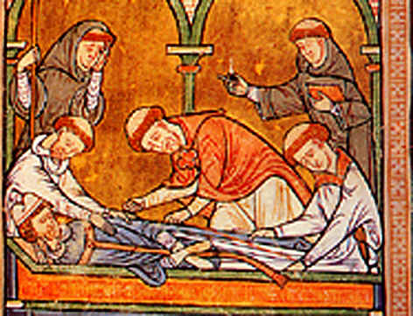
The Murder of Thomas Beckett
Beckett was murdered while standing at the altar of the Cathedral.
Henry was horrified by the act and did penance for his words by walking barefoot through the streets of Canterbury and being flogged, but in the end he got what he wanted, Church courts became subject to English law.

Slide 93
England in the High Middle Ages
England has the distinction of limiting the power of their monarch in 1215.
In that year King John signed a document known as the Magna Carta, or Great Charter.
There were many other factors which made England a unique country.

Slide 94
King John
(The king who flushed his kingdom down the John)
Henry’s son became king.
King John was highly corrupt and made many mistakes during his reign.
Corruption
He threw people in jail without a trial.
He also placed heavy taxes on his barons, much to their resentment.

Slide 95
Losses to France
John waged a war with King Philip II (Philip Augustus) of France. In this war he lost the lands that England still controlled in that country.
John attempted to regain these lands, but failed.

Slide 96
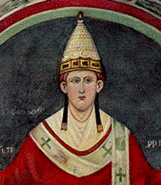
Conflict with the Pope
John also got into a conflict with Pope Innocent III over the selection of the Archbishop of Canterbury.
John thought, as king, he should be able to choose the next Archbishop, the Pope disagreed

Slide 97
“Weapons” of the Church
The church had powerful weapons that it could use against rulers of Europe.
People believed they needed to receive the sacraments of the Catholic Church in order to achieve salvation.
These sacraments included:
Eucharist (communion), Marriage, Holy Orders, Baptism, Extreme Unction (last rights), Confirmation, and Anointing of the sick.

Slide 98
John Begs Forgiveness
The Pope placed an interdict on England, which meant the people could not receive the sacraments.
John was forced to beg the Pope for forgiveness and pledge to make England a Fief of the Catholic Church. After that England owed a fee to the Church every year.
In this case, the Pope won out over the power of the monarch.

Slide 99
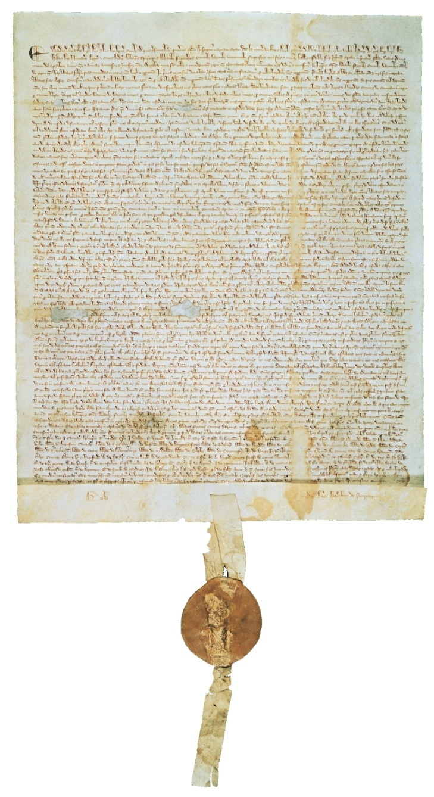
The Magna Carta
King John’s corruption and heavy taxation of the Nobles caused them to rebel against him.
In 1215 at Runnymede, they forced him to sign the Magna Carta (Great Charter) which limited the power of the English Monarch.

Slide 100
Ideas in the Magna Carta
The Magna Carta required the King to proclaim certain rights (pertaining to freemen), respect certain legal procedures, and accept that his will could be bound by the law
The Magna Carta also instituted the idea of Habeas Corpus, which meant you could not be held in jail without due cause.

Slide 101
King Edward I
During the reign of King Edward I we see the evolution of the idea of Parliament.
From the French parler (to speak) it began as an advisory board for the king.
Later, this body the “power of the purse” because it was believed that “what touches all should be approved by all”

Slide 102
The Parliament eventually evolved into two houses
The House of Lords
  Made up of Bishops and Nobles
The House of Commons
Made up of Knights and Burghers (City Dwellers)

Slide 103
The French Kingdom
After the death of Charlemagne the western part of his empire (which became France, faced many challenges. There were heirs fighting for the crown, Vikings invasions, attacks from Spanish Muslims and so there was no centralized power.
The Lords of the Carolingian family were unable to hold the throne and so the Great Lords of France decided to appoint a king.

Slide 104

Hugh Capet
The King appointed by the great lords was Hugh Capet, he was the count of Paris or the Île de France.
Capet made himself more powerful by having the lords also elect his son as co-ruler and making the office hereditary. This established the Capetian Dynasty.

Slide 105
The Holy Roman Empire
The Eastern part of Charlemagne’s Kingdom later became known as the Holy Roman Empire (later Germany).
The territory was broken into divisions known as duchies ruled by dukes.
These dukes elected a king,
but he originally did not
have a lot of power.

Slide 106


Otto I
Otto was elected king and consolidated power by defeating many of the nobles of Germany who had taken land from the kingdom.
He later moved into Italy and reclaimed much of the territory which had been ruled by Charlemagne.
After assisting the Pope with a revolt he was crowned “Emperor of the Romans,” thus beginning the Holy Roman Empire.

Slide 107
Struggles With Italy
Later Holy Roman Emperors wanted to assert their power in Italy. Otto I had been very involved with the development of the Church in his Empire and later Holy Roman Emperors had done the same thing.
The Pope viewed this as wanting too much power that should have been his

Slide 108
Two of the Holy Roman Emperors Frederick I and Frederick II were involved in conflicts with the Pope in Italy.
While away in Italy, the German Nobles rebelled at home and the two kings lost a lot of their power.
Because of its involvement in the struggle for power in Italy, the Holy Roman Empire was not able to achieve the political unity which was to develop in France, England, and later, Spain.
Germany and Italy were not united under single leadership until the 19th Century.

Slide 109
Papal States and Simony
The Papal States were the territories surrounding Rome which were controlled by the Pope and the Church.
As the Middle Ages went on the church became more involved in political affairs. The feudal government of the time complicated matters. Lords appointed these bishops and other church officials as their vassals, and they had to be loyal to their lords, bishops and abbots became more worldly and neglected their spiritual duties.
A practice known as simony developed where lords would sell church offices. This became an important source of income for lords and nobles.

Slide 110

Church Reform
By the 11th century church officials realized that they need more control over appointments to the church.
They wanted to eliminate a practice which had developed which was known as Lay Investiture.

Slide 111
Lay Investiture
When an Abbot or Bishop was appointed to the church they were given symbols of their new office.
These objects were a ring and a staff, they symbolized the spiritual authority which was being granted, or invested, by the church. The ring represented marriage to the church and the staff was symbolic of the duty to be a good shepherd to the people.

Slide 112

Pope Gregory VII and the Church wanted to end the practice of lay investiture and take that power back for the church.
Pope Gregory Declared that only the church had the authority to appoint church officials. He claimed that the church’s power was supreme and that the nobility did not hold any power over the church.
This led to a conflict with Holy Roman Emperor Henry IV.

Slide 113
Henry IV vs. Pope Gregory VII
Henry sent a letter to the Pope which declared that the Pope was a fake and had no real authority. His letter ended, “I, Henry, king by the grace of God, with all of my Bishops, say to you, come down, come down, and be damned throughout the ages”
Obviously, the Pope was not pleased by this. Pope Gregory VII excommunicated Henry IV and supported the overthrow of his power.

Slide 114

Henry IV, was faced with the prospect of losing his kingdom to lords who were rebelling against him and supporting the overthrow of his power.
Henry decided to go apologize to the Pope and be reinstated with the Church. Henry traveled to Canossa in northern Italy to meet the pope and apologize in person. He wore a hair shirt and stood outside barefoot in the snow. As a priest, the Pope had to accept Henry’s penance and lift his excommunication.

Slide 115
The Concordat of Worms
The dispute over lay investiture continued. Henry overthrew the Pope and then, Gregory died in exile. After they were both dead the conflict continued for several generations.
Finally in 1122 at Worms the Concordat of Worms passed. In this agreement the Church won the power to appoint church officials and the emperor got to give the new bishop the symbols of government authority while the church instilled the ring and staff which were symbols of spiritual authority.

Slide 116
The Church Supreme
The attempts to make the church more powerful did not end with Gregory VII. During the 12th and 13th century the Popes continued to strengthen the papacy.
Pope Innocent III declared the Act of Papal Supremacy (authority over all secular rulers) He stated that the Pope was,
  “lower than God but higher than man . . . Judges all and is judged by no one. . . . Princes have power on earth, priests over the soul. As much as the soul is worthier than the body, so much worthier is the priesthood than the monarchy . . . NO king can reign rightly unless he devoutly serve Christ’s vicar.”

Slide 117
“Weapons” of the Church
The Church claimed that it held the power of salvation through the administration of the sacraments. The church could manipulate people and their leaders through the control of these sacraments.
The church could excommunicate someone, this was where they cut off a single person from receiving the sacraments.
The church could also place an interdict over an entire country. In this case no one in the entire country or region could receive the sacraments.

Slide 118
The Sacraments
The church had seven sacraments
  Baptism: Done at birth to cleanse original sin.
  Confirmation: Young men and women were confirmed in their baptism and were able to receive communion.
  Eucharist: Communion, the bread and wine which was believed to be the body and blood of Christ.
  Penance and Reconciliation: Also known as extreme unction, an attempt to remove sin from the soul before death.
  Anointing of the sick
  Holy orders: When men and women joined the church.
  Matrimony: Marriage

Slide 119
THE CRUSADES
1096-1204

Slide 120
The Crusades
Essentially, the Crusades were a series of wars over control of the Holy Land and of the Holy city of Jerusalem.
They were a spiritual, political, economic, and ideological battle between the Christian World and the Muslim World.

Slide 121
The First Crusade
The First Crusade was called by Pope Urban II.
The letter he had received from Alexius I claimed that the Turks were harassing Christian pilgrims who were attempting to visit Jerusalem.
The Pope seized upon this opportunity to raise an army and go reclaim the holy land.

Slide 122

The Council of Clermont
While attending a Council at Clermont in 1095, Pope Urban called a meeting of the people.
The Pope called the Muslims Infidels, or unbelievers.
He stated that it was the Christian duty of the Nobles and Knights of Europe to go and reclaim the holy land because “God Willed it.”

Slide 123

The Early Crusades
The official Crusading army reached the city of Jerusalem in 1099. After a siege they captured the city.
During the siege and battle the Crusaders slaughtered almost everyone in the city including many Jews and Orthodox Christians.

Slide 124
Crusader States
After the capture of Jerusalem, the Crusaders established Crusader States in the Holy Land.
There cities represented a Christian presence in the area and became centers for trade with the west.

Slide 125

Saladin
While the first Crusade was successful in taking Jerusalem it was recaptured by the Muslim general Saladin in 1187.
  Unlike what the Christians had done, Saladin showed mercy to the inhabitants of the city.
This led to the Third Crusade where Richard the Lionhearted and Philip Augustus of France were defeated. Richard negotiated a treaty with Saladin to allow for pilgrims to visit the city.

Slide 126
Later Crusades
The Western armies were never successful at capturing Jerusalem after the First Crusade.
During the Fourth Crusade the Crusading armies became involved in a Byzantine dispute and attacked and captured the city. The Western leaders held the city from 1204 until the Byzantine threw them out in 1261.
  The Western Christians destroyed churches, icons, buildings, and statues—destroying much of the Byzantine culture in the process.

Slide 127
The Children’s Crusade
In 1212 a young French boy named Nicholas of Cologne announced that the Crusaders had failed because they were not innocent.
Thousands of young people joined him and went to southern Italy to sail to the Holy land.
The sailors there promised to take them to the holy land, but many were shipwrecked or were taken to N. Africa and sold into slavery.

Slide 128
Positive and Negative Effects of the Crusades
Positive:
  The Crusades increased trade between east and west.
  This increase in trade is thought to be one of the events which led to the Renaissance, or rebirth of Europe in the 15th century.
Negative
  The Crusades led to a legacy of bitterness between the Christian and Muslim world.
  They hurt the Byzantine Empire.

Slide 129

Key events of Crusades
Pope Urban’s speech
The capture of Jerusalem
Founding of Crusader states
Loss of Jerusalem to Saladin
Sack of Constantinople by
western Crusaders

Slide 130
Effects of Crusades
Weakened the Pope and nobles; strengthened monarchs
Stimulated trade throughout the Mediterranean area and the Middle East
Left a legacy of bitterness among Christians, Jews, and Muslims
Weakened the Byzantine Empire
Constantinople
Fell to the Ottoman Turks in 1453, ending the Byzantine Empire
Became capital of the Ottoman Empire

Slide 131

Spain
Ferdinand and Isabella
  In Spain King Ferdinand and Queen Isabella eliminated the power of the Nobles.
  They took control of the national church.
  They tried to make Iberia (Spain and Portugal) Homogeneous.
Reconquista: Ferdinand and Isabella forced all non-Catholics to leave Spain or convert to Christianity.

Slide 132
Learning, Literature, and the Arts

Slide 133
The Rise of Universities
Medieval Universities got their start as educational guilds
The first Medieval University was in Bologna, Italy . The students at the school formed their own guild in 1158.
Later came the University of Paris, and then the University at Oxford England.

Slide 134

Areas of Study
Students in medieval universities studied the following subjects
  Grammar: The proper way to write
  Rhetoric: Public speaking, learning how to make arguments (debate)
  Logic: Using reason
  Arithmetic: Basic Math
  Geometry
  Music
  Astronomy

Slide 135

Teaching Style
Books were rare and expensive in the Middle Ages. The main method of teaching was by lecture. Teachers would read from books and students would take notes.
There were not regular exams given, but when a student applied for a degree, they were given an exam.

Slide 136
Degrees
There were various types of degrees awarded by medieval universities
  Theology: The study of religion and God
  Law
  Medicine
Upon completion of 4-6 years of study they would earn a Bachelor of Arts degree. If they continued in school they could earn a doctor’s degree and would be able to teach. A doctor’s degree could take ten years of more.

Slide 137
The Development of Scholasticism
As people began to make more scientific discoveries there emerged a crisis-how to reconcile new scientific discoveries with the teachings of the Church.
The field of Scholasticism attempted to do this. Scholasticism was an effort to reconcile faith and reason and show that what was accepted on faith was in harmony with what could be learned through reason and experience.

Slide 138

Greek Influences
The thinking of the Greek philosophers had
a great influence on medieval (and Renaissance) thinking.
Aristotle proposed that our view of the world is learned through the senses and through what we experience.
  Aristotle taught that the universe was eternal which was in conflict with the Christian teaching of Creation.
  Aristotle believed that God was an impersonal principle that made caused order in the universe, but was unmoved, Christianity believed that God was concerned with the deeds of people.

Slide 139

St. Thomas Aquinas
St. Thomas Aquinas made the most famous effort to reconcile the teachings of Aristotle with the teachings of the Church.
His best known work is Summa Theologica.

Slide 140
Teachings of Thomas Aquinas
St. Thomas Aquinas believed that there were two types of truth
Religious Truth: Things that are revealed by faith and cannot be proven by science.
Scientific Truth: Things that can be proven by science.
He believed that things related to faith did not need truth to be valid became they came from God who was infallible.
Also, he believed knowledge was not the enemy of faith because it did not corrupt faith. Both faith and reason come from God and were not in competition with each other but supported each other.

Slide 141

Vernacular Literature
The universal language of medieval civilization was Latin.
Latin was the language of Rome and was a common language which could be used in churches and at Universities.
  A common language at universities allowed students from many different countries to be able to understand the teachings there.

Slide 142
Vernacular
The vernacular was the language of the common people.
  This included Spanish, French, English, and German.
People began to produce literature in their own languages.
  The most popular form of vernacular literature in the 12th century was troubadour poetry, which was mostly love stories about life at court between knights and ladies of the court.

Slide 143

Troubadours
Troubadours were usually travelling poets and musicians who would go from court to court telling their stories of courtly love.

Slide 144

Medieval Architecture
During the 11th and 12th centuries there was a boom in architecture and building.
Originally buildings were built in a Basilica style which consisted of a rectangular building with a flat wooden roof.
Later, Romanesque architecture replaced this flat roof with a rounded arch.

Slide 145


Stained Glass
The stained glass windows of churches were also used to teach stories from the Bible to a mostly illiterate population.

Slide 146
Romanesque Architecture
Romanesque architecture developed to have some specific traits.
  Rounded Arches
  Thick walls with small windows with stone roofs.
The dark environment of the church was meant to suggest the power and mystery of God.

Slide 147



Slide 148



Slide 149


Slide 150
Gothic Architecture
Later, changes were made to the Romanesque style which developed a new style known as Gothic Architecture.
Gothic architecture developed some distinct characteristics of its own.
  Vaulted Arches (Pointed)
  Flying Buttresses
  Thinner walls and stained glass windows
The advancements allowed thinner walls and larger windows, which allowed for these new churches to have much more natural light.
The Gothic style was much more serene and self-confident.

Slide 151



Slide 152


Slide 153



Slide 154


Flying Buttresses

Slide 155



Slide 156

Gargoyles
A Gargoyle functioned as a grotesque. They were meant to scare away evil spirits, but often also acted as water spouts for the churches.

Slide 157



Slide 158

A Time of Crisis
Important Dates
  The Black Death spreads throughout Europe: 1350
  The Great Schism (Avignon Papacy) begins: 1378

Slide 159
The Black Death
During the 13th century the middle ages had reached a high point, the population had grown and there was an explosion of learning and culture.
The 14th century would bring about many changes in medieval Europe.
Europe had become overpopulated and people were beginning to feel the effects of that overpopulation.
Prior to the plague, there was a famine from 1315 to 1322 which killed off about 10% of Europe’s population.

Slide 160
What was the Black Death?
The Black death was the most devastating natural disaster in European history.
The Black Death, or bubonic plague, was a bacterial infection which killed 38 million people throughout Europe out of a pre-plague population of 75 million.
In urban areas, the death rate was 50-60% of the population.

Slide 161
Types of Plague
The most common form of plague was bubonic plague, which was carried by fleas which lived on black rats.
  There was also pneumonic plague, which was bubonic plague which settled in the lungs and was spread by coughing.
  There was also septicemic plague which attacked the bloodstream and could be spread from one person to another.
It is thought that the plague originated in Asia and was spread via trade routes to Europe.

Slide 162


The first area hit was Italy, ships which had been trading with Asia sailed into Italian ports with plague-infested rats.
The ships were quarantined, but the rats got to shore.
The poor sanitation of the time allowed for the quick spread of the disease. The plague spread more quickly in the crowded urban areas where people lived close together. Rural areas did not fare quite as badly.
The plague travelled via trade route throughout Europe.

Slide 163
People could be infected with the plague and not show symptoms for weeks.
When plague broke out in a town people would flee, not knowing they were infected, and start plague in another town.
The plague would spread faster during the warm months and go dormant for most of the colder months.
The plague was worst from 1347-1351, but broke out sporadically for many years afterward.

Slide 164

The Spread of the Black Death

Slide 165
Impact of the Black Death
Decline in population: 38 million people died from the black death. This caused a labor shortage throughout Europe. Where land had been scarce before, people could now gain access to it.
Scarcity of Labor: The scarcity of labor caused by the plague actually helped improve working conditions for peasants in Europe. Many could demand wages for the first time.

Slide 166
Towns freed from feudal obligations: Many towns lost large numbers of the populations. Many of these towns asked for freedom for their lords or had lost their lords to the plague.
The power of the church declined because people lost faith in a church which had been unable to save them from such as disaster.
Disruption of Trade: The plague caused trade to break down. People feared travelers and “plague goods” which may carry the disease.

Slide 167

Symptoms of the Plague
The plague began with headache and fever, along with chills, nausea, vomiting, and stiffness.
Within a day or two, the swellings appeared. They were hard, painful, burning lumps on his neck, under his arms, on his inner thighs. Soon they turned black, split open, and began to ooze pus and blood. They may have grown to the size of an orange.

Slide 168
After the lumps appeared he would start to bleed internally. There would be blood in his urine, blood in his stool, and blood pooling under his skin, resulting in black boils and spots all over his body (this is where the name “black death” comes from).
The fluids coming out of the body would smell horrible and most people died within a week of the onset of symptoms.
People died so quickly there was little or no time to bury the dead, so the bodies piled up or were buried in shallow graves.

Slide 169

Social Symptoms
The plague contributed to Anti-Semitism in Europe.
  People blamed the Jews for the plague. In the city of Strasbourg a Christian mob murdered 2,000 Jews.
  Similar massacres occurred throughout Europe.

Slide 170
Economic Consequences
The Plague was actually good for the European Economy.
  There was enough farmland to go around.
  People were able to afford and buy land.
  Workers demanded wages for their labor.
  Cities grew as peasants and serfs, now free of feudal obligations, flocked to cities.
  Merchants explored new businesses.

Slide 171

The Decline of Church Power
During the 14th century the power of the church began to decline.
European kings, who were gaining power, were no longer willing to accept the idea of Papal supremacy over them.
One of these conflicts was between Pope Boniface VIII and King Philip IV of France.

Slide 172


King Philip IV believed he should be able to tax the clergy.
Pope Boniface VIII said that he could not.
Philip IV refused to accept the Pope’s authority and sent his troops to Italy to bring him to France to stand trial.
The Pope escaped, but died shortly after leaving the office of Pope open for election . . .

Slide 173
The Great Schism/Avignon Papacy
During the conclave, Philip arranged for the election of a French Pope.
The Papacy then moved to Avignon, France, where it remained from 1305-1377.
A later Pope, Gregory XI, returned the Papacy to Rome, but died soon after the move.

Slide 174
The cardinals insisted on the election of an Italian Pope, Pope Urban VI.
Five months later, the French cardinals declared the election of that Pope invalid and elected their own, Clement VII.
Now Europe had TWO Popes. This created a lot of problems, the Pope was the head of the Church and people were uncertain as to which Pope they should follow.
  The French and their allies supported the French Pope.
  England and the Holy Roman Empire supported the Italian Pope.
The two Pope excommunicated each other and there was chaos within the Church.

Slide 175

The Council of Constance
Church cardinals called a Church council at Pisa and tried electing a new Pope and then there were three!
The Holy Roman Emperor finally called the Council of Constance to resolve the Great Schism.
  The two Popes were deposed, the third resigned and a new Pope was elected.

Slide 176
Attempts at Church Reform
All of this corruption and chaos within the Church made some want to reform the Church.
In England John Wycliffe made arguments that salvation came from faith and not from the Church itself.
  He and his followers translated part of the Bible into English.
  His reforms helped to lay the foundations for later change, but were unsuccessful at the time.

Slide 177

Jan Hus
Wycliffe's teachings may have influenced a Czech reformer by the name of Jan Hus.
Hus acted upon the ideas of Church reform. He spoke out against corrupt church practices.
He was invited to the Council of Constance where he had been told he would be safe, but was burned has a heretic.

Slide 178
The Hundred Years War
This war was a conflict between England and France.
There were several factors which led to the war.
  England had lands which it claimed in France
  England and France were in competition for Flanders.
  Edward had a claim to the French throne, but the French were outraged at the idea of having an English King.
  Both sides welcomed war as a chance to assert their own agendas.
The war officially stared when King Philip VI of France took English holdings and Edward III declared war on France.
What occurred was a 116-year conflict that changed the two countries.

Slide 179
France vs. England
The French and English had different fighting styles.
  The French tended to use the crossbow.
  The English used the longbow.
At the battle of Crecy, the English had a sound victory over the French using their bowmen.
After the battle King Henry V of England executed the French prisoners.
At Agincourt, the English won another victory when the French cavalry became bogged down in the mud of the battlefield.

Slide 180


Slide 181

Jeanne d’Arc (Joan of Arc) 1412-1431
Charles was the uncrowned king of France, the douphin.
Joan of Arc was a young French peasant girl who claimed that she heard voices that told her it was her duty to save France.
In 1429 she made it to Charles’ court and convinced him to let her lead his army in battle.

Slide 182

Orleans
At the battle of Orleans, Joan was able to lead the French troops to victory.
Joan was, however, captured by the English in 1430 and was burned as a heretic.
She became a martyr and symbol for the French in the war.

Slide 183
Gunpowder
The French were eventually able to win the war because of Gunpowder.
The French developed cannons and were able to defeat the English.
The French achieved victory in 1453.

Slide 184
Political Recovery
As the power of the Church declined New Monarchs were emerging in Europe who consolidated their power and made their kingdoms strong under their central authority.

Slide 185

France
The Hundred Years war benefitted France by providing it with a sense of national identity.
Later King Louis XI (the spider) strengthened the power of the French Monarchy by instituting the taille, or tax, on the French Monarchs.
Through deals and alliances, Louis managed to gain control over the nobles of France.

Slide 186


England
The Hundred Years War devastated England.
  The country lost territory and the nobles lost confidence in the monarchy
This led to a conflict called the War of the Roses between the houses of York and Lancaster.
Eventually the house of Lancaster won and Henry Tutor (Henry VII) became the first Tutor King.

Slide 187
Central and Eastern Europe
The Holy Roman Empire was different from France, England, and Spain in that it never consolidated power under a strong king.
In 1438 The Hapsburg dynasty gained power over the office of Holy Roman Emperor.
In Eastern Europe different religious groups came into conflict
  Roman Catholics, Eastern Orthodox Christians and Muslims began to fight each other.

