Slide 1
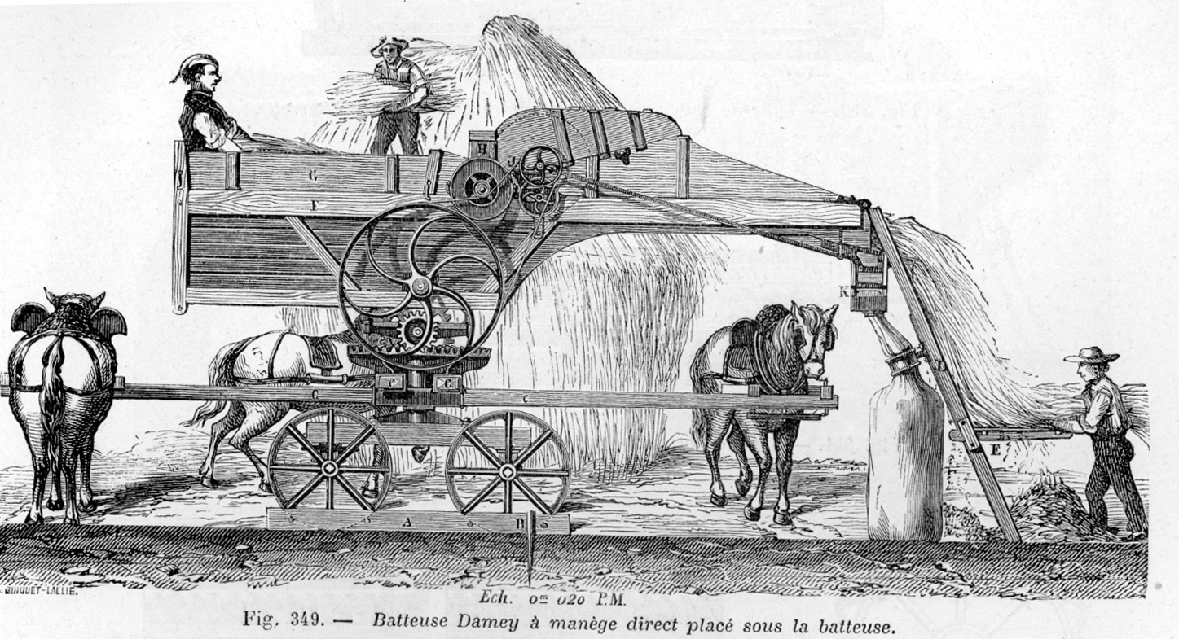
The Agricultural Revolution

Slide 2
The Agricultural Revolution
Agricultural methods had not changed much since the Middle Ages
Tools – hoe, sickle, wooden plow
Three-field system – farmers left 1/3 of the land fallow each year to restore fertility to the soil
Open-field system – unfenced farms with few improvements made to the land
No significant surplus – only enough food was made to feed the population

Slide 3
Agriculture and Industry
The Industrial Revolution brought machinery to farms
The use of farm machinery meant that fewer farm workers were needed
Displaced farm workers moved to the cities to find work in factories
This is called rural-to-urban migration
Growing populations in urban cities required farmers to grow more crops
Food to eat
Raw materials (like cotton) for textile factories

Slide 4
Agricultural Innovators
Jethro Tull (English)
Seed drill: Planted seeds in straight rows as opposed to scattering them over a field
Horse-drawn cultivation: Loosened the soil and eliminated weeds
Lord Townshend (English)
Crop rotation: Ended the three-field system by illustrating how planting different crops in the same field each year kept the soil from becoming exhausted
Robert Bakewell (English)
Stock breeding: First to scientifically breed farm animals for increased production of, and better quality, beef, milk, wool, etc.
Arthur Young (English)
Agricultural writer: Popularized new farming methods and machinery
Justus von Liebig (German)
Fertilizers: Invented fertilizers to enrich exhausted soil, which increased the amount of available farmland

Slide 5
Agricultural Machinery
Eli Whitney – Cotton gin (1793) – Increased cotton production
Cyrus McCormick – Mechanical reaper (1834) – Increased wheat production
Other important inventions: Horse-drawn hay rake, threshing machine, steel plow
Steam engines, gasoline and diesel engines, and electric motors were added to farm machinery as these types of engines were invented.
The Industrial and Agricultural Revolutions complemented one another. Developments and needs in one created developments and needs in the other.

Slide 6
Agricultural Science
Agriculture became a science during the Agricultural Revolution
Farmers and governments invested in agricultural research
Established agricultural schools, societies, and experimental stations
Progress in agriculture
Pesticides, stock breeding, new foods, food preservation, new farming techniques and irrigation methods, frozen foods
Result
Today, in the industrialized world, much more food is grown by far fewer farmers than was grown 200 years ago (or is grown today in the non-industrialized world)
Notes:
Notes: A good topic of discussion might focus on the modern taste for organic foods which do not emphasize technology. Question: What methods and technologies of the Agricultural Revolution do organic farmers utilize? How might our lives be different if we lived 200 years ago, when food was costlier and could not be easily preserved? Another point of discussion could focus on the differences in agricultural production between the industrialized and non-industrialized world.

Slide 7
Review Questions
Describe three features of agriculture before the Agricultural Revolution.
How did agricultural machinery change farm labor?
Describe the inventions or methods of at least three agricultural innovators.
Weigh the pros and cons of modern agriculture’s use of pesticides, preservation, and stock breeding.

Slide 8
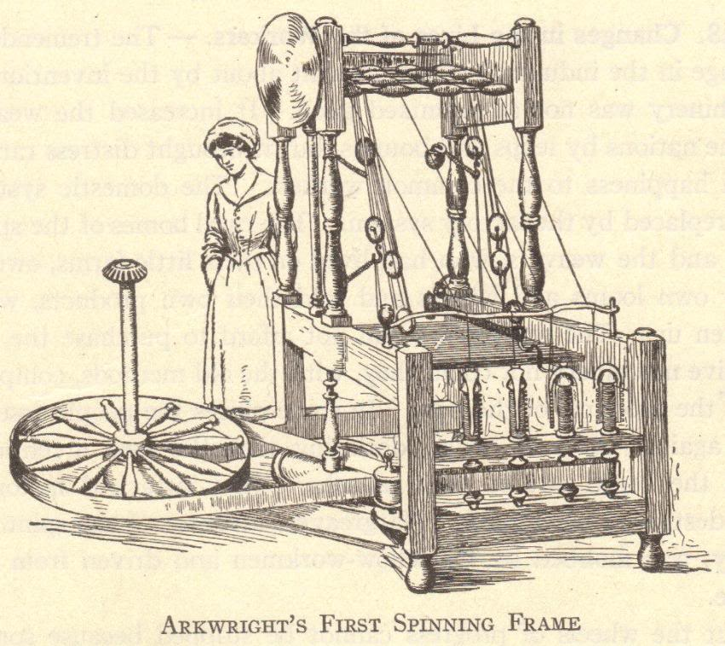
The First Industrial Revolution

Slide 9
Historical Significance of the Industrial Revolution
An ancient Greek or Roman would have been just as comfortable in Europe in 1700 because daily life was not much different – agriculture and technology were not much changed in 2000+ years
The Industrial Revolution changed human life drastically
More was created in the last 250+ years than in the previous 2500+ years of known human history

Slide 10
What was the Industrial Revolution?
The Industrial Revolution was a fundamental change in the way goods were produced, from human labor to machines
The more efficient means of production and subsequent higher levels of production triggered far-reaching changes to industrialized societies

Slide 11
The Industrial Revolution
Machines were invented which replaced human labor
New energy sources were developed to power the new machinery – water, steam, electricity, oil (gas, kerosene)
Increased use of metals and minerals
Aluminum, coal, copper, iron, etc.

Slide 12
The Industrial Revolution
Transportation improved
Ships
Wooden ships → Iron ships → Steel ships
Wind-powered sails → Steam-powered boilers
Trains
Automobiles
Communication improved
Telegraph
Telephone
Radio

Slide 13
Developments
Mass production of goods
Increased numbers of goods
Increased diversity of goods produced
Development of factory system of production
Rural-to-urban migration
People left farms to work in cities
Development of capitalism
Financial capital for continued industrial growth
Development and growth of new socio-economic classes
Working class, bourgeoisie, and wealthy industrial class
Commitment to research and development
Investments in new technologies
Industrial and governmental interest in promoting invention, the sciences, and overall industrial growth

Slide 14
Background of the Industrial Revolution
Commercial Revolution
15th, 16th, and 17th centuries
Europeans expanded their power worldwide
Increased geographic knowledge
Colonies in the Americas and Asia
Increased trade and commerce
Guild system could not meet the demands of increasing numbers goods

Slide 15
Development of the Domestic System of Production
Domestic system developed in England
Late 1600s-late 1800s
Domestic system of production – “putting out” system
Businesspeople delivered raw materials to workers’ homes
Workers manufactured goods from these raw materials in their homes (typically articles of clothing)
Businesspeople picked up finished goods and paid workers wages based on number of items
Domestic system could not keep up with demand

Slide 16
Factory System
Developed to replace the domestic system of production
Faster method of production
Workers concentrated in a set location
Production anticipated demand
For example: Under the domestic system, a woman might select fabric and have a businessperson give it to a home-based worker to make into a dress. Under the factory system, the factory owner bought large lots of popular fabrics and had workers create multiple dresses in common sizes, anticipating that women would buy them.

Slide 18
England: Birthplace of the Industrial Revolution
No concrete start date for the Industrial Revolution
Marked by gradual, slow changes
After 1750 – these changes were noticeable first in England

Slide 19
Why the Industrial Revolution Started in England
Capital for investing in the means of production
Colonies and Markets for manufactured goods
Raw materials for production
Workers
Powerful navy
Geography

Slide 20
England’s Resources: Capital
The Commercial Revolution made many English merchants very wealthy
These merchants had the capital to invest in the factory system – money to buy buildings, machinery, and raw materials

Slide 21
England’s Resources: Colonies and Markets
Wealth from the Commercial Revolution spread beyond the merchant class
England had more colonies than any other nation
Its colonies gave England access to enormous markets and vast amounts of raw materials
Colonies had rich textile industries for centuries
Many of the natural cloths popular today, such as calico and gingham, were originally created in India
China had a silk industry

Slide 22
England’s Resources: Raw Materials
England itself possessed the necessary raw materials to create the means of production
Coal – vast coal reserves powered steam engines
Iron – basic building block of large machines, railroad tracks, trains, and ships

Slide 23
England’s Resources: Workers
Serfdom and guilds ended earlier in England than other countries
English people could freely travel from the countryside to the cities
Enclosure Acts – caused many small farmers to lose their lands, and these former farmers increased the labor supply

Slide 24
England’s Resources: Merchant Marine
World’s largest merchant fleet
Merchant marine built up from the Commercial Revolution
Vast numbers of ships could bring raw materials and finished goods to and from England’s colonies and possessions, as well as to and from other countries

Slide 25
England’s Resources: Geography
England is the political center of Great Britain, an island
Great Britain (as the entire island was called beginning in 1707) did not suffer fighting on its land during the wars of the 18th century
Island has excellent harbors and ports
Damp climate benefited the textile industry (thread did not dry out)
Government stable and supportive
No internal trade barriers

Slide 26
“Necessity Is the Mother of Invention”
Spinning Jenny (James Hargreaves)
Need to speed up weaving
Power loom created

Slide 27
“Necessity Is the Mother of Invention”
Power loom
Increased demand for raw cotton
Invention of the cotton gin

Slide 28
“Necessity Is the Mother of Invention”
Cotton gin
Demands for stronger iron
Improvements in iron smelting and the development of steel (Bessemer process)

Slide 29
“Necessity Is the Mother of Invention”
As more steam-powered machines were built, factories needed more coal to create this steam
Mining methods improved to meet the demand for more coal
The process of inventing never ends
One invention inevitably leads to improvements upon it and to more inventions
Notes:
Notes: An excellent example of this phenomenon is the personal computer or cell phone. Cell phones were initially used by professionals who needed fast communications for business. The everyday usefulness of cell phones was quickly apparent, increasing demand. Cell phone towers were built around the globe, and cell phone technology continues to grow more complex. Have students compare the original “brick” cell phone to the iPhone.

Slide 30
The Textile Industry-where it all began
Textiles – cloths or fabrics
First industry to be industrialized
Great Britain learned a lot about textiles from India and China

Slide 31
The Birth and Growth of the Textile Industry
John Kay (English)
Flying shuttle, 1733
Hand-operated machine which increased the speed of weaving
James Hargreaves (English)
Spinning jenny, 1765
Home-based machine that spun thread 8 times faster than when spun by hand
Richard Arkwright (English)
Water frame, 1769
Water-powered spinning machine that was too large for use in a home – led to the creation of factories

Slide 32
The Birth and Growth of the Textile Industry
Samuel Crompton (English)
Spinning mule, 1779
Combined the spinning jenny and the water frame into a single device, increasing the production of fine thread
Edward Cartwright (English)
Power loom, 1785
Water-powered device that automatically and quickly wove thread into cloth
Eli Whitney (American)
Cotton gin, 1793
Device separated raw cotton from cotton seeds, increasing the cotton supply while lowering the cost of raw cotton
Elias Howe (American)
Sewing machine, 1846
Speed of sewing greatly increased

Slide 33
Development of Steam Engines
Early water power involved mills built over fast-moving streams and rivers
Early water power had problems
Not enough rivers to provide the power needed to meet growing demand
Rivers and streams might be far removed from raw materials, workers, and markets
Rivers are prone to flooding and drying

Slide 34
Steam Power
Humans tried harnessing steam power for millennia
Hero of Alexandria, Egypt – created a steam-driven device in the 1st century B.C.E.
Thomas Newcomen, England (1704)
Created a steam engine to pump water from mines
James Watt, Scotland (1769)
Improved Newcomen’s engine to power machinery

Slide 35
Steam Engines
By 1800, steam engines were replacing water wheels as sources of power for factories
Factories relocated near raw materials, workers, and ports
Cities grew around the factories built near central England’s coal and iron mines
Manchester, Liverpool

Slide 36
Coal and Iron
Vast amounts of fuel were required to smelt iron ore to burn out impurities
Abraham Darby (1709)
Discovered that heating coal turned it into more efficient coke; smelting iron- seperating iron from its ore
Henry Cort (1783)
Developed the puddling process which purified and strengthened molten iron

Slide 37
Increases in Coal and Iron Production, 1770-1800
Coal production doubled
6 million to 12 million tons
Pig iron production increased 250%
1800 – 130,000 tons
Great Britain produced as much coal and iron as every other country combined

Slide 38
Bessemer Process and Steel
Prior to the Industrial Revolution, steel was difficult to produce and expensive
Henry Bessemer, 1856
Developed the Bessemer process
Brought on the “Age of Steel”
Steel is the most important metal used over the past 150+ years

Slide 39
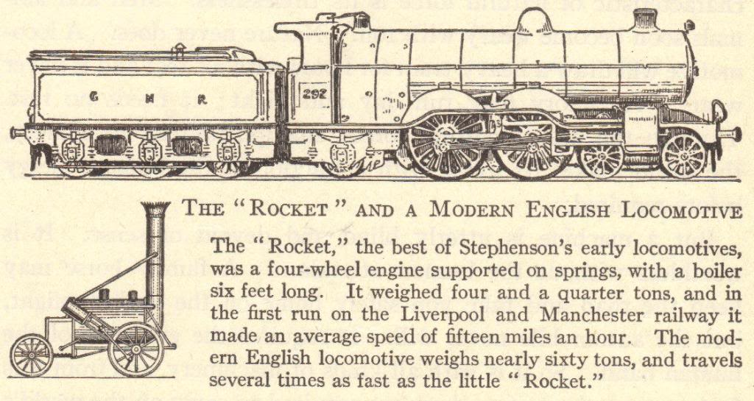
Transportation
Increased production
Search for more markets and raw materials
Better and faster means of transportation
Before the Industrial Revolution
Canal barges pulled by mules
Ships powered by sails
Horse-drawn wagons, carts, and carriages
After the Industrial Revolution
Trains
Steamships
Trolleys
Automobiles

Slide 40
Transportation Revolution
Robert Fulton (American)
Steamboat (1807)
Sped water transportation
Thomas Telford and John McAdam (British)
Macadamized roads (1810-1830)
George Stephenson (English)
Locomotive (1825)
Improved roads
Fast land transport of people and goods
Gottlieb Daimler (German)
Gasoline engine (1885)
Led to the invention of the automobile
Rudolf Diesel (German)
Diesel engine (1892)
Cheaper fuel
Orville and Wilbur Wright (American)
Airplane (1903)
Air transport

Slide 41
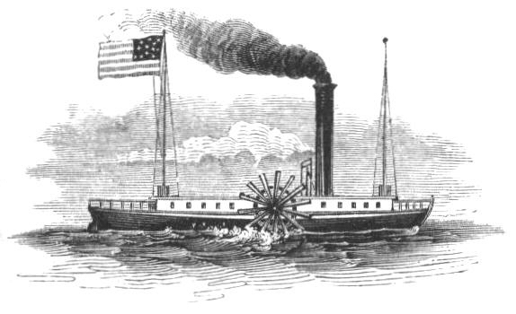
Steamboats
Robert Fulton invented the steamboat in 1807
The Clermont operated the first regular steamboat route, running between Albany and New York City

Slide 42
Railroads
1830 – Stephenson’s “Rocket” train traveled the 40 miles between Liverpool and Manchester in 1 ½ hours
1830-1870 – railroad tracks went from 49 miles to over 15,000 miles
Steel rails replaced iron rails
1869 – Westinghouse’s air brake made train travel safer
Greater train traveling comfort – heavier train cars, improved road beds, and sleeping cars

Slide 43
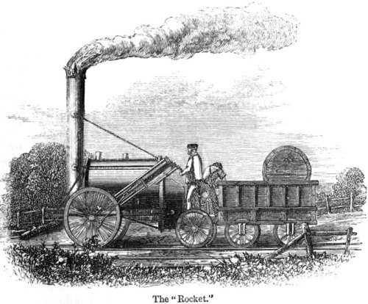

Slide 44
Communications Revolution
Samuel F.B. Morse (American)
Telegraph (1844)
Rapid communication across continents
Alexander Graham Bell (American)
Telephone (1876)
Human speech heard across continents
Cyrus W. Field (American)
Atlantic cable (1866)
United States and Europe connected by cable
Guglielmo Marconi (Italian)
Wireless telegraph, an early form of the radio (1895)
No wires needed for sending messages
Lee de Forest (American)
Radio tube (1907)
Radio broadcasts could be sent around the world
Vladimir Zworykin (American)
Television (1925)
Simultaneous audio and visual broadcast

Slide 45
Review Questions
What was the Industrial Revolution?
Describe at least three developments of the Industrial Revolution.
Compare and contrast the domestic and factory methods of production.
Why did the Industrial Revolution begin in England?
Explain why one invention or development leads to another.

Slide 46
Review Questions
Explain how developments in the textile industry sparked the Industrial Revolution.
Describe at least three developments in the area of transportation.
Describe at least three developments in the field of communications.
Considering the conditions necessary for industrialization to occur, how well equipped is the undeveloped world for becoming industrialized? Are modern undeveloped nations in a better or worse position than 18th- and 19th-century England?
Notes:
Note: Answers to all questions are found on slides 1-43. Question 9 is open to discussion and interpretation.

Slide 47
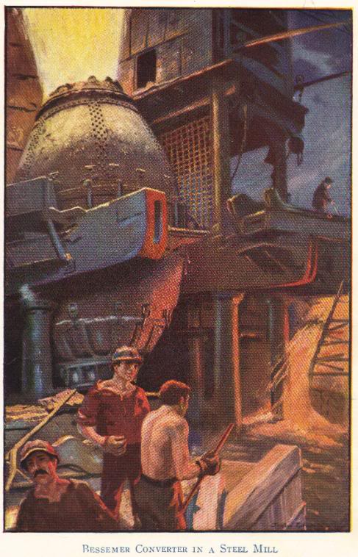
The Second Industrial Revolution

Slide 48
The First and Second Industrial Revolutions
The first, or old, Industrial Revolution took place between about 1750 and 1870
Took place in England, the United States, Belgium, and France
Saw fundamental changes in agriculture, the development of factories, and rural-to-urban migration
The second Industrial Revolution took place between about 1870 and 1960
Saw the spread of the Industrial Revolution to places such as Germany, Japan, and Russia
Electricity became the primary source of power for factories, farms, and homes
Mass production, particularly of consumer goods
Use of electrical power saw electronics enter the marketplace (electric lights, radios, fans, television sets)

Slide 49
The Spread of the Industrial Revolution
Mid-1800s – Great Britain, the world leader in the Industrial Revolution, attempted to ban the export of its methods and technologies, but this soon failed
1812 – United States industrialized after the War of 1812
After 1825 – France joined the Industrial Revolution following the French Revolution and Napoleonic wars
Circa 1870 – Germany industrialized at a rapid pace, while Belgium, Holland, Italy, Sweden, and Switzerland were slower to industrialize
By 1890 – Russia and Japan began to industrialize

Slide 50
Transportation
Railroads
Industrialized nations first laid track in their own countries, then in their colonies and other areas under their political influence
Russia – Trans-Siberian railroad (1891-1905)
Germany – Berlin-to-Baghdad railroad across Europe to the Middle East
Great Britain – Cape-to-Cairo railroad vertically across Africa
Canals
Suez Canal (1869) – provided access to the Indian Ocean from the Mediterranean Sea without the need to sail around Africa
Kiel Canal (1896) – North Sea connected to the Baltic Sea
Panama Canal (1914) – provided access from one side of the Americas to the other without the need to sail around the tip of South America

Slide 51
Transportation
Automobiles
Charles Goodyear – vulcanized rubber, 1839
Gottlieb Daimler – gasoline engine, 1885
Henry Ford – assembly line, 1908-1915
Airplanes
Orville and Wilbur Wright – airplane, 1903
Charles Lindbergh – first non-stop flight across the Atlantic, 1927
20th-century – growth of commercial aviation

Slide 52
Review Questions
Compare and contrast the First and Second Industrial Revolutions.
When did the United States begin to industrialize?
Explain how trains and canals aided transportation, citing at least one example for each.
What contributions did Charles Goodyear, Gottlieb Daimler, and Henry Ford make to automobile production?

Slide 53
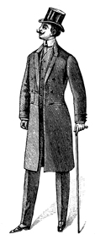
The Results of the Industrial Revolution

Slide 54
Results of the Industrial Revolution
Economic Changes
Expansion of world trade
Factory system
Political Changes
Decline of landed aristocracy
Social Changes
Development and growth of cities
Science and research stimulated
Industrial capitalism
Unemployment
Growth and expansion of democracy
Rise to power of businesspeople
Increased government involvement in society
Nationalism and imperialism stimulated
Increased power of industrialized nations
Improved status and earning power of women
Increase in leisure time
Population increases
Problems – economic insecurity, increased deadliness of war, urban slums, etc.
Increased standard of living
Mass production of goods

Slide 55
Economic Changes: Expansion of World Trade
Increased production meant that industrialized nations produced more than could be consumed internally
Sought new foreign markets
Bought many raw materials from foreign markets
New iron, steam-powered ships, along with other technological advances, made international trade (and travel) cheaper, safer, and more efficient

Slide 56
Economic Changes: Expansion of World Trade – Free Trade and Tariffs
Free trade – trade without barriers or tariffs – was initially used
As nations competed for markets, protective tariffs were put in place to limit foreign competition within an industrialized nation and its colonies
Motivation was to protect businesses in the home country and colonies, but this often meant people in the home country or colonies paid inflated prices for goods
Notes:
Notes: Possible discussion about tariffs vs. free trade. Compare NAFTA and the European Union.

Slide 57
Economic Changes: Factory System Possible Due to Standardized Parts
Eli Whitney is popularly credited with the invention of interchangeable parts in the late 1700s
But interchangeable parts had already been used in Europe
Before the late 1700s, each part of an item (like a musket) was made individually by a single person, with each part made to fit the whole
Standardized, or interchangeable, parts were created en masse to make a lot of duplicate products (such as hundreds of muskets)
Manufacturers decided upon standard sizes for their goods and created large quantities of components
Such as deciding that a musket barrel should be two feet long and making 100 duplicate musket barrels, then deciding that triggers for these muskets should be two inches tall and making 100 2-inch triggers
Standardized parts could be kept in a set location in a factory
As a worker assembled an article, he or she would take whatever parts were needed from a bin of standardized (interchangeable) parts

Slide 58
Economic Changes: Factory System Perfected with the Assembly Line
Developed by Henry Ford between 1908 and 1915
Brought the work to the worker instead of the worker to the work
Product moves along a conveyor belt, with each worker contributing labor along the way to create the finished product

Slide 59
Economic Changes: Factory System
Manufacture comes from the Latin manu and facere, meaning to make by hand
But during the Industrial Revolution, the meaning of manufacturer switched from the person who made an article by hand to the capitalist who hired workers to make articles
Workers no longer owned the means of production (simple hand tools)
Instead, the newer means of production (expensive machinery) were owned by the capitalist

Slide 60
Economic Changes: Mass Production of Goods
Motor vehicle production in the United States
1895 – 33,000 motor vehicles
1910 – 181,000 motor vehicles
2000 – 5,542,000 passenger cars alone
Factors contributing to mass production
Standardized (or interchangeable) parts
Assembly line
Labor division and specialization
Mass production meant more items were produced at lower costs
More people could afford to buy manufactured goods, which in turn spurred demand

Slide 61
Economic Changes: Industrial Capitalism and the Working Class
Pre-Industrial Revolution rural families did not rely solely on wages for sustenance
Owned their own farms or gardens where they raised most of their own food
Made their own clothing
Unemployment was rare
Industrialization destroyed workers’ independence
Workers in cities did not have the means to grow their own food or make their own clothing
Workers relied entirely upon their employers for wages with which they bought everything they needed

Slide 62
Economic Changes: Industrial Capitalism’s Risks
Workers came to rely entirely on their employers for their livelihoods
No more small family farms or gardens to provide extra food
No more day-laboring for a neighboring farmer to earn extra money
When the factory slowed down, the worker had nowhere to go for sustenance
Entrepreneurs assumed enormous risk in establishing new enterprises
No more workers working from home – capitalists had to supply a factory
No more custom orders – capitalists had to anticipate demand
No more at-will laborers – workers relied on capitalists for steady labor

Slide 63
Economic Changes: Industrial Capitalism
The financial investments required to run large industries brought about modern capitalism
Capital – wealth that is used to produce more wealth
Entrepreneur – person who starts a business to make a profit
Capitalist – person who invests his or her money in a business to make a profit
Corporation – company owned by stockholders who have purchased shares of stock
Actual running of the company left to hired managers rather than to the stockholders
As industries grew and small business operations faded into obscurity, the relationship between workers and business owners disintegrated

Slide 64
Economic Changes: Industrial Capitalism’s Problems
Small manufacturers cannot compete with large corporations
Consumers must buy from large corporations
Workers have had to fight for decent wages and working conditions
Large corporations can influence the government

Slide 65
Economic Changes: Increased Standard of Living
Mass production made manufactured goods less expensive, so more people could afford them
Standard of living wasn’t raised for everyone – factories paid low wages, and many immigrants and rural-to-urban migrants lived poorer lives than their parents and grandparents had lived

Slide 66
Economic Changes: Unemployment
Overproduction
Also called under-consumption
Mass production anticipates demand – if goods don’t sell, a manufacturer produces less and lays off workers
Recession
Overproduction across many industries with widespread lay-offs
Depression
Long-lasting recession
Notes:
Notes: This is a great opportunity to discuss the recession which began in the fall of 2008. Regarding unemployment, this is a chance to bring economics lessons into the classroom, such as the belief among many economists that a 6% unemployment rate can be expected in a strong, healthy, capitalist economy.

Slide 67
Political Changes: Decline of Landed Aristocracy
Before the Industrial Revolution – power was in the hands of the landed aristocracy and monarchs
Landed aristocracy refers to lords, dukes, etc., who owned the land
Although vassalage was gone by the 18th century, the working relationship between lords and peasants remained the same
Peasants either worked the land for lords or rented land from them
Wealth was based on agriculture, which meant that those who owned the most land were the wealthiest
Landed aristocracy owned and controlled the most land, making this the wealthiest and highest-ranking socio-economic group
Industrial Revolution – factories became more valuable than land
Wealth of the aristocracy dwindled
Growing middle class, with wealth based in industry, wanted more political power

Slide 68
Political Changes: Growth and Expansion of Democracy
The middle class grew during the Industrial Revolution
Gained more rights
The working class effectively began with the Industrial Revolution
The working class fought for rights in the workplace
The working class demanded and earned a voice in government

Slide 69
Political Changes: Increased Government Involvement in Society
Government actions to help workers
Legalization of unions
Established minimum wage
Standards for working conditions
Forms of social security
Government actions to help consumers
Regulation and inspection of goods and foodstuffs
Government actions to help businesses
Laws to stop or limit monopolies
Some governments took control of vital industries

Slide 70
Political Changes: Increased Power of Industrialized Nations
With wealth came power
Imperialism expanded
Imperialistic, industrialized nations built up their navies to gain and protect assets

Slide 71
Political Changes: Nationalism and Imperialism Stimulated
Increased production meant an increased need for raw materials
Industrialized nations expanded their colonial empires and spheres of influence in their search for more raw materials
Worldwide scramble for colonies
Fought the peoples in the lands they controlled
Fought one another for colonies and spheres of influence
Governments saw imperialist expansion as the key to continued industrial growth and wealth

Slide 72
Social Changes: Development and Growth of Cities
Paris
18th century - 600,000 people
London
18th century – 500,000 people
Circa 1900 – over 6,200,000 in the London urban area
Circa 1900 – over 2,714,000 in the Paris urban area
Circa 2000 – over 11,000,000 in the Paris urban area
Circa 2000 - over 7,100,000 in the London urban area
Rural-to-urban migrants – people who left the countryside to live in cities
A sign of an industrialized nation is that a large proportion of the population lives and works in urban areas

Slide 73
Social Changes: Improved Status and Earning Power of Women
Initially, factory owners hired women and children because they worked for lower wages
This brought many women, otherwise impoverished, to cities to work in factories
Governments limited the work of children and, at times, of women
Women gained economic power and independence
Before industrialization, it was almost impossible for a woman to remain single and live on her own
Factories and urban centers attracted women in large numbers
Women fought for and eventually gained political rights
Notes:
Note: This is a complicated issue. The presence of women and children in factories, doing the same work as men for less pay, was a threat to men. Limiting the employment of women and children brought job security to men. It is easy to fall into the trap of labeling an end to child labor, and equal pay for women, altruistic when these actions benefited men quite a lot.
Note: Women continue to relocate to cities more than men. In New York City, there are approximately 100 adult women for every 85 adult men. A good discussion might focus on why women continue to be attracted to large urban areas.

Slide 74
Review Questions
Describe the economic, political, and social changes which resulted from the Industrial Revolution.
What risks did workers face from the factory system of production?
How did women benefit from the Industrial Revolution?
Imagine that you are a government official in a developing nation. What lessons for your country might you take away from a study of the Industrial Revolution? What pitfalls might you want to avoid?

Slide 75
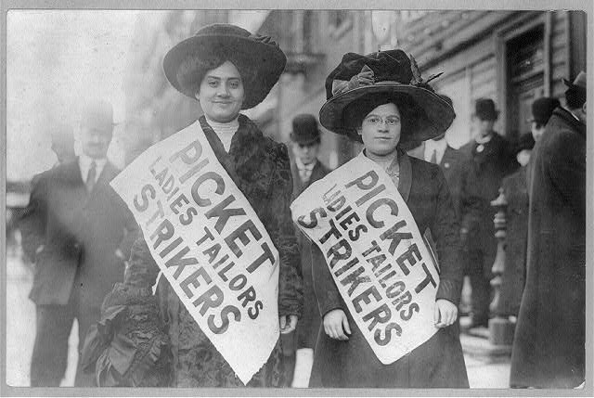
The Labor Movement

Slide 76
Changing Employee-Employer Relationships
Domestic system
Workers and employers knew each other personally
Workers could aspire to become employers
Factory system
Workers no longer owned the means of production (machinery)
Employers no longer knew workers personally
Factories often run by managers paid by the corporation
Relationships between employers and employees grew strained

Slide 77
Problems of the Factory System
Factories were crowded, dark, and dirty
Workers toiled from dawn to dusk
Young children worked with dangerous machinery
Employment of women and children put men out of work
Women and children were paid less for the same work
Technological unemployment – workers lost their jobs as their labor was replaced by machines
Notes:
Note: Silas Marner by George Eliot describes the changing textile industry due to technological advances.

Slide 78
Slum Living Conditions
Factory towns – often built and owned by factories
Not a strange concept to rural-to-urban migrants who were used to living on a lord’s estate or property
Full of crowded tenements
Few amenities
Tenements – buildings with rented multiple dwellings
Apartment buildings with a more negative connotation
Overcrowded and unsanitary
Workers were unsatisfied both inside and outside the factories

Slide 79
Rise of Labor Unions
Before labor unions, workers bargained individually – “individual bargaining”
Before factories, a worker could bargain for better wages and working conditions by arguing his or her particular skills
But in factories, work is routine and one worker can easily replace another
With labor unions, workers bargained together as a group, or collective – “collective bargaining”
Organized groups of workers elected leaders to bargain on their behalf
Used tools (such as strikes) to gain rights

Slide 80
Legal Protections for Workers
Limited hours for women
Later – equal pay for equal work
Eventual end to child labor
Schools and requirements for school attendance grew as children were removed from the workforce
Health and safety codes
Minimum wage
Legalization of unions

Slide 81
Review Questions
How and why did employer-employee relationships change during the Industrial Revolution?
Describe living conditions in factory towns.
Describe the weapons used by employers and unions.
Why was the establishment of yearly wages for members of parliament important to the British Labour party?
What are the advantages and disadvantages of unions for workers and consumers?

Slide 82
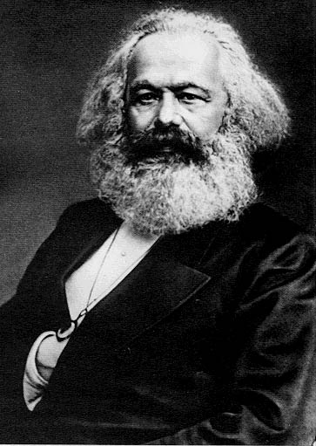
The Cooperative Movement and Socialism
Karl Marx: “cooperation will replace competition”
COMMUNISM
No private property
No social classes
Everything is owned in common

Slide 83
Marxism – Communism
Economic Interpretation of History
Economic changes lead to historical changes.
Historically, the wealthy classes have held all power.
Class Struggle
History has been a struggle between the rich and the poor.
Surplus Value
Workers produce all wealth but receive only enough to survive.
Inevitability of Socialism
In the Industrial Revolution, the struggle is between the capitalists (owners of the means of production) and the proletariat (workers).
“Surplus value” (profit) of the workers’ labor goes to the capitalists.
Industrial wealth leads to the concentration of wealth among fewer and fewer capitalists, while the living and working conditions of the proletariat grow worse.
The proletariat will eventually rebel and create a socialist state.
Notes:
Note: Anti-Marxists might argue that Marx has been proven wrong because working conditions have improved. Marxists might argue that the struggle of the proletariat is not yet over. Still others might argue that Marx was right in some respects and wrong in others; that is, no truly socialist state has ever been created, but governments have established many socialist-type reforms and institutions. An interesting class activity is to have students create two lists—one listing the industries the federal government does control, and another listing those businesses which remain privately owned. This discussion should get interesting once the class starts discussing the federal government’s involvement with industries such as banking and automobile manufacturing following the recession of late 2008.
Note: Marx referred to himself as a “communist” to separate himself from Utopian socialists.

Slide 84
Socialism
Socialists – viewed the capitalist system as inherently wrong (against private ownership)
Belief that capitalism is designed to create poverty and poor working conditions because of its end goal of earning maximum profits for investors
“From each according to his abilities, to each according to his needs.”
Socialism – government owns the means of production
Belief that if the government (“the people”) owns the means of production, these factories and industries will function in the public (as opposed to private) interest
Against the violent revolution spoken of by Marxists

