Slide 1
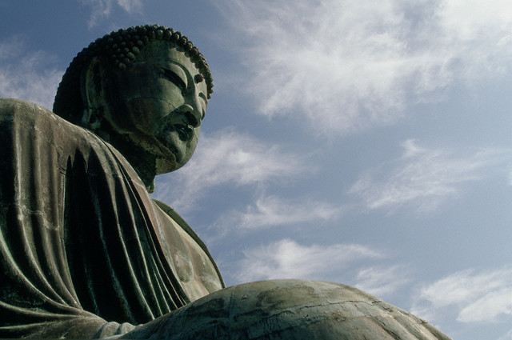

Slide 2

STANDARD WHI.3a
The student will demonstrate knowledge of ancient river valley civilizations, including Egypt, Mesopotamia, the Indus River Valley, and China, and the civilizations of the Hebrews, Phoenicians, and Kush, by
locating these civilizations in time and place.
Indian civilization—Indus River Valley (South Asia)
• Chinese civilization—Huang He Valley (East Asia)
These river valleys offered rich soils for agriculture, and they tended to be in locations easily protected from invasion by nomadic peoples.
b) describing the development of social, political, and economic patterns, including slavery.
• Hereditary rulers (dynasties of kings, pharaohs)
• Rigid class system, where slavery was accepted
Development of political patterns
• World’s first states (city-states, kingdoms, empires)
• Centralized government (often based on religious authority)
• Written law codes (Ten Commandments, Code of Hammurabi)
Development of economic patterns
• Metal tools and weapons (bronze, iron)
• Increasing agricultural surplus (better tools, plows, irrigation)
• Increasing trade along rivers and by sea (Phoenicians)
• Development of the world’s first cities
• Specialization of labor
c) explaining the development of religious traditions.
Development of religious traditions
• Polytheism was practiced by most early civilizations.
e) explaining the development of language and writing.
• Pictograms (earliest written symbols)

Slide 3
STANDARD WHI.4b
The student will demonstrate knowledge of the civilizations of Persia, India, and China in terms of chronology, geography, social structures, government,
economy, religion, and contributions to later civilizations by
b) describing India, with emphasis on the Aryan migrations and the caste system.
Physical barriers such as the Himalayas, the Hindu Kush, and the Indian Ocean
made invasion more difficult.
Mountain passes in the Hindu Kush provided invasion routes into the Indian subcontinent.
The Indus and Ganges were the most important rivers in the Indian subcontinent.
Aryans (Indo-Aryans)
• Migration, assertion of dominance
• Rigid caste system (hereditary), which influenced all social interactions and choices of occupations
Gupta empire
• Golden age of classical Indian culture
• Contributions—mathematics, new textiles, literature
c) describing the origins, beliefs, traditions, customs, and spread of Hinduism.
Hinduism
• Caste system in religious law based on occupations
• Belief in many forms of one major deity
• Reincarnation: Cycles of rebirth
• Karma: Future reincarnation based on present behavior
• Vedas and Upanishads: Sacred writings
d) describing the origins, beliefs, traditions, customs, and spread of Buddhism.
Buddhism
• Founder: Siddhartha Gautama (Buddha)
• Four Noble Truths
• Eightfold Path to Enlightenment
Asoka’s missionaries and their writings spread Buddhism from India to China and other parts of Asia.

Slide 4
STANDARD WHI.4e, f
The student will demonstrate knowledge of the civilizations of Persia, India, and China in terms of chronology, geography, social structures, government,
economy, religion, and contributions to later civilizations by
e) describing China, with emphasis on the development of an empire and the construction of the Great Wall;
f) describing the impact of Confucianism, Taoism, and Buddhism.
Migratory invaders raided Chinese settlements from the North. The Great Wall was built by Qin Shi Huangdi as a line of defense against invasions.
China was governed by a succession of ruling families called dynasties.
Chinese rulers were considered divine, but they served under a Mandate of Heaven only as long as their rule was just.
The Silk Roads facilitated trade and contact between China and other cultures as far away as Rome.
Contributions of classical China
• civil service system
• paper
• porcelain
• silk
Contributions of Confucianism in forming the social order in China
• Belief that humans are good, not bad
• Respect for elders
• Code of politeness, still used in Chinese society today
• Emphasis on education
• Ancestor worship
Contributions of Taoism in forming Chinese culture and values
• Humility
• Simple life and inner peace
• Harmony with nature
Yin/Yang represented opposites for Confucianism and Taoism. Chinese forms of Buddhism spread
throughout Asia.

Slide 5
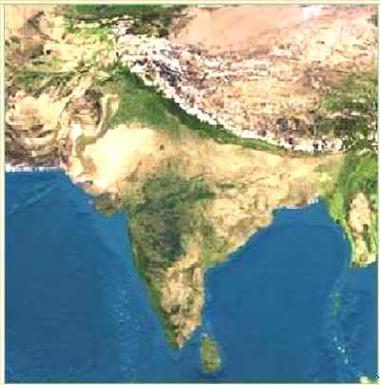
Section 1
India is a land of great: Diversity
India has over 110 different languages with over 1100 dialects spoken. Its geography ranges from fertile forests, to desert, to high mountains.
Indian Subcontinent: A landmass that is smaller than a continent. India is a subcontinent of Asia. It is divided from Asia by the Himalaya and Hindu Kush mountain ranges.

Slide 6
Khyber Pass
Himalaya
Tallest mountains in the world.
Hindu Kush
Hindu Kush
To the NW, above the Indus river.
Himalaya
Khyber Pass
Mountain pass in the Hindu Kush.
This was the passage for invaders who entered India.

Slide 7
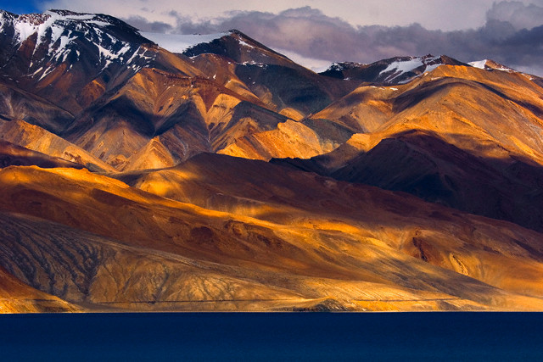
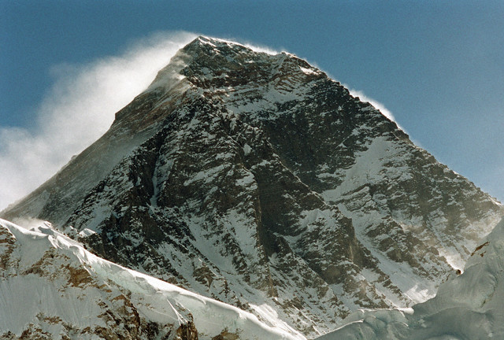
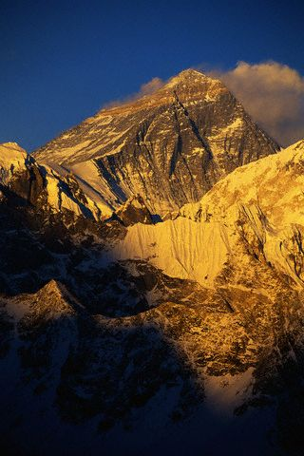
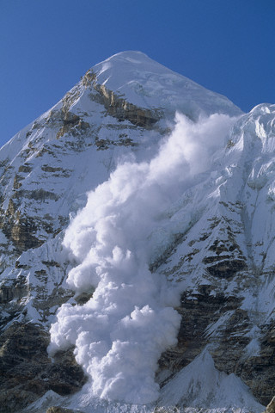
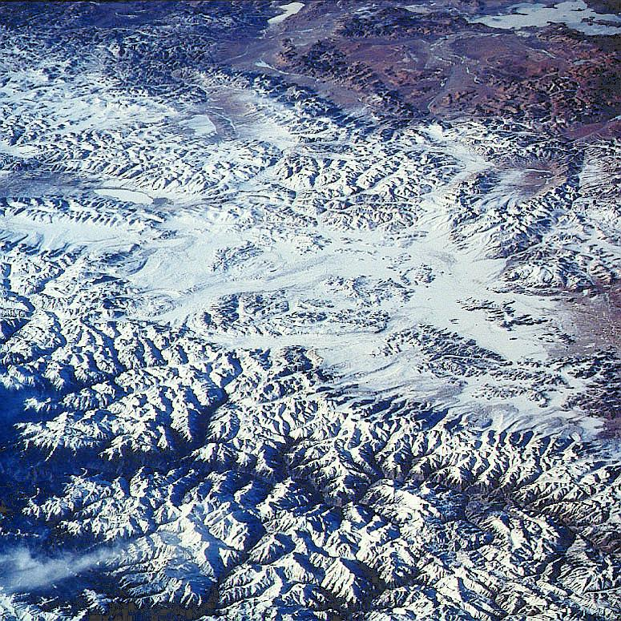
Himalaya
29, 035 ft

Slide 8
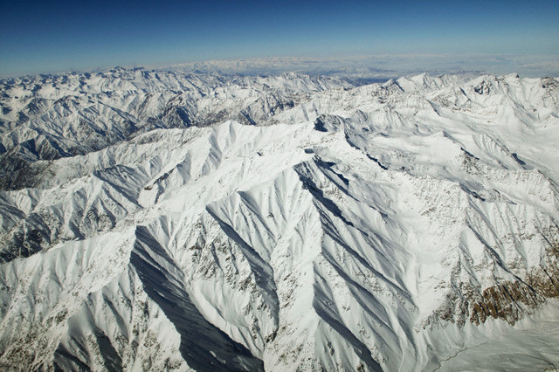
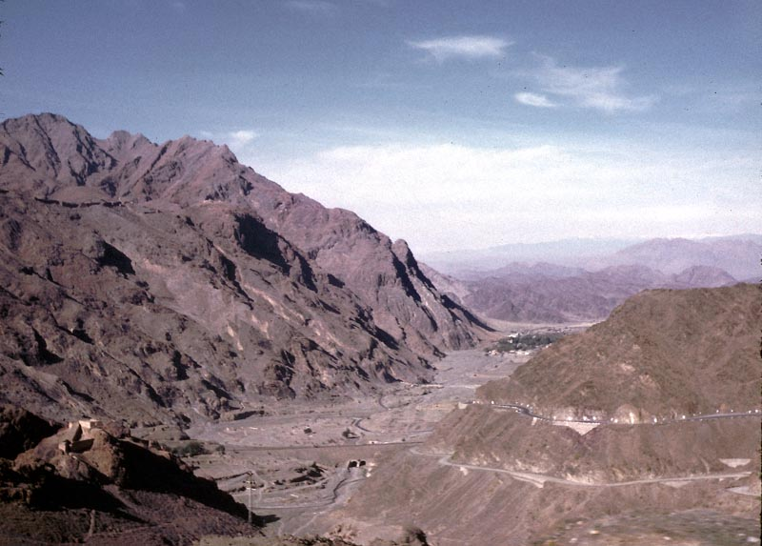
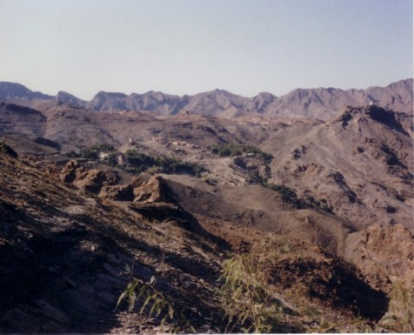
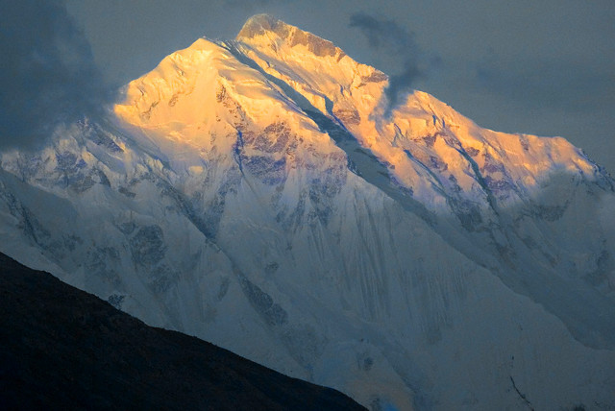
Hindu Kush
Khyber Pass

Slide 9
Ganges River
Most sacred river of India.
Indus River
Site of the first Indian Civilization
Deccan Plateau
Triangular region in central India between E. and W. Ghats.
Is very arid.
Eastern and Western Ghats
Mountains frame the Deccan, have fertile coastal plains
Indus
Ganges
Deccan
Plateau
W. Ghats
E. Ghats

Slide 10
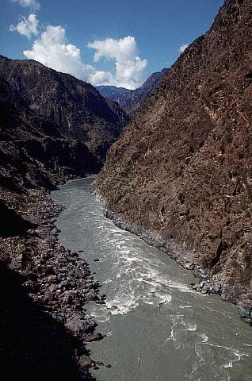
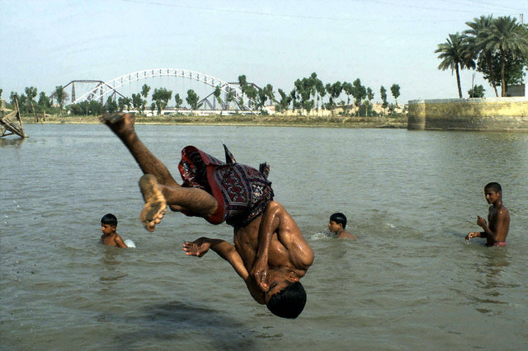
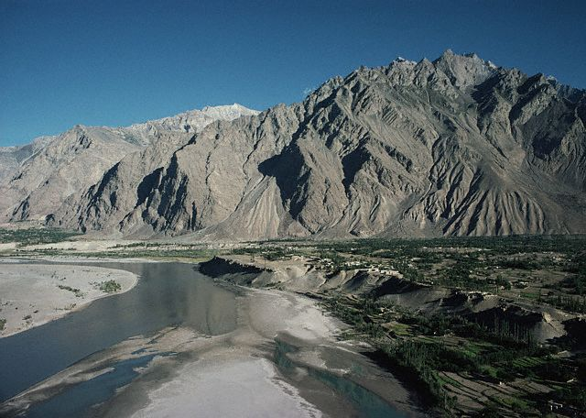
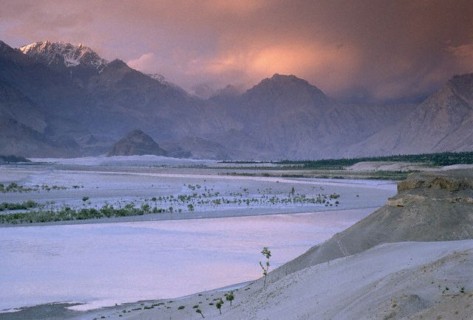
Indus River

Slide 11
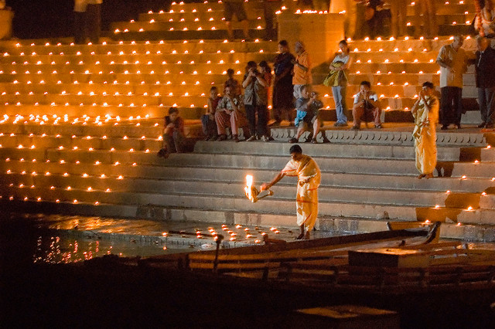
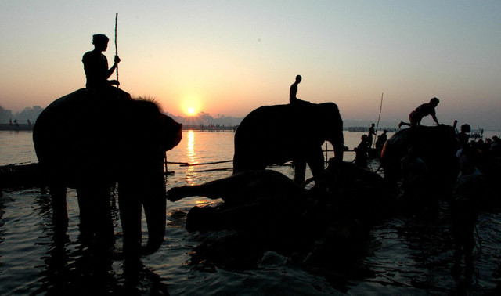
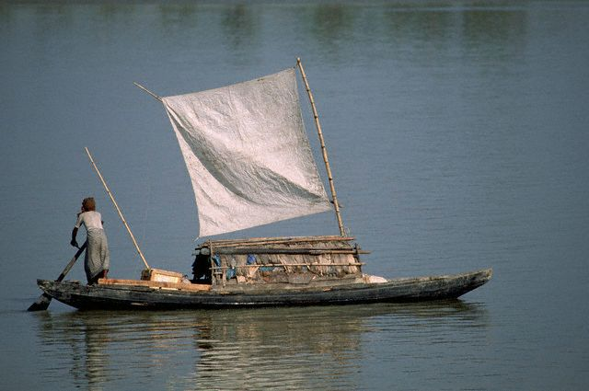
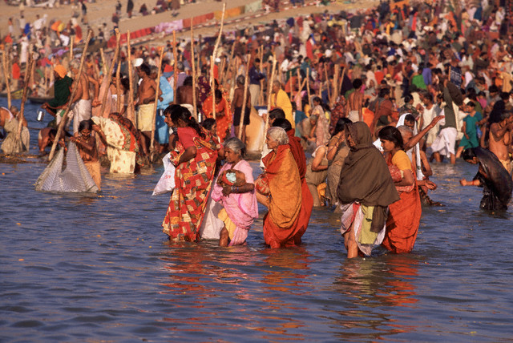
Ganges River

Slide 12
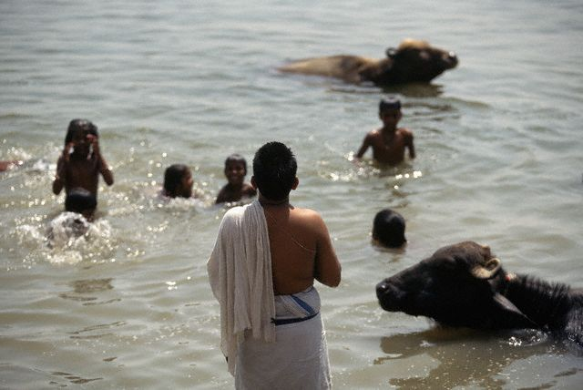
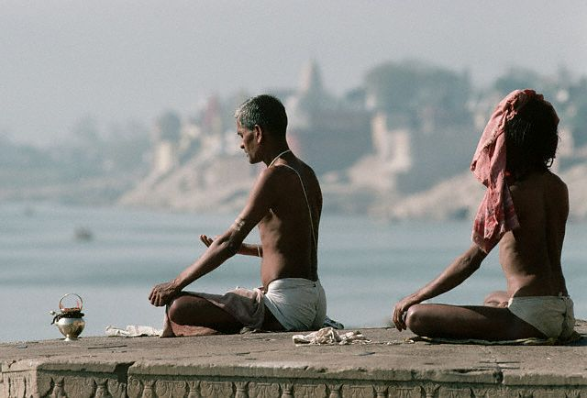
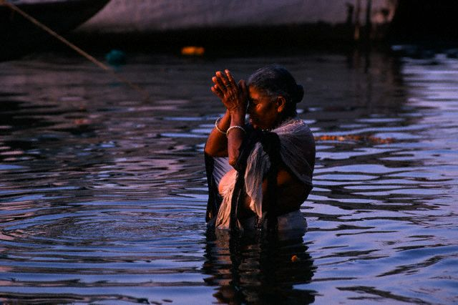
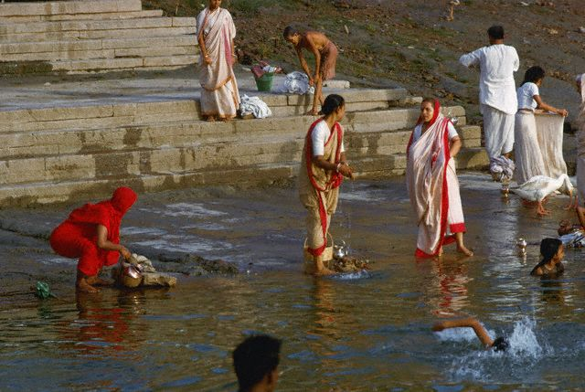

Slide 13
Monsoons
Monsoons are seasonal winds. These winds blow from different directions during different times of the year.
Winter
Monsoon
Summer Monsoon
Blows over the Arabian Sea and Indian Ocean bringing rain to India.
Arabian
Sea
Bay of
Bengal
Summer
Monsoon
Winter Monsoon
Blows over land and is dry.
Indian Ocean

Slide 15
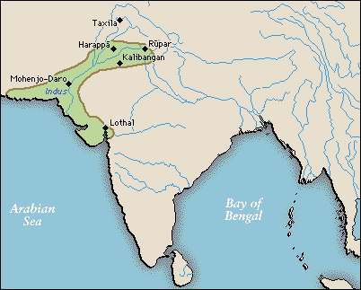
Began in: 3000 B.C. to 1500 B.C. in the Indus River Valley. It is thought that a civilization existed here that reached hundreds of miles from the Himalaya mountains to the shore of the Arabian Sea.
Two main cities found are:
Harappa and Mohenjo-Daro
Harappa and Mohenjo-Daro
Population: It is thought that Harappa had up to 35,000 people at its height and that Mohenjo-Daro has between 35,000-40,000 people.
Organization: These cities were very carefully planned.

Slide 16
Features: There is evidence of streets laid out in grids, walled neighborhoods, multi-story buildings, water and sanitation systems, garbage chutes that took trash from houses to street-level garbage bins.
Houses were made of mud bricks baked in ovens are were square forming a grid pattern.
Rulers and Economy: Rulers said their powers came from the gods. It is thought that religious and political life were closely linked.
Their economy was based on agriculture, including wheat, barely, and peas. They probably traded with other city states in Mesopotamia by sailing across the Persian Gulf. They traded copper, lumber, gemstones, and luxury goods for Textiles and food. Trade may have also gone over land through the Khyber pass.

Slide 17
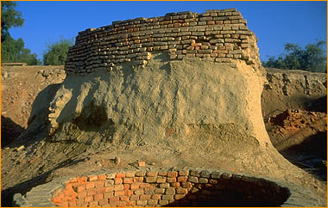
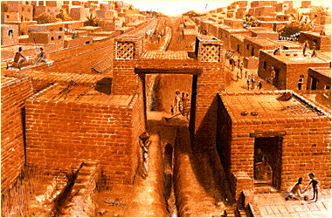
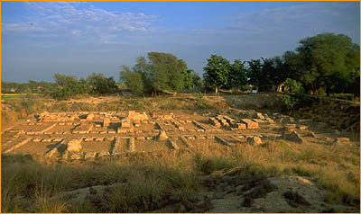
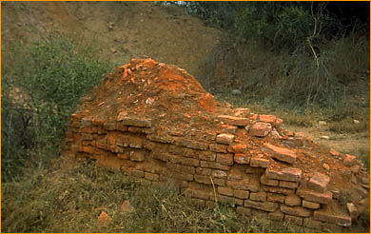
One of 8 public wells found so far

Slide 18
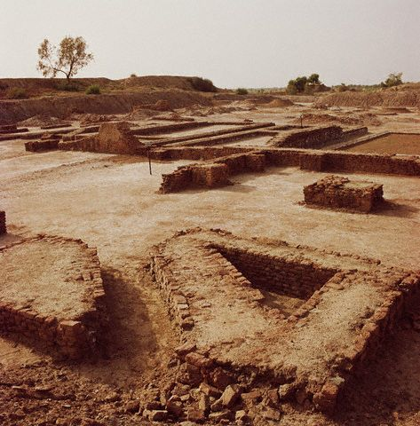
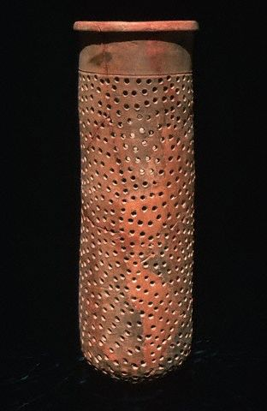
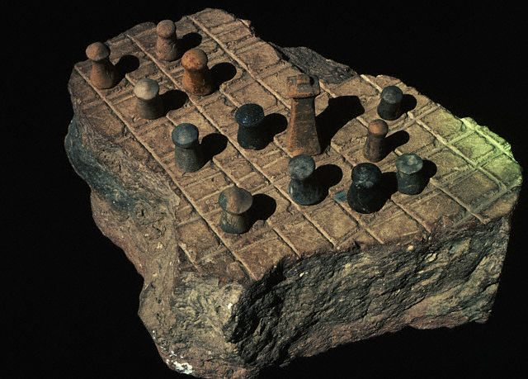
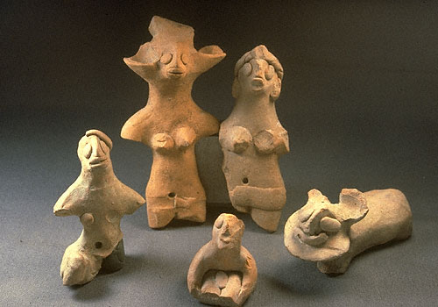
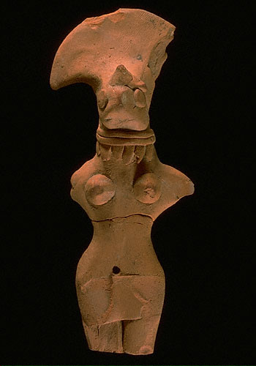
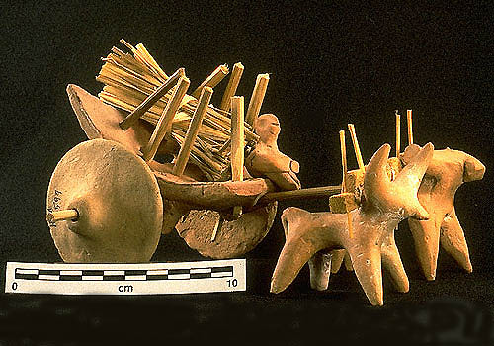

Slide 19
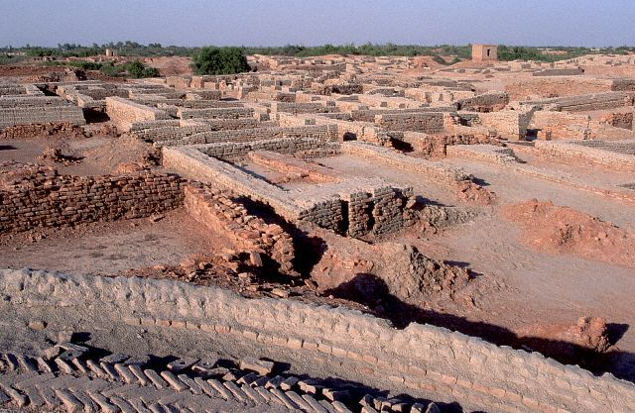
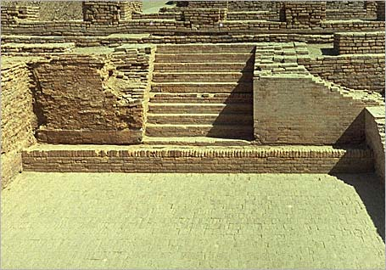
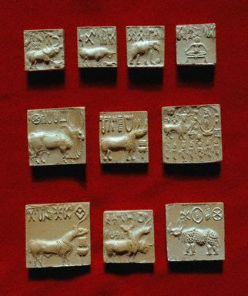
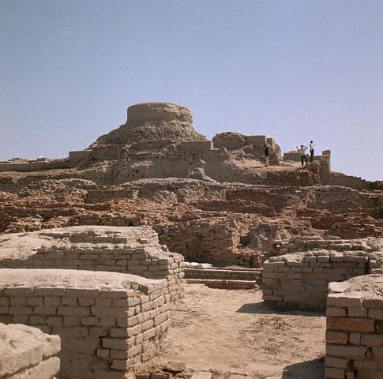
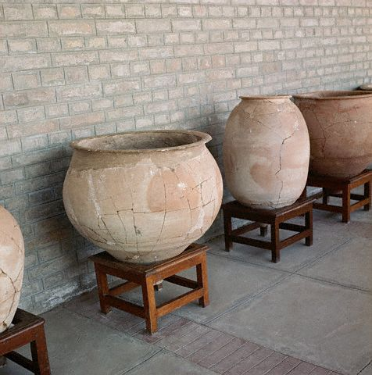

Slide 20
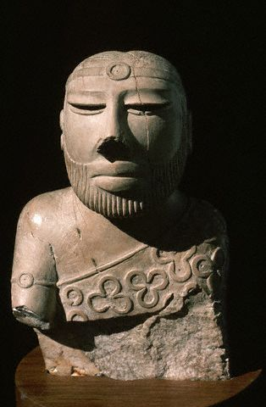
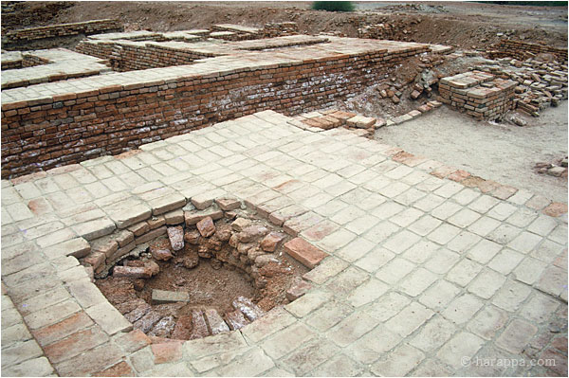
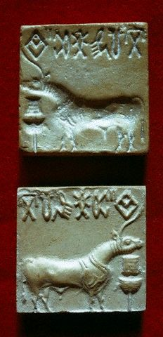
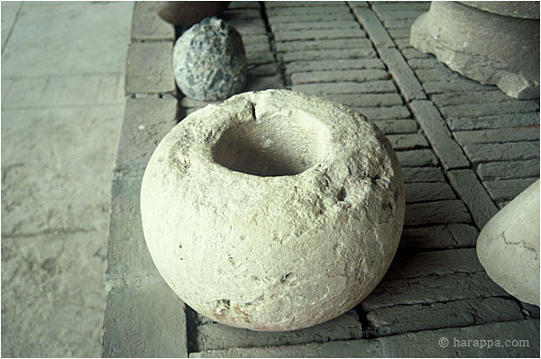
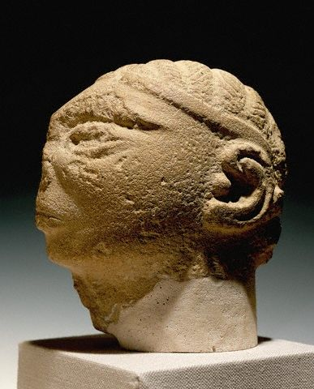

Slide 21
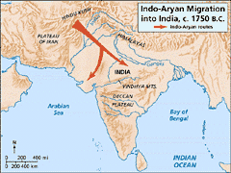
The Aryan Invasion Theory of India
Historians are not exactly sure what brought an end to the Indus Valley Civilizations. It may have been a natural disaster, climate change or a change in the course of the Indus River.
1500 B.C.: In this year many historians believe a group of Indo-European nomads began to move out of C. Asia. These people were known as the Aryans.
It is thought that they migrated south through the Hindu Kush using the Khyber pass.
Arrival in India: Advanced East from the Indus Valley, eventually occupying almost all of India. Some theorize that the Dravidians (The original people of India) recognized the advanced technology of the Aryans and eventually assimilated into Aryan culture and were not forced to migrate south.
Warfare: Were advanced fighters.

Slide 22
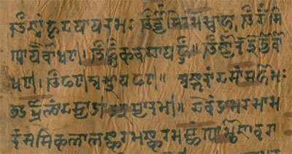
Influence of Iron: Iron tools allowed for improvements in Agriculture including the plow.
Agriculture: Tools and irrigation made it possible for the people to clear the jungle around the Ganges and create a rich farming region.
Basic crops in the north were grains, and in the south rice was common. People also began to grow cotton and spices.
Sanskrit: 1000 B.C: The written language known as Sanskrit enabled the peoples to write down their stories and religious chants and rituals. These eventually became the sacred texts of Hinduism, the Vedas.
Rajas: Princes of the Aryans, warring chieftains who fought each other seizing territory and prisoners.

Slide 23
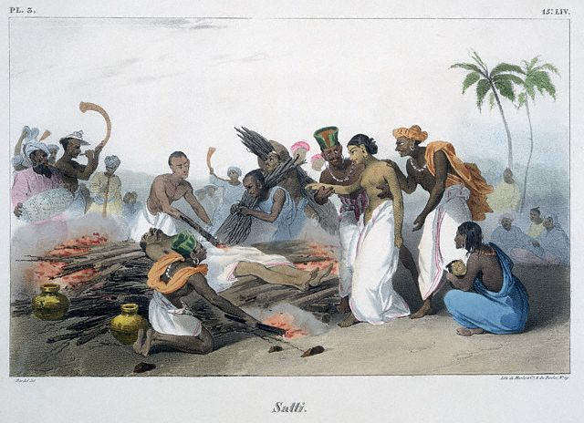
Family Life in Ancient India
Family was the most basic unit of Indian society. There was an ideal of an extended family including multiple generations living together.
Patriarchal: Indian society was male dominated. Only men could inherit property and only boys were educated.
Arranged Marriages: Parents usually arranged marriages for political and economic reasons when children were very young.
Status of Women: Women had very low social status.
There was a ritual of Suttee (Sati) where women were expected to throw themselves on the crematory fires of their dead husbands.
If they refused they were disgraced.

Slide 24
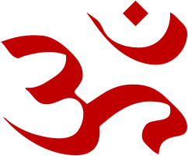
Aum, or Om
Seen as the sound of the universe
Brahman: Brahman is the all-powerful spiritual force of Hinduism.
Hindus believe that Brahman is too complex for people to understand and so it is divided into the many different gods and goddesses of Hinduism to simplify it. These gods and goddesses represent different aspects of Brahman.
Because of this Hinduism is often seen as Polytheistic, but some argue that it is not because all of the gods are part of the one universal god.
Atman: The Essential self or the Soul.
The essence of Brahman that is inside every living thing.

Slide 25
Moksha: The ultimate goal of Hinduism. To achieve Shanti, or ultimate peace. To be released from the cycle of death and rebirth.
Karma
All of the actions in this life that affect your next life.
Has nothing to do with revenge or retribution
Moksha
Union with Brahman.
Release from Samsara
Dharma
Your Duty. The rules you must follow to earn good Karma.
Samsara
Being stuck in the cycle of death and rebirth.
Suffering

Slide 26
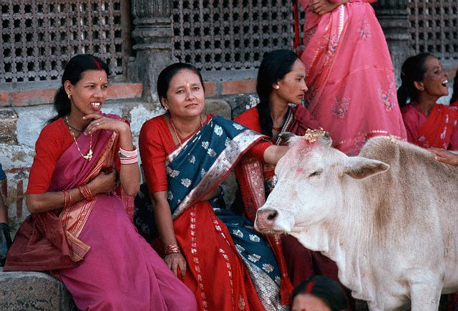
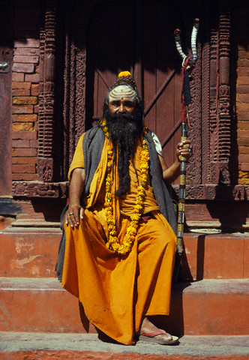
Hindus consider all life to be sacred and so they practice the principle of ahimsa, or non-violence.
Because of this many Hindus are vegetarian
Cows are Sacred in India because they are seen as the most generous of all animals.
The sacred texts of Hinduism are the
Vedas and Upanishads
.
Phases of Life
The First Ashrama - "Brahmacharya" or the Student Stage
The Second Ashrama - "Grihastha" or the Householder Stage
The Third Ashrama - "Vanaprastha" or
the Hermit Stage, retirement from the householder stage.
The Fourth Ashrama - "Sannyasa" or the Wandering Ascetic Stage

Slide 27


Yoga
Was developed as a method of training the body to achieve oneness with Brahman.
It is a form of meditation
Yoga entails mastery over the body, mind, and emotional self, and transcendence of desire. According to the followers, the Yogi eventually reaches the enlightened state (Moksha) where there is a cessation of thought and an experience of blissful union.
(Wikipedia)

Slide 28

The Caste System
The Caste System is a system of social division in India.
There is some debate as to it origins, but it is made up of four main castes and several sub-castes. You are born into your caste and may not change your caste within your lifetime.
Brahmins
The top caste, the priests. They are the closest to Brahman
Kshatryias
Second Caste, the
warriors and princes
Vaishya
Merchants, artisans and landowners
(Skilled workers)
Shudra
The workers, the lowest caste.
(unskilled workers)
Each caste has its own Dharma, or duty. You must obey the dharma of your caste to earn good Karma and be able to be reincarnated at a higher caste in the next life.

Slide 29


Untouchables
These people were the bottom of Hindu society, they are not considered part of the caste system.
About 5% of the population of India. They are required to perform the dirtiest jobs dealing with trash, human waste, and death.
People of other castes refuse to do these jobs because they may damage their Karma.
In the past Untouchables were not allowed to associate with people of other castes. They were even required to carry of noisemaker to warn people of the approach so they would not accidentally run into someone.
Discrimination against them continues today, even though the caste system has been declared illegal.

Slide 30


Slide 31

Siddhartha Gautama
The Buddha, began his life as a prince in India.
Birth: Was born into the wealthy warrior caste.
It is believed that before his birth his mother had a dream of an elephant piercing her side with its tusk. This was interpreted to mean that he would be a great leader or a wandering holy man.
Childhood
His mother died shortly after his birth. His father lavished him with wealth so he would never want to leave the palace. He was completely sheltered from the outside world.

Slide 32

The Three Visions
Siddhartha grew up never knowing much about the outside world.
He married young and had a son.
When he was in his 20’s he went outside the palace and experienced three visions which changed his life.
The saw someone in advanced old age.
He saw a very sick person
He saw a dead body.
Siddhartha had never before been aware of human suffering.
He felt his life was a lie and abandoned it to become an ascetic, or wandering holy man in an attempt to find a way to end human suffering.

Slide 33


Seeking Truth
Siddhartha tried many different ways of achieving enlightenment.
He tried mediation, fasting, physical discomfort, but none along worked for him.
He almost starved himself to death at one point.
After that he knew he needed to try something different.
Enlightenment
Siddhartha decided that he would meditate until he discovered the way to end human suffering.
Bodhi Tree: He sat under a Bodhi tree and said that he would not get up until he had achieved enlightenment.
He mediated for 40 days amidst temptation, and at the end said that he was “awake” he had achieved, Nirvana, or Enlightenment. This is when he became the Buddha, or enlightened one.

Slide 34

Teachings of the Buddha
The Buddha gave his first sermon in the deer park where he taught the four main ideas of his teachings.
Four Noble Truths
All life is full of suffering
We suffer because we desire things that are illusions. We want material possessions.
The way to not suffer is to overcome our desire
To do that one must follow the Eightfold path, or Middle Way

Slide 35

The Eightfold Path (The Middle Way)
1. Right view
  One must understand the four noble truths.
2. Right intention
Know what you really want
3. Right speech
Speak truth and speak well of others.
4. Right action
Do not kill, steal, lie, be unchaste, or take drugs or alcohol.
5. Right livelihood
Don’t do a job that harms others.
6. Right effort
Do your best, always
7. Right mindfulness
Keep control of yourself and your urges.
8. Right concentration
One must meditate to understand the world.

Slide 36
Spread of Buddhism
Convents and Monasteries: The Buddha had many followers, both men and women. He did not discriminate based on gender.
Death of the Buddha: He died of food poisoning at the home of a friend.
Scriptures: His teachings were collected in the Tripitika, or three baskets of wisdom.
Teachings
Caste System: The Buddha rejected the caste system. He said all people were capable of achieving enlightenment in one lifetime. Although not everyone did, so Buddhism does believe in reincarnation.
Ahinsa: Taught non-violence, same as Hinduism
Meditation: Taught that one should meditate. Yoga and Martial arts are seen as a form of mediation.

Slide 37

Reincarnation: The Buddha taught the belief of Samsara, or Reincarnation. As long as one is tied to material possessions of this earth and does not achieve enlightenment then one will have suffering.
Nirvana: The ultimate goal of Buddhism, to be released from the cycle of death and rebirth.

Slide 38

The Sand Mandala (tib: kilkhor) is a Tibetan Buddhist tradition which symbolizes the transitory nature of things. As part of Buddhist canon, all things material are seen as transitory. A sand mandala is an example of this, being that once it has been built and its accompanying ceremonies and viewing are finished, it is systematically destroyed.

Slide 39


Slide 40












Next Page

Slide 44


Slide 45



Slide 46



Slide 47



Slide 48


Slide 49



Slide 50



Slide 51



Slide 52



Slide 53

Theravada Buddhism
Buddhism as Philosophy.
Theravada Buddhists do not view the Buddha as a god.
This is seen as the more difficult path of Buddhism. It is sometimes called the Little Boat.
Theravada Buddhists believe that enlightenment is achieved the same way that the Buddha did it, through strict practice.
They believe if you are dedicated you can achieve enlightenment in one lifetime.

Slide 54

Mahayana Buddhism
Buddhism as religion.
Mahayana Buddhists elevated the Buddha to god status.
Is seen as the easier path to enlightenment. The Big Boat.
Mahayana Buddhists take a vow NOT to enter Nirvana, even though they too strive to reach enlightenment. Instead their vow is to return to the world of suffering and assist all others in reaching Nirvana first, thus casting the role of Buddhists as compassionate protectors and saviors

Slide 55

Mahayana Buddhism
-Enlightenment is achieved through a normal life with varying degrees of spiritual involvement.
-Vow to be reborn in order to help all other sentient beings reach Nirvana first.
-Compassion is the highest virtue
-Encourages practice in the world and among the general community.
-Followed with reference to higher beings, more like a religion.
Theravada Buddhism
-Intense, dedicated and time-consuming effort required to attain enlightenment.
-Reaching Nirvana is the ultimate goal of the -Theravada Buddhist
Strives for wisdom first
-Centers on meditation, and requires personal dedication such as being a monk or nun.
-Followed as a teaching or Philosophy

Slide 56

Section 2
Mauryan Dynasty
Aryan Influence: Aryans influenced the language and social structure of Indian Society.
Aryan influence also led to the development of Hinduism and Buddhism.
Later Invasions: Alexander the Great eventually spread into India in 327 B.C., but his soldiers couldn’t deal with the Monsoon rains and so they forced him to turn back.

Slide 57


Founding of the Mauryan Dynasty
Founded by Chandragupta Maurya, who ruled from 324 to 301 B.C.
Organization
The King set up his government with governors and secret police. He feared being poisoned and so had people taste all of his food.

Slide 58


Asoka (Ashoka): The empire flourished under his rule
He is often considered the greatest ruler in the history
of India.
Religious Conversion
After he converted to Buddhism he used Buddhist ideals for his rule.
Buddhist Ideals
He set up hospitals for animals and people. He ordered trees to be planted along the roads to provide shade for travelers. He gave up war and violence being almost the exact opposite of his grandfather, Chandragupta. He freed his prisoners and gave them back their land
Missionaries
Asoka sent missionaries throughout Asia.
He is greatly responsible for spreading Buddhism outside India into the rest of Asia.

Slide 59



Ashoka erected pillars throughout his empire and beyond. He inscribed them with Buddhist teachings to spread the religion.

Slide 60


Kushan Kingdom and the Silk Road
Afghanistan: Located in Afghanistan, Pakistan and down into the Ganges river valley in northern India
Kushan: Established their empire after the fall of the Mauryan Empire.
Trade Empire: had diplomatic contacts with Rome, Persia and China, and for several centuries were at the center of exchange between the East and the West
Silk Road
Trade route connected China to the West. Arose between 200B.C.-100 A.D.. Covered 4,000 miles. People and camels carried goods through mountains, deserts, and across the water.

Slide 61

The Guptas: India had its golden age under the Guptas
Chandragupta (No Relation): Founder of the Gupta Empire. He established his capital at the old Maurya city of Pataliputra.
Samudragupta: Expanded the Empire
Dominant Political Force
The Guptas became the most powerful force in the region.
They engaged in trade with China, SE Asia, and the Mediterranean.

Slide 62



Chandragupta II: The Gupta Empire reached its greatest point under him. He controlled a vast empire, from the mouth of the Ganges to the mouth of the Indus River and from what is now North Pakistan
Trade: The Guptas traded with people from China, SE Asia, and the Mediterranean.
Pilgrim routes: Religious trade was also vital to their economy. Religious travelers, or pilgrims, journeyed through India for different religious reasons.
Huns: Eventually the Huns invaded from central Asia and brought an end to the Golden age of the Guptas.

Slide 63


Indian Culture
Literature
Vedas: main scriptural texts of Hinduism
Upanishads: are part of the Vedas and form the Hindu scriptures which primarily discuss philosophy, meditation, and the nature of God
Ramayana: an ancient Sanskrit epic attributed to the poet Valmiki and is an important part of the Hindu canon
Mahabharata (Bhagavad Gita): Holy text of a conversation between Krishna and Arjuna taking place on the battlefield of just prior to the start of a war. It explains many moral principles of Hinduism and explains Karma

Slide 64


Architecture
Ashoka erected pillars to spread Buddhist teachings throughout his empire.

Slide 65




Stupa: A shrine that houses Buddhist relics

Slide 66





Pagodas, also associated with Buddhism evolved from Stupas.
They are usually Buddhist temples or shrines.

Slide 67


Rock Chamber: Devolved by Asoka to house monks and serve as halls for religious ceremonies.

Slide 68




Stone caves of Ajanta

Slide 69



Science and Mathematics
The decimal numeral system, including the concept of zero, was invented in India during the reign of the Guptas
Algebra
Our Numbering System, now called
Arabic Numbers
During the Gupta empire philosophers first proposed that the earth was not flat, but was instead round and rotated on an axis by viewing a lunar eclipses.

Slide 70





Gupta Structures

