Slide 1
The Enlightenment: The Age of Reason

Slide 2
Standard: WHII.6 The student will demonstrate knowledge of scientific, political, economic, and religious changes during the sixteenth, seventeenth, and eighteenth centuries by explaining the political, religious, and social ideas of the Enlightenment and the ways in which they influenced the founders of the United States.
Essential Questions: Who were some Enlightenment thinkers, and what were their ideas? How did philosophers of the Enlightenment influence thinking on political issues? How did the Enlightenment promote revolution in the American colonies?

Slide 3
Essential Understanding
Enlightenment thinkers believed that human progress was possible through the application of scientific knowledge, reason, and logic to issues of law and government. Enlightenment ideas influenced the leaders of the American Revolution and the writing of the Declaration of Independence.

Slide 4
Political Systems
Autocracy/Dictatorship
Absolute power/unlimited authority; right of governing in a single person
Requires a massive amount of force (e.g., army) to exert control over unwilling people
Communism
A scheme of equalizing the social conditions of life (e.g., distributing wealth equally to all people)
No private ownership of property
The individual is second to the society
Democracy
Government by the people; a form of government in which the supreme power is vested in the people and exercised directly by them or by their elected representatives under a free electoral system
Facism
Characterized by elements of pride in the nation
Anti -Marxism, -parliamentary democracy
Emphasis on military, strong government, and loyalty to a strong leader
The individual is second to the state or race
Monarchy
Form of rulership whereby a king or queen, emperor or empress, holds absolute (e.g., some countries in Africa, the Middle East, and Asia) or limited (e.g., constitutional monarch in England) power, usually inherited
Theocracy
A state or government which is run by priests or clergy
Theocracies are becoming more common as Islamic fundamentalism grows in strength

Slide 5
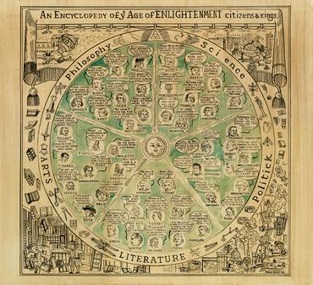
What was the Enlightenment?
The Enlightenment was an 18th Century philosophical movement (a change of outlook) built on the achievements of the Scientific Revolution
The Enlightenment philosophers hoped to make a better society by applying reason to social, political, and economic problems
Discussion was about reason, natural law, government, and progress

Slide 6
Roots of the Enlightenment
The Scientific Revolution
Scientific successes created great confidence in the power of reason – if people could use reason to find laws that governed the physical world (physical sciences), why not use reason to discover laws that govern human nature?
The Renaissance and Reformation
The humanists of the Renaissance questioned accepted beliefs and celebrated the worth of the individual
During the Reformation, Protestants rebelled against the Catholic Church
Classical and Christian Influences
Many Enlightenment thinkers were inspired by classical culture, going all the way back to the ancient Greeks (some pointed to the democracies of ancient Athens and Rome)

Slide 7
Natural Law
Natural law = rules discoverable by reason

Slide 8
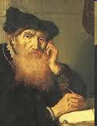
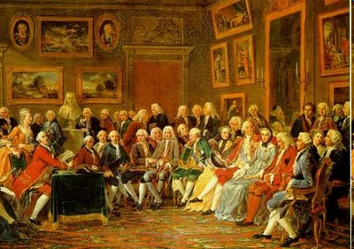
Philosophes
Thinkers called philosophes (French for ‘philosophers’) championed the Enlightenment ideas
Philosophes often gathered in informal meetings called salons, held in the elegant homes of the wealthy
During the salons, they exchanged and debated ideas, which helped to shape and spread the ideas of the Enlightenment

Slide 9
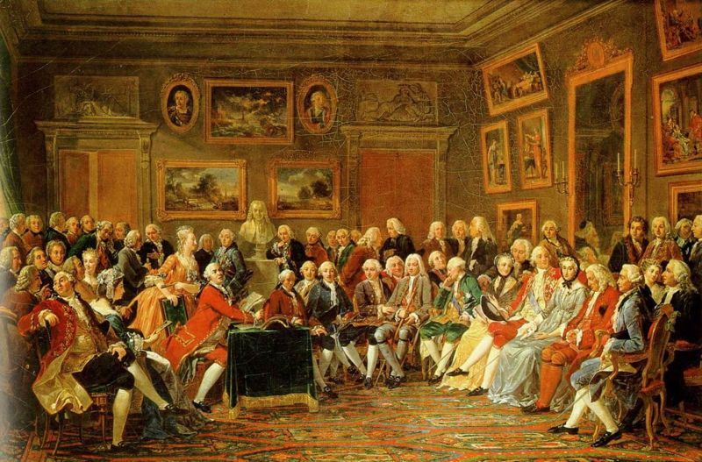
Madame Geoffrin’s Salon

Slide 10
New Ideas vs. Old Beliefs
Enlightenment thinkers prized reason over authority
They questioned the basis of religion, morality, and government
Everything, they said, must be examined anew in the light of reason
This outlook led to many clashes with accepted beliefs
Examples of things that were questioned:
Christian faith, which was based largely on trust in the Bible as God’s word
Divine right of kings to rule

Slide 11
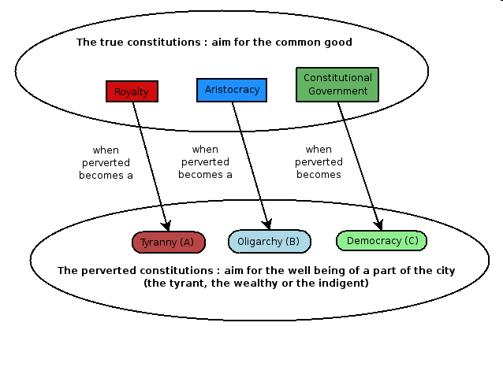
Questions
Enlightenment thinkers asked questions such as:
What natural laws govern the way people should live?
How well do our institutions agree with natural law?
Does natural law give all people certain rights?
What is the best form of government?

Slide 12
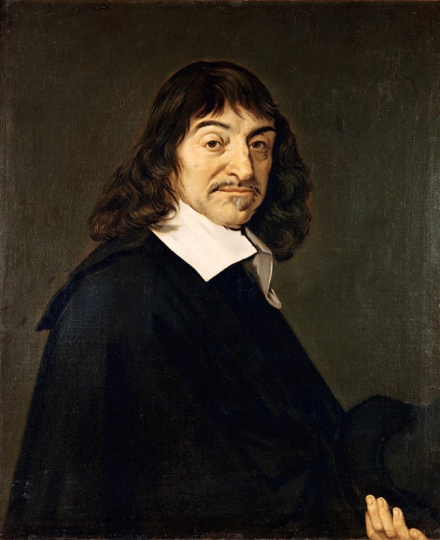
René Descartes (1596 –1650)
Descartes has been called the ‘Father of Modern Rationalism’: reason is the chief source of knowledge
He has also been called the ‘Father of the Enlightenment’
Discourse on Method (1637) begins by calling all knowledge into question
He can rationally be sure of only one thing–his own existence: “Cogito, ergo sum” “I think, therefore I am”

Slide 13
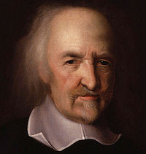
Thomas Hobbes (1588–1679)
Believed that people are driven by selfishness and greed and that in order to avoid chaos, people must enter into a social contract: giving up their freedom to a government that will ensure order (represents what is best for society as a whole)
Believed that absolute power was needed to preserve order in society; absolute monarch must be strong and able to suppress rebellion
Wrote Leviathan - 1651

Slide 14
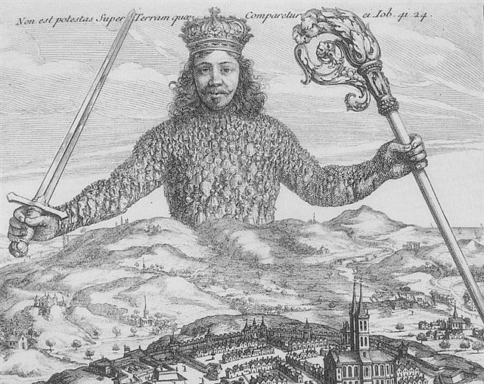
Leviathan -1651
Written during the English Civil War
The book concerns the structure of society and legitimate government
One of the earliest and most influential examples of social contract theory
“People are naturally cruel, greedy, and selfish. Life in a state of nature would be solitary, poor, nasty, brutish, and short”

Slide 15
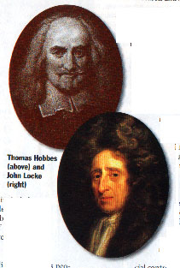
Thinker Major Ideas Quotation Connection
__to US___
Hobbes People are driven by
selfishness & greed. To avoid chaos, [a
‘brutish’ life], people
enter a social
contract --- giving up
their freedom to a
gov’t that will
ensure order. Such
a powerful gov’t
[absolute monarchy]
must be strong &
able to suppress
rebellion.
“People are
naturally cruel,
greedy, & selfish.
Life in a state of
nature would be,
solitary, poor,
nasty, brutish &
short.”
Social concept
but NOT
absolute
monarchy.
Publication
Leviathan
Notes:
A major shift in population from the North and East to the South and West caused Southern and Western states to gain representatives in Congress based on the census, while some states in the North and East lost representation.
Principles of Government

Slide 16
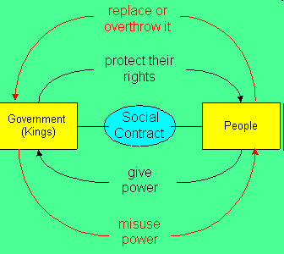
The Social Contract
The social contract is the concept that human beings have made an agreement with their government, whereby the government and the people have distinct roles and responsibilities
The theory is based on the idea that humans abandoned a natural (free and ungoverned) condition in favor of a society that provides them with order, structure, and most importantly, protection

Slide 17
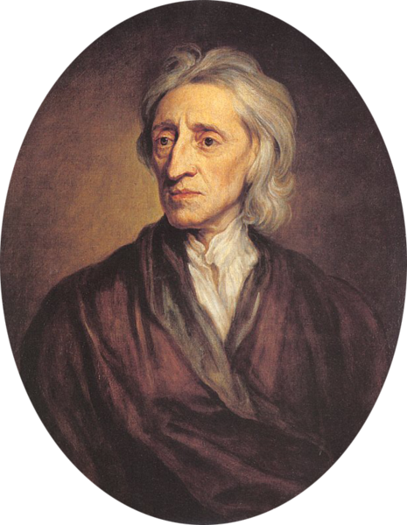
John Locke (1632–1704)
Believed that people were basically reasonable and moral
Believed in natural rights (rights that belonged to all humans from birth):
Life – Liberty – Property
Wrote Two Treatises of Government
Argued that people formed governments to protect their natural rights
Government existed to protect rights, and if it didn’t, it should be overthrown (Social Contract)
Supported democracy (limited power and accepted by all citizens); opposed absolute monarchy

Slide 18
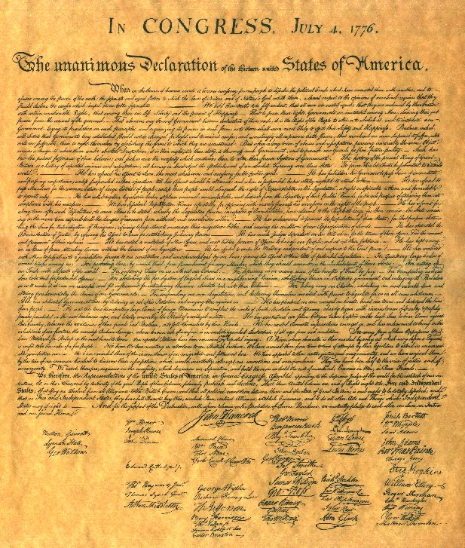
What are Natural Rights?
The right to:
religious worship
speech
press
assembly
property
the pursuit of happiness.
These rights are referred to in the American Declaration of Independence

Slide 19
John Locke
Argued that people are born with a mind that is a tabula rasa, or blank slate, and that knowledge comes to it through the five senses.
This meant that the right influences could create a new kind of society by creating a new way of understanding

Slide 20
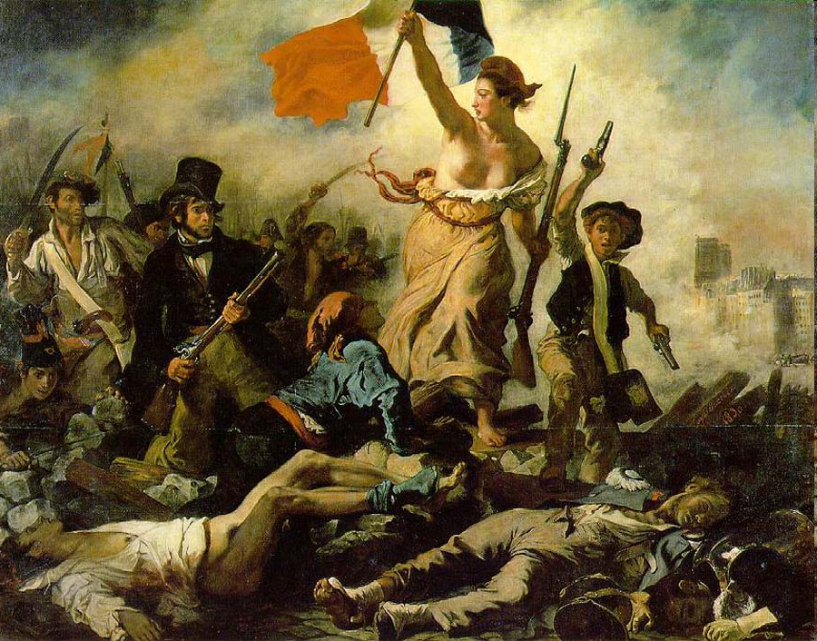
Influencing Revolution
Locke’s idea that the people could overthrow a government that isn’t protecting their natural rights influenced leaders of the American Revolution, the French Revolution, and the Latin American Revolutions

Slide 21
Thinker Major Ideas Quotation Connection to US
Locke People have a
natural right to
life, liberty, &
property. Rulers
have a responsibility
to protect those
rights. People have
the right to change
a gov’t that fails to
do so.
“Men being… by
nature all free, equal, & independent, no one can be put out of this estate & subjected to
the political power of another with-out his own consent.”
Ideas influenced
authors of the
Declaration of
Independence.
Publication
Treaties of Gov’t
Notes:
A major shift in population from the North and East to the South and West caused Southern and Western states to gain representatives in Congress based on the census, while some states in the North and East lost representation.
Principles of Government

Slide 22
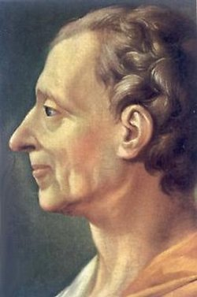
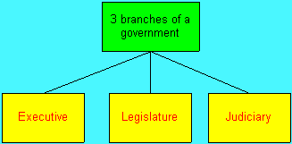
Baron de Montesquieu (1689-1755)
Believed that the best way to protect liberty was to divide power between three branches: the legislative, executive, and judicial (separation of powers) – each with the power to check the other two
His idea of checks and balances would influence the U.S. Constitution
Published The Spirit of the Laws: 1748
Believed that government elected by the people was the best form

Slide 23
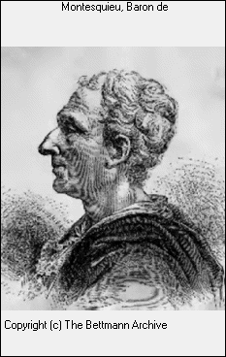
Thinker Major Ideas Quotation Connection to US
Montes-
quieu
The powers of gov’t should be separated into executive,
legislative, & judicial
branches, to prevent
any one group from gaining too much power.
“In order to have…
liberty, it is necessary that gov’t be set up so that one man need not be afraid of
another.”
His ideas about separation
of powers greatly influenced
the Framers of the U.S. Constitution.
Publications
Persian Letters &
Spirit of the Laws
Notes:
A major shift in population from the North and East to the South and West caused Southern and Western states to gain representatives in Congress based on the census, while some states in the North and East lost representation.
Principles of Government

Slide 24
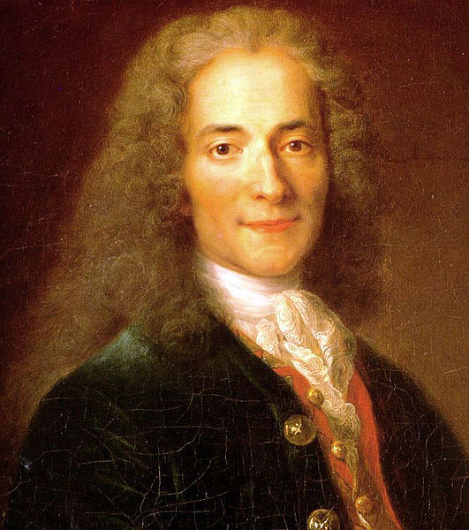
Voltaire (1694 – 1778)
Arguably, the most famous ‘philosophe’ was Voltaire
Strong supporter of Freedom of Speech, Thought, & Religion
Believed governments should ensure personal freedoms – battled corruption, injustice, and inequality
Believed in the separation of church and state
Satirist who used wit as a weapon to expose the abuses of his day (the French Monarchy, the nobility, and the Catholic Church)
Wrote: Candide (‘we must cultivate our garden’)
Was imprisoned and forced into exile
“I do not agree with what you have to say, but I'll defend to the death your right to say it.”

Slide 25
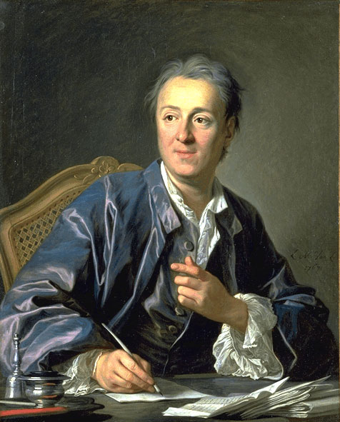
Denis Diderot (1713 –1784)
Leading philosophe who edited The Encyclopedia: a collection of articles from Philosophes and scientists covering every subject possible (including criticisms of aspects of society, the church, government, the slave trade, torture, taxes, and war)
Purpose was to change the general way of thinking
Helped spread Enlightenment ideas

Slide 26
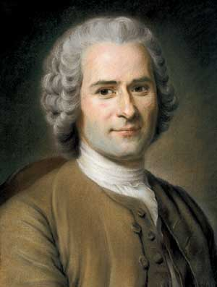
Jean-Jacques Rousseau (1712–1778)
Argued that people are naturally good, but society corrupts them through environment, education, and laws
Felt that society placed too many limitations on people’s behavior – some controls are necessary, but should only be imposed by governments that had been freely elected
Champion of democracy for his idea that political authority lies with the people
Opposed strong government (oppression)
Published The Social Contract in 1762

Slide 27
Thinker Major Ideas Quotation Connection to US
Rousseau People are basically good
but become
corrupted by
society. In an
ideal society,
people would
make the laws
& would obey
them willingly.
“Only the general will can direct the
energies of the state in a manner
appropriate to the end for which it was
founded --- i.e., the
common good.”
Rousseau has been hailed as the champion
of democracy for his idea that political
authority lies with the people. -- Also, pushed
social contract.
Publications
Social Contract & Emile
Notes:
A major shift in population from the North and East to the South and West caused Southern and Western states to gain representatives in Congress based on the census, while some states in the North and East lost representation.
Principles of Government

Slide 28
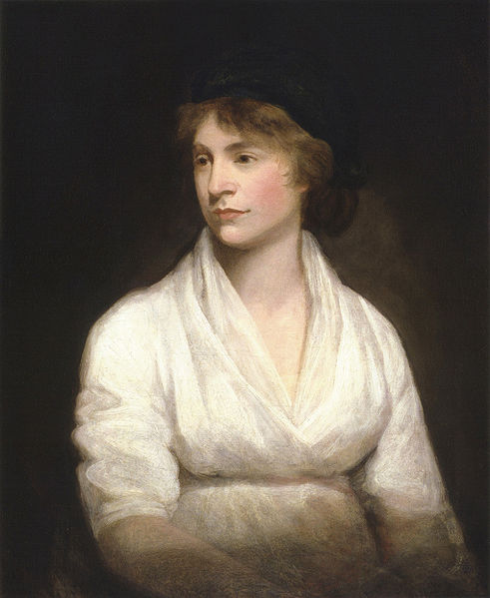
Mary Wollstonecraft (1759–1797)
Early spokesperson for Women’s Rights
Argued that women should have the same rights as men
Governments should extend political rights to women
Women should enjoy educational freedoms
Wrote: A Vindication of the Rights of Woman in 1792

Slide 29
Adam Smith (1723–1790)
The French Physiocrats (those who focused on economic reforms) and the Scottish philosopher Adam Smith founded modern economics
The Physiocrats believed that if people were free to pursue their economic self-interest, all society would benefit
They developed the doctrine of laissez-faire, which argued that the government should not interfere with natural economic processes by imposing regulations (“hands off”)
Smith wrote about this in his book, The Wealth of Nations
This policy replaced that of mercantilism, which required government regulation of the economy to achieve a favorable balance of trade

Slide 30
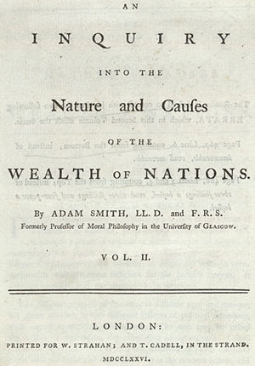
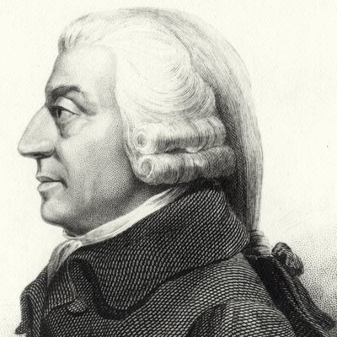
Adam Smith
Smith said the government had only three legitimate functions: protecting society from invasion (army), defending citizens from injustice (police), and maintaining public works like roads and canals that private individuals could not afford

Slide 31
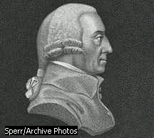
Laissez-faire (Capitalism)
The Wealth of Nations (1776)
In his famous treatise, The Wealth of Nations, Adam Smith argued that private competition free from regulation produces and distributes wealth better than government-regulated markets. Since 1776, when Smith produced his work, his argument has been used to justify capitalism and discourage government intervention in trade and exchange. Smith believed that private businesses seeking their own interests organize the economy most efficiently, “as if by an invisible hand.”
Adam Smith

Slide 32
Censorship
Some government and church authorities felt they had a sacred duty to defend the old order so they waged a war of censorship, or restricting access to ideas and information; however, ideas spread regardless

Slide 33
Enlightened Despotism
Despotism: rule by a despot or tyrant; cruel and arbitrary use of power

Slide 34
Goals of Enlightened Rulers
Some monarchs did accept Enlightenment ideas. They became enlightened despots, or absolute rulers who used their power to bring about political and social change (governed by Enlightenment principles while retaining royal power).
The Philosophes hoped to convince the ruling classes that reform was necessary and believed that enlightened rulers were to: establish and preserve natural rights; nurture the arts, sciences, and education; and to enforce the laws fairly over all subjects
Philosophes tried to influence rulers in Prussia, Austria, and Russia to make enlightened reforms

Slide 35
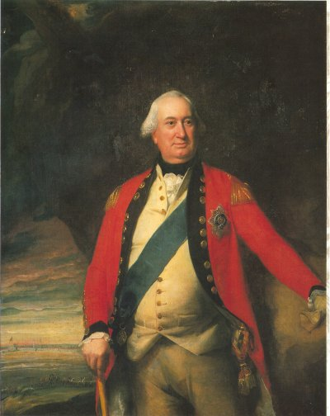
Frederick II the Great of Prussia (r. 1740-1786)
One of Europe’s most cultured kings
He exerted extremely tight control over his subjects – still, he saw himself as the ‘first servant of the state,’ with a duty to work for the common good
When the king wasn’t busy fighting wars, he had swamps drained & forced peasants to grow new crops such as potatoes
He tolerated religious differences, welcoming victims of religious persecution
He abolished torture, except in treason and murder cases, and granted limited freedom of speech and limited freedom of the press
In the end, however, Frederick desired a stronger monarchy and more power for himself

Slide 36
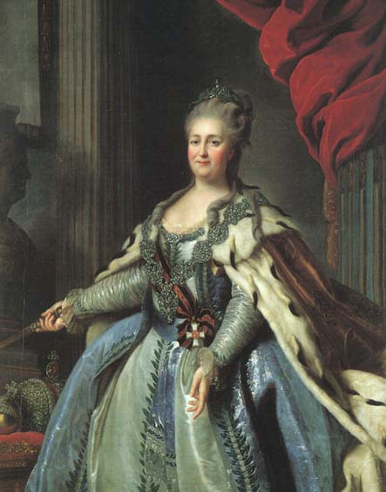
Catherine the Great of Russia (r. 1762-1796)
She read the works of philosophes and exchanged letters with Voltaire and Diderot
Believed in the Enlightenment ideas of equality and liberty
She made limited reforms in law and government but ultimately didn’t want to give up power – when a serf revolt broke out, she ruthlessly suppressed it
In the end, she did not adopt Enlightenment reforms because she needed the support of the Russian nobility who opposed change

Slide 37
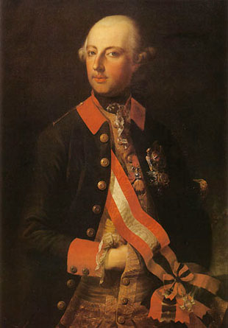
Joseph II of Austria (r. 1765-1790)
The most radical Enlightenment Despot
His mother was Maria Theresa
“Undercover Boss” (traveled in disguise among his subjects to learn of their problems)
He recognized equality before the law and enacted reforms, including religious toleration and free press
His program largely failed
Nobles were alienated because of the serfs’ being freed

Slide 38
Results of the Enlightenment
Ideas about freedom and representative government inspired leaders in the American colonies to revolt and establish an independent republic (United States of America), which in turn influenced the French Revolution and the Latin American Revolutions
The Declaration of Independence, the Constitution of the United States, and the Bill of Rights incorporated Enlightenment ideas
Can you identify some of the ideas?

Slide 39
Enlightenment: Main Ideas
Applied reason to the human world
Stimulated religious tolerance
Fueled democratic revolutions around the world
Influenced the framers of the United States Constitution

Slide 40
Think, Pair, Share
Now, we will look at sections of the United States Constitution and the Bill of Rights
DIRECTIONS:
Think about which passages were influenced by an Enlightenment thinker
Then, think about which thinker influenced the passage
Share your ideas with your neighbor
Be prepared to share your thoughts

Slide 41
The Constitution of the United States of America
Article 1 All legislative Powers herein granted
Section 1 shall be vested in (given to) a Congress
of the United States, which shall consist of a Senate and House of Representatives.
Article II The executive Power shall be vested in a Section 1 President of the United States of
America.
Article III The judicial Power of the United States Section 1 shall be vested in one supreme Court,
and in such inferior (lower) Courts as the Congress may from time to time ordain and establish.

Slide 42
The Bill of Rights
Amendment 1: Congress shall make no law respecting an establishment of religion, or prohibiting the free exercise thereof; or abridging (limiting) the freedom of speech or of the press.
Amendment 5: No person shall…be subject for the same offense to be twice put in jeopardy of life or limb; nor shall be compelled (forced) in any criminal case to be a witness against himself; nor be deprived of life, liberty, or property, without due process of law.
Amendment 8: Excessive bail shall not be required, nor excessive fines imposed, nor cruel and unusual punishments inflicted.

Slide 43
The Constitution of the United States of America
Article 1 All legislative Powers herein granted
Section 1 shall be vested in (given to) a Congress
of the United States, which shall consist of a Senate and House of Representatives.
Article II The executive Power shall be vested in a
Section 1 President of the United States of America.
Article III The judicial Power of the United States
Section 1 shall be vested in one supreme Court, and in such
inferior (lower) Courts as the Congress may from
time to time ordain and establish.
ANSWER: Montesquieu
Three Branches of Government

Slide 44
The Bill of Rights
Amendment 1: Congress shall make no law respecting an establishment of religion, or prohibiting the free exercise thereof; or abridging (limiting) the freedom of speech or of the press. ANSWER: Voltaire
Amendment 5: No person shall…be subject for the same offense to be twice put in jeopardy of life or limb; nor shall be compelled (forced) in any criminal case to be a witness against himself; nor be deprived of life, liberty, or property, without due process of law. ANSWER: Locke
Amendment 8: Excessive bail shall not be required, nor excessive fines imposed, nor cruel and unusual punishments inflicted. ANSWER: Beccaria

Slide 45
Declaration of Independence
The government has an obligation to protect the people’s natural rights to ‘life, liberty, and property’ (Locke)
The people have a right to ‘alter or abolish’ unjust governments (a right to revolt) (Locke)
The principle of popular sovereignty, which states that all power comes from the people, is another important point in the Declaration
Constitution
A social contract into which the people would enter (Hobbes, Rousseau)
Elected legislature and an elected president, instead of a hereditary monarch (Locke, Montesquieu)
Separation of powers among the legislative, executive, and judicial branches (Montesquieu)
Checks and balances (Montesquieu)
Bill of Rights (important to the passage of the Constitution)
People had basic rights that the government must protect, such as freedom of religion, speech, and the press (Voltaire)

Slide 46
Coming up…
1789: The French Revolution toppled the monarchy in the name of liberty and equality

