Slide 1
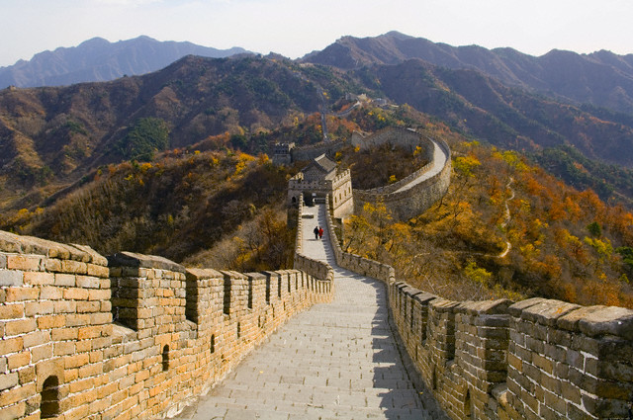

Slide 2
Chapter 3 Section 3
Huang He
The Yellow River, aka China’s sorrow because of frequent flooding.
Yangtze
(Chang Jiang)
Yellow Sea
North China Plain
Plain between two major rivers. Most populated area of China.
Huang He
Yangtze
Yellow
Sea

Slide 3
Tian
Fertile Land
10% of the land is good for agriculture
Physical Landscape
Desert: Gobi
Taklimakan Desert
Mountains
Himalaya
Tian Shan
Plateau of Tibet
High plateau N. of the Himalaya.
Taklimakan
Gobi
Plateau
of Tibet
Himalaya

Slide 4
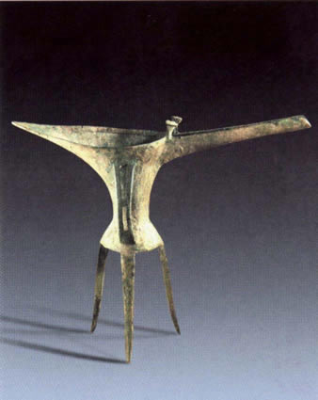
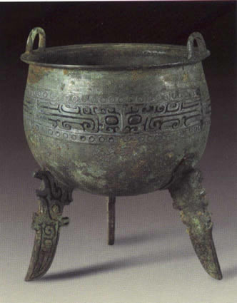
First Dynasty Xia Dynasty c.2070 BC–1600 BC
It was during this period that Chinese civilization developed a ruling structure that had civilian government and harsh punishment for breaking the law. From this the earliest forms of Chinese legal codes came into being.
Second: Shang 1750-1122 B.C.
Aristocracy: Rich upper-class land owners, ruled.
Economy was based on agriculture.
The Aristocracy was constantly at war.
Capital Cities
It is thought that they moved their capital several times, finally establishing their capital at Anyang, north of the Huang He.

Slide 5
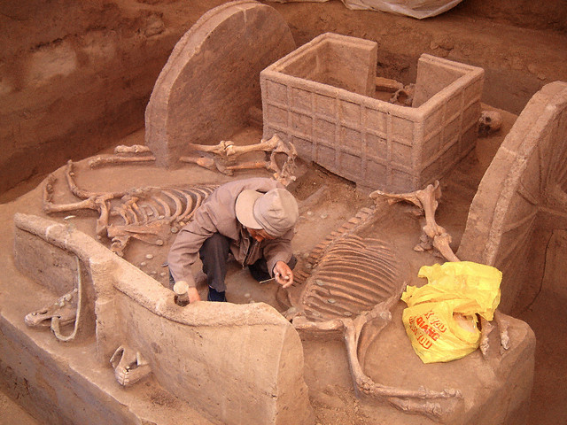
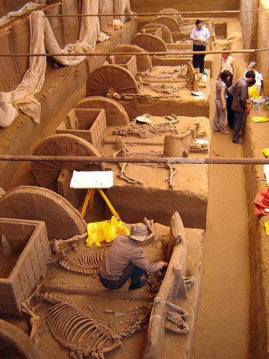
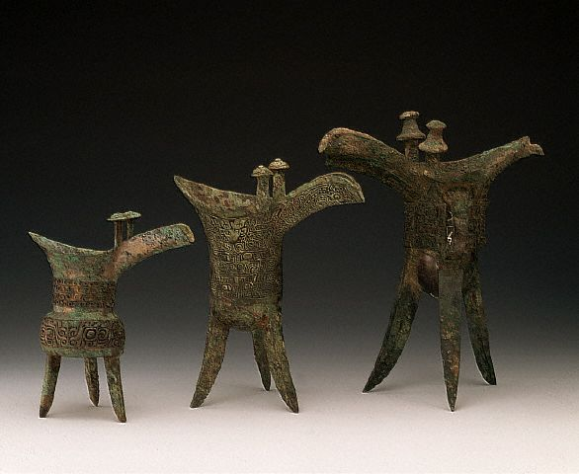
Anyang

Slide 6
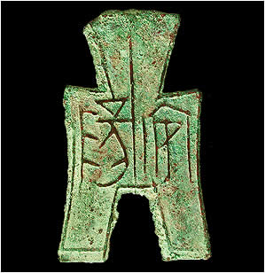
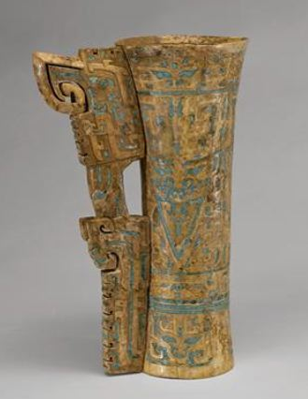
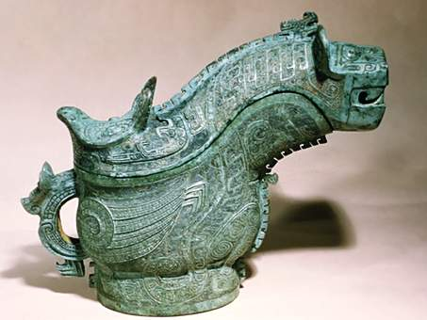
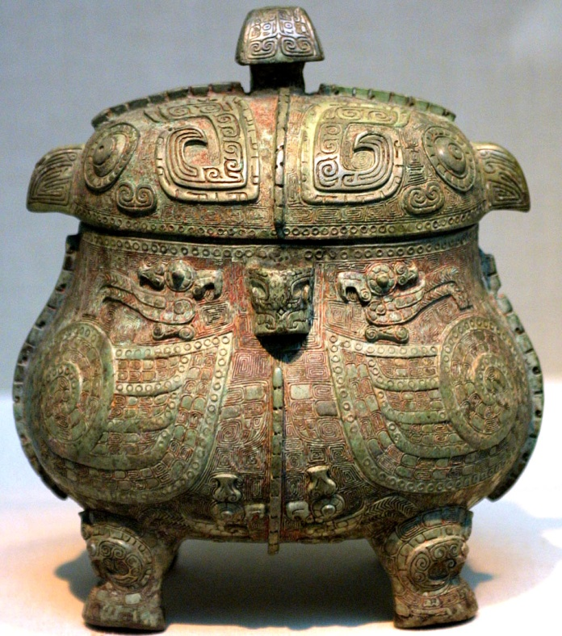
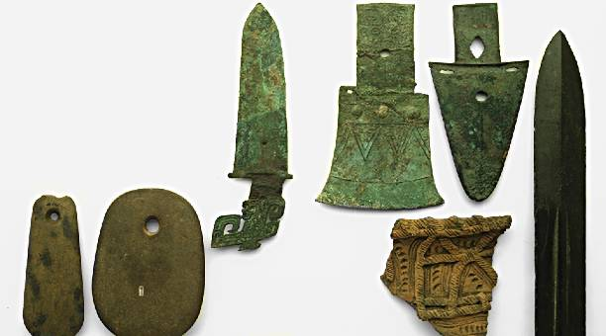
Shang Bronze
The Shang were master bronze makers.

Slide 7
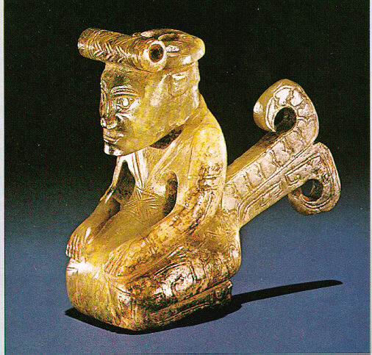
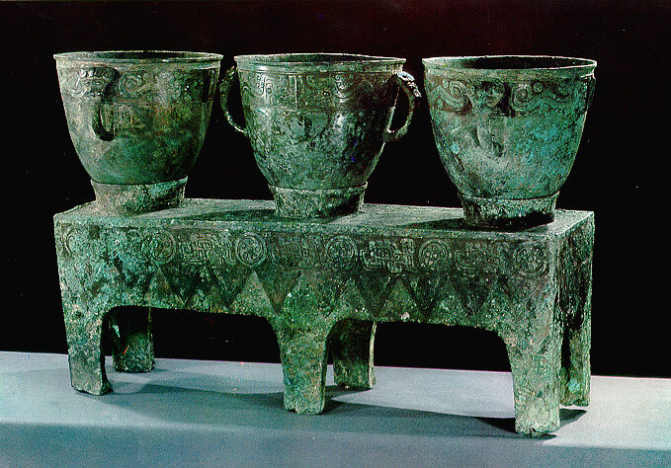
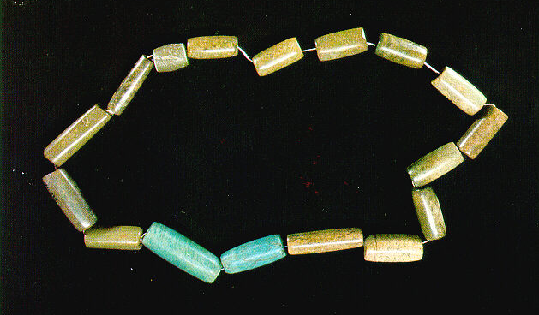
Political and Social Structure
The Shang King ruled from his palace at Anyang.
He split his territory up among different generals.
He could appoint and remove these generals.
The Shang frequently waged war on the fringes of their kingdom.
When a Shang king died, the servants were buried in the tomb with the king. The tomb was also filled with riches for the afterlife.

Slide 8
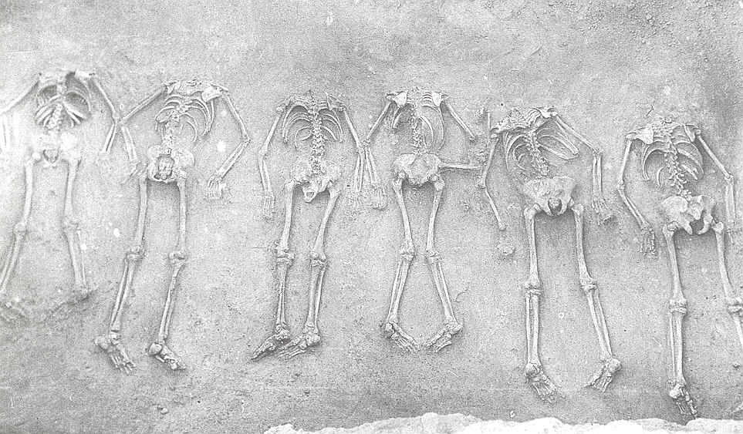
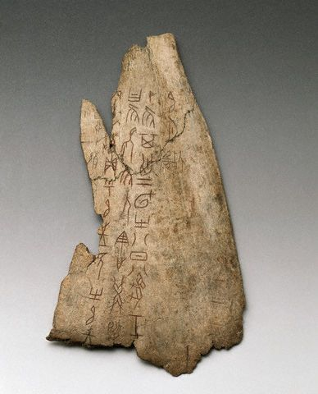
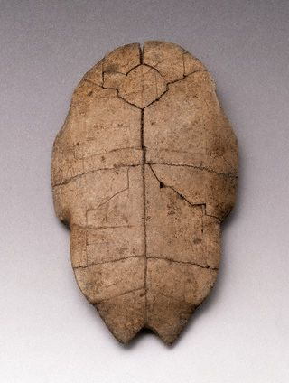
Religion and Culture
Possessed a very strong belief in life after death.
The Shang practiced human sacrifice to win the favor of the gods or give the king company in the afterlife.
Ancestor Veneration
The ancestors were seen as a link between the present world and the spiritual world. They could bring good or bad fortune to a family. Offerings of food and drink were offered to them
Oracle Bones
A way to communicate with the ancestors. Animal bonds were carved with questions, then heated or broken. A priest then interpreted the breaks.

Slide 9
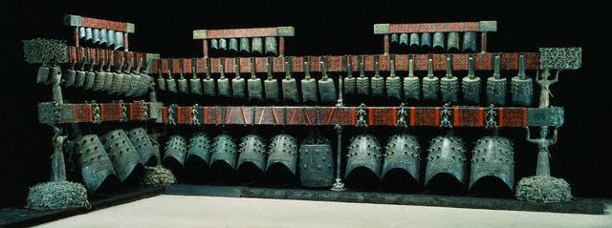
Zhou Dynasty 1045-256 B.C.
Duration
Lasted for almost 900 years, longest lasting dynasty in Chinese History.
Political Structure
Head was a king who ruled over an imperial bureaucracy. The king was seen as the link between heaven and earth and had divine-like powers.
The rulers of the different provinces were aristocrats, similar to the way it was in the Shang dynasty.

Slide 10
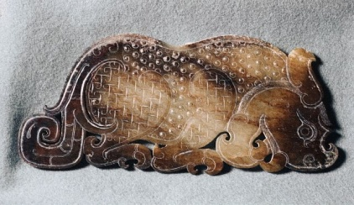
The Mandate of Heaven/Dynastic Cycle
Mandate of Heaven:
The Zhou used the Mandate of Heaven to justify their rule.
Heaven, the law of nature, kept order in the universe by choosing the king. The king was responsible for being a good ruler.
Dao: The Way
The King was responsible to rule by the Dao, he had to keep the gods happy to protect people from natural disaster, or bad harvest.
If he didn’t do this he would lose power.
The mandate of heaven was used to explain the rise and fall of different dynasties. When a ruler took over they claimed they had earned the mandate of heaven, or they would not have been able to win. This was closely tied to the Dynastic Cycle

Slide 11

The Dynastic Cycle
New Ruler Gains the Mandate of Heaven
Dynasty founded by powerful leader
Period of Rebellion
Ruler loses the Mandate of Heaven
Period of Great Power and Prosperity
Golden Age
Period of Decline and Corruption

Slide 12
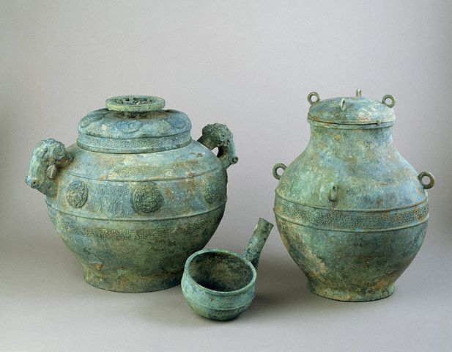
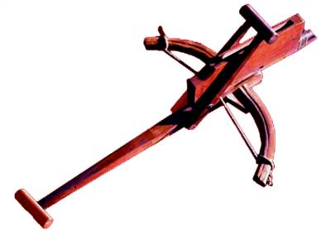
Decline of the Zhou
Later Zhou rulers began to become corrupt.
Civil war broke out between the kingdoms
This is called the “Warring States Period”
Changes in Warfare
Iron Weapons were developed.
Infantry (foot soldiers) and Cavalry (soldiers on horseback) became more prevalent.
Began to use the crossbow

Slide 13
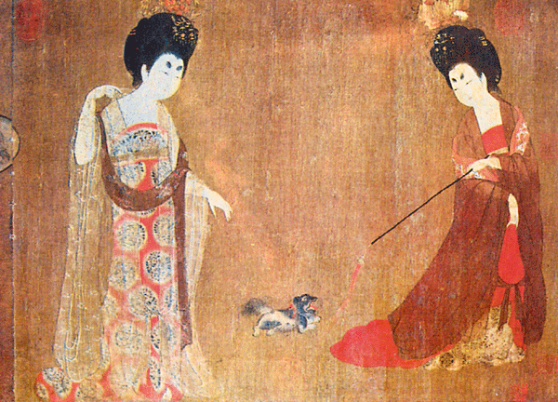
Life under the Zhou
Economic and Technological Growth
Made major advancements during this period that improved life for the people.
Irrigation and Water Projects
Began to control the flow of rivers to water crops. Farming could be more reliable without dependence on rains.
Farming Advancements
Iron plows, increase arable land.
An agricultural surplus led to an increase in trade.
The most important trade item was silk.
It’s secret was closely guarded.
Sharing the secret of silk was punishable by death.

Slide 14
Family
In an agricultural society families had to work together to survive. Family, and extended families, were very important.
Filial Piety
Family members were responsible to obey the needs and wants of the male head of the family.
Everyone had to know their place.
Children were expected to provide for their parents in old age.
Role of Women
Ancient China was a patriarchal, or male dominated, society.
Some women had power, but this was generally looked down upon.
Women were expected to raise children and work in the home.

Slide 15



Chinese Language
Pictograms
Written Chinese is made up of pictograms, or characters.
These are symbols that represent things.
Ideograms
Two or more characters arranged to represent an idea.
東
Pictograms for mountain, sun, and moon
Ideogram for East, all the pictograms are combined.

Slide 16
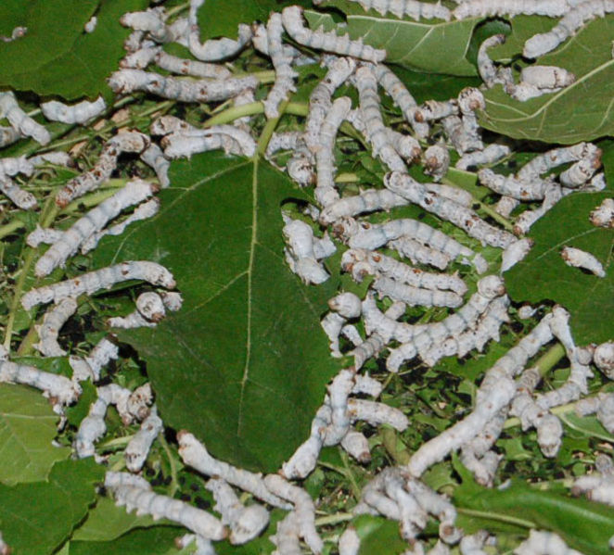
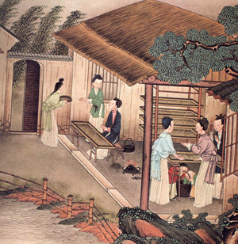
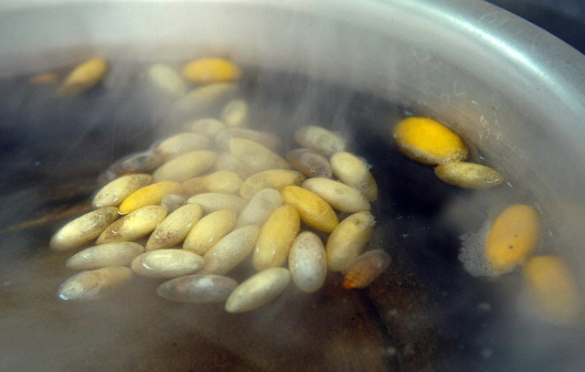
Trade
An agricultural surplus led to an increase in trade.
The most important trade item was silk.
It’s secret was closely guarded.
Sharing the secret of silk was punishable by death.
Silk is made from the cocoons of silkworms
These worms feed on Mulberry leaves.
The cocoons are boiled to kill the silkworm
Then the cocoons are unwound and combined to make silk thread

Slide 17
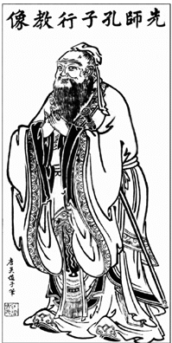
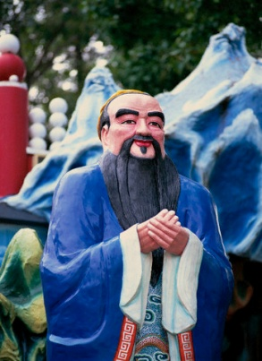
Chinese Philosophies
Chinese philosophers were less concerned with the afterlife, and more concerned with how to improve life presently on earth.
Confucianism
Founder: Confucius
famous Chinese thinker and social philosopher, whose teachings and philosophy have deeply influenced Chinese, Korean, Vietnamese, and Japanese life and thought.
Is known to the Chinese as the first teacher, his name was “Master Kung”
Was born in 551 B.C.

Slide 18
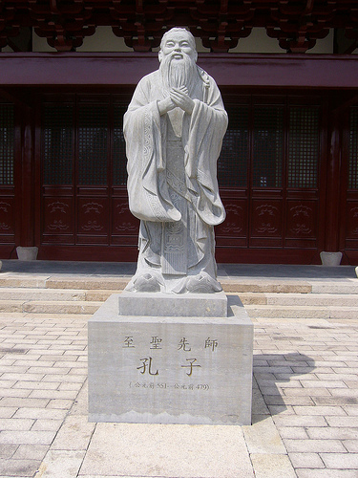
Wanted to be
Confucius originally wanted to be a political advisor.
He traveled around the country trying to persuade political leaders to listen to him.
He was rejected and so he decided to become a teacher instead.
Confucius developed a great following of students.
These students collected his teachings after his death.
This teachings are collected in The Analects.
A collection of sayings and advice.
"In teaching, there should be no distinction of classes.“
-Confucius

Slide 19
Thought that people were:
Confucius taught that people were born good and that bad behavior, or evil was learned behavior.
Treatment of Others
Confucius taught that you should be respectful of others.
Confucius believed that personal interests were subordinate to the needs of the family and community.
Government Leaders
In order to govern others one must first govern oneself.
Leaders should practice self control and be moral.
Merit: Leaders should rule by example. If a ruler is fair and just then his people will follow and do the same.
To govern by virtue, let us compare it to the North Star: it stays in its place, while the myriad stars wait upon it." (Analects II, 1)

Slide 20
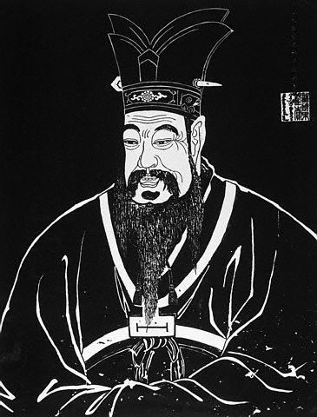
Filial Piety
Confucius taught that people should have Filial Piety, respect for your elders and superiors.
Confucius taught that order in the university would only exist if people followed their role. He established five key relationships which brought about an orderly society.
Ruler to Subject
Father to Son (Parent to Child)
Husband to Wife
Older Brother to Younger Brother
Friend to Friend
The only equal relationship was friend to friend.

Slide 21
Specific duties were prescribed to each of the participants in these sets of relationships. Such duties were also extended to the dead, where the living stood as sons to their deceased family. This led to the veneration of ancestors.
In time, filial piety was also built into the Chinese legal system: a criminal would be punished more harshly if the culprit had committed the crime against a parent, while fathers exercised enormous power over their children.

Slide 22
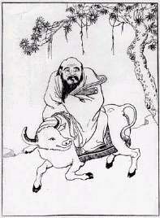
Daoism (Taoism)
Founded by Laozi, the “Old Master”
It was said that he lived without leaving any traces.
Holy Text: Tao Te Ching
Way of Life
He believed a person's conduct should be governed by instinct and conscience. He believed "simplicity" to be the key to truth and freedom. Lao Tzu encouraged his followers to observe, and seek to understand the laws of nature; to develop intuition and build up personal power; and to wield power with love, not force.
View of Government
Daoism views government as being unnatural.
“The universe is sacred, You cannot improve it. If you try to change it, you will ruin it. If you try to hold it, you will lose it.”

Slide 23

Yin and Yang
Yin is the darker element; it is passive, dark, feminine, downward-seeking, and corresponds to the night. Often symbolized by water or earth
Yang is the brighter element; it is active, light, masculine, upward-seeking and corresponds to the day. Often symbolized by fire or wind.
These are complementary opposites rather than absolutes. They do not represent good and evil, one force is not seen as morally superior to the other.

Slide 24
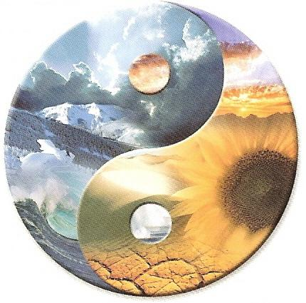
Yin and Yang do not exclude each other.
  Everything has its opposite: although this is never absolute, only relative
Yin and Yang are interdependent.
  One cannot exist without the other
Yin and Yang can be further subdivided into Yin and Yang.
  Any Yin or Yang aspect can be further subdivided into Yin and Yang.
Yin and Yang consume and support each other.
  Yin and Yang are usually held in balance: as one increases, the other decreases
Yin and Yang can transform into one another.
  At a particular stage, Yin can transform into Yang and vice versa. For example, night changes into day
Part of Yin is in Yang and part of Yang is in Yin.
  The dots in each serve as a reminder
  that there are always traces of one in the other

Slide 25
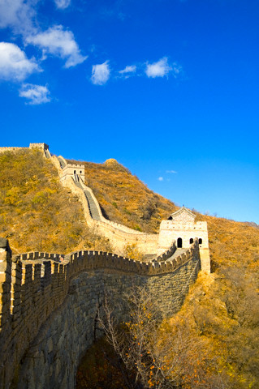
Legalism
Founded by: Han Feizi
Nature of Man
Legalism believed that man was born bad and had to learn to be good.
The state is more important than the individual
Rulers
Rulers should be strong and rule with absolute power.
Laws
Legalists believed that if the punishments were heavy and the law equally applied, neither the powerful nor the weak would be able to escape state control

Slide 26
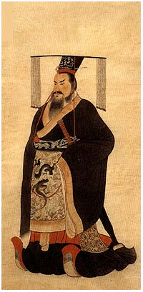
Section 4
Qin (Chin) Dynasty (221 BC - 206 BC)
The fall of the Zhou dynasty led to a period of Chaos called the “Warring States Period”, at the end of this the emperor Qin Shihuangdi unified China under a single leader, becoming the first Emperor of China.
First Emperor came to power in 221 B.C.
Shi Huangdi (Shihuangdi) First Emperor of China.
He came to power at the age of 13.
He dramatically changed life in China.

Slide 27
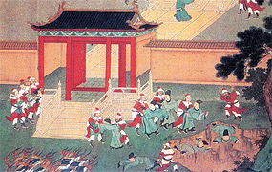
Ruling Philosophy
Qin adopted Legalism to rule his regime (government in power)
Style of Rule
Centralized power to avoid another civil war.
Treatment of People
People who opposed his rule were punished or executed.
He held mass book burnings to get rid of ideas contrary to what he believed.

Slide 28
Written Language
Shi Huangdi made many reforms
He unified written Chinese, having a common written language allowed for easier communication.
He created a single currency to make trade easier
He built roads throughout his empire to make travel easier.
He dug the Grand Canal from the Yangtze to Central China to make trade and travel easier.

Slide 29
Military Division
Dealt with government/
defense issues.
Inspectors who checked on government officials.
Dealt with issues that affected the people
Larger divisions
Smaller Divisions

Slide 30
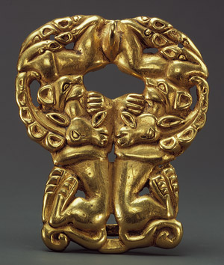
Xiongnu
Nomadic warriors to the north of China.
They kept invading along the northern borders.
Mastered the art of fighting on horseback, using horse archers to attack.
Construction of The Great Wall
Shihuangdi ordered that a wall be built across the northern border of the empire.
There were already some walls along the borders, he had them jointed together.
This was a massive construction project, many people died during construction and are allegedly buried inside the wall itself.

Slide 31
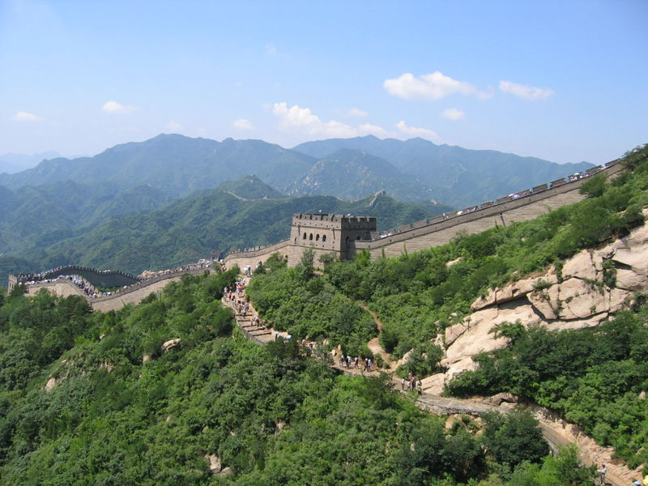
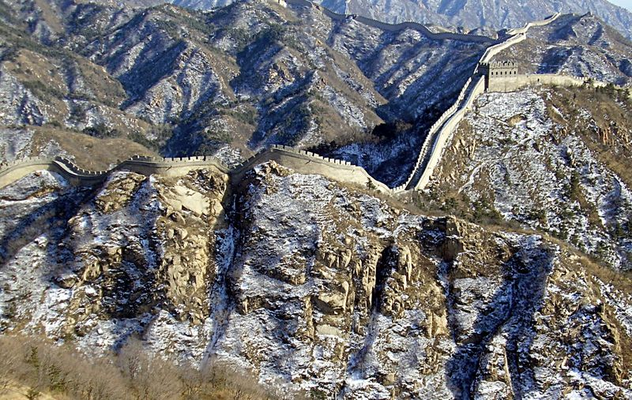
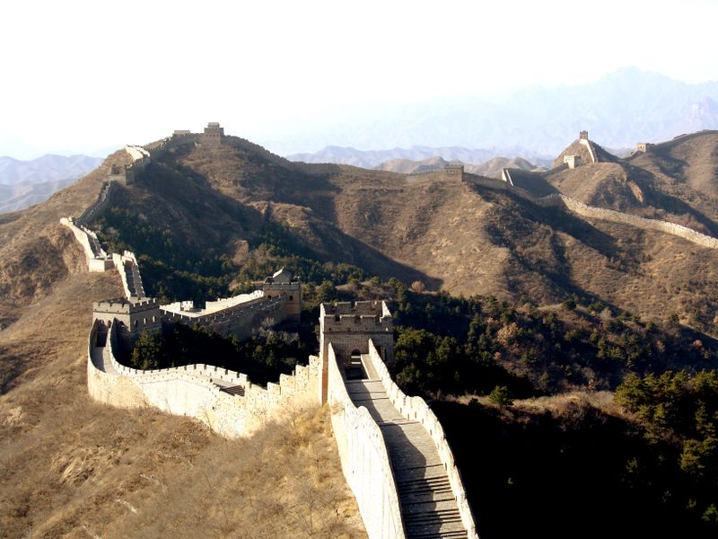
The Great Wall is the world's longest man-made structure, stretching over 6,352 km
(3,948 miles)

Slide 32
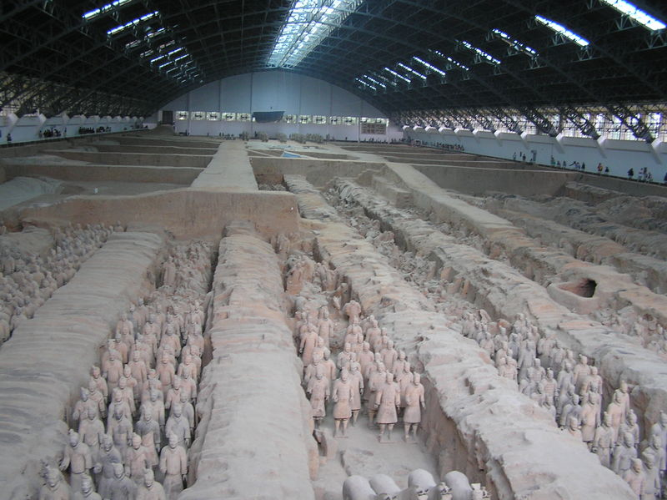
Fall of the Qin Dynasty
The harsh rule of Shihuangdi angered many in his Empire
After his death there was another period of civil war
The next dynasty to arise was one of the greatest and longest lasting in Chinese History.

Slide 33
The Han Dynasty (206 BC–AD 220)
Liu Bang: A man of peasant origin, was the founder of the Han Dynasty.
Ruling Philosophy
The Han adopted Confucianism as their ruling philosophy
Choosing of rulers
Officials and rulers were chosen by merit, rather than by birth. That way they were better qualified to rule.
Civil Service Exam
The Han set up schools to train people for government work.
Students had to learn Chinese history, law, and the teachings of Confucius.
They had to pass an exam to be able to work in the government.

Slide 34
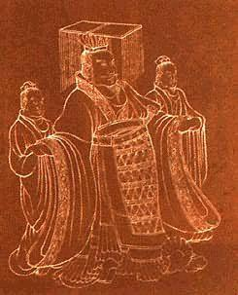
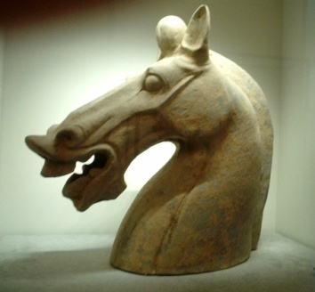
Expansion of Empire
Han rulers added territory to the north and out to the South China sea into what is today Vietnam.
The Han Emperor Wudi, forced the Xiongnu back north through war and diplomacy, and brought peace to the empire for 150 years.
The Silk Road expanded during the Han Empire under Wudi, it was said he heard of Heavenly Horses that were very powerful
Culture under the Han
Confucian schools were established during this time.
Life of Peasants
Peasant life was not good during this time.
A growth in population reduced the amount of available farm land, forcing many farmers out of business.
Many were forced to sell their land and become tenant farmers.
Wealthy land-owners gained much of the land.

Slide 35
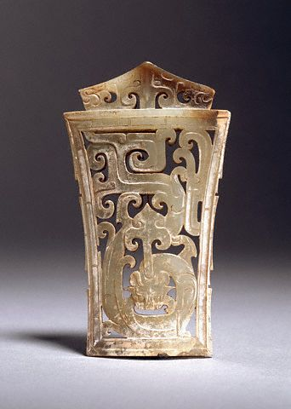
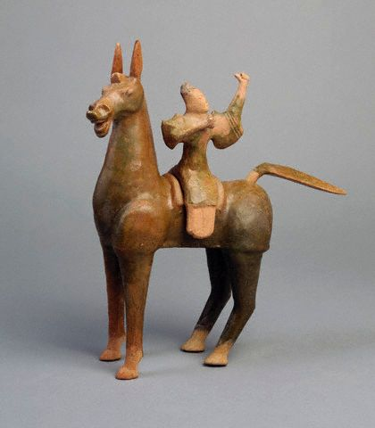
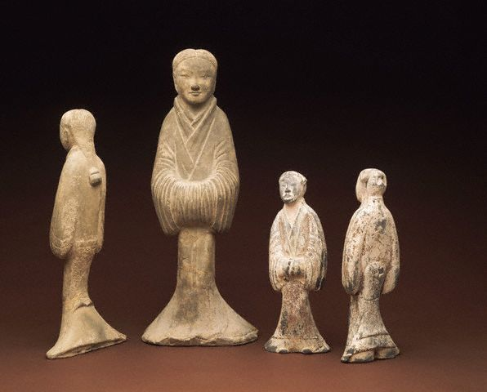
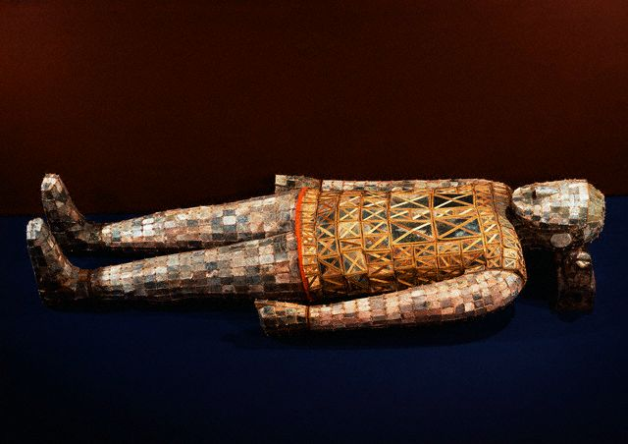
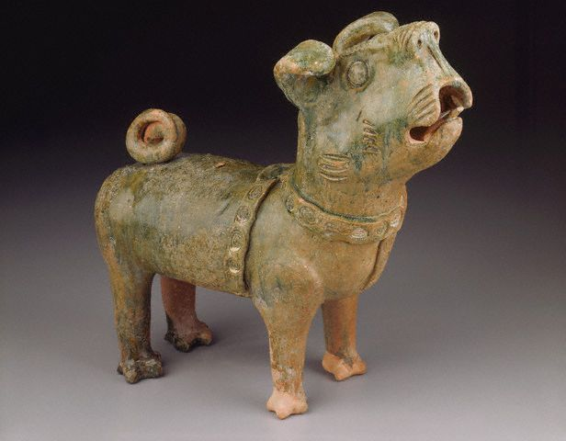
Han Artifacts

Slide 36
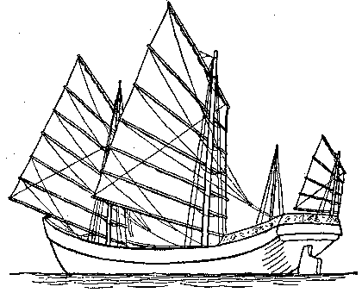
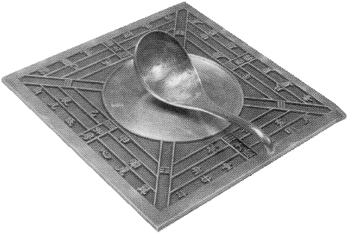
Technological Advancements
Rudder and Fore and Aft Rigging
The rudder allowed for the steering of ships.
The rigging and shape of the sails allowed ships to use wind coming from different directions.
A Chinese Junk (Ship)
Textiles
Began to weave cotton cloth
Paper
Writing on paper began about 100 A.D.
Paper was made with hemp/linen and Bamboo.
The Chinese also invented the Magnetic Compass and gunpowder

Slide 37
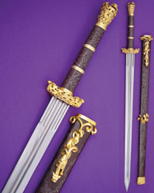
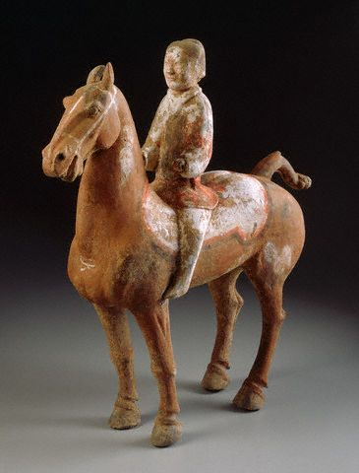
Iron Casting: Steel
The Chinese were able to invent steel.
This led to stronger, and more durable, tools and weapons.
Reproduction of a Han style sword
Decline of the Han
Han rulers became corrupt over time.
Power of the Central government declines and aristocrats began to fight over power.
China fell into another period of civil war.

Slide 38
Culture of Han
Confucian Schools
Became the basis of education in China for many years to come.
Culture of Qin
Terra Cotta Army
Was created to guard the emperor Qin Shihuangdi in the afterlife.
Each soldier is unique.
The army, dressed in uniforms, with weapons, is made to scale.
There are horses, wooden chariots, and several thousand bronze weapons.
They were originally painted with bright colors, but this has faded over time.

Slide 39






Slide 40




