Slide 1
Absolutism
A system in which the ruler, usually a monarch, holds absolute power (complete authority) over the government and the lives of the people
Monarch = a king or queen who rules a territory, usually for life and by hereditary right
The opposite of a constitutional government or democracy, such as that found in the United States
In 17th Century Europe, absolutism was tied to the idea of the divine right of kings
Divine right = belief that the authority to rule comes directly from God

Slide 2
Essential Understandings
The Age of Absolutism takes its name from a series of European monarchs who increased the power of their central governments.
Characteristics of Absolute Monarchies:
Centralization of power
Concept of rule by divine right

Slide 3
Power of a Monarch
In the 17th Century, people looked to the monarch for political stability
Absolute monarchs had tremendous powers
Make laws
Levy taxes
Administer justice
Control the state’s officials
Determine foreign policy
No written Constitution or Bill of Rights
Most people did not have any rights at all

Slide 4
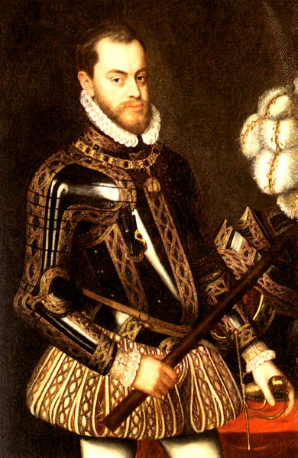
Spain
Philip II
(r. 1527-1598)
“Advancing Catholicism and Increasing Spain’s Power”

Slide 5
Background: Charles V-grandson of Ferdinand and Isabella
King of Spain & Ruler of the Austrian Hapsburg Empire (Holy Roman Empire & Netherlands)
Ruling two empires involved Charles in constant warfare
As a devout Catholic, he sought to suppress Protestantism in the HRE (he was eventually forced to allow the German princes to choose their own religion)…remember this???
The scattered empire proved to be too scattered for any one person to rule effectively so Charles divided it up between his brother, Ferdinand (HRE) and his son, Philip (Spain)

Slide 6
Philip II
Reigned as an absolute monarch
Devoted most of his time to government work (unlike many other monarchs)
Defended the Catholic Church and turned back the rising Protestant tide in Europe
Fought many wars in an attempt to advance Spanish Catholic power (e.g., the Netherlands)

Slide 7
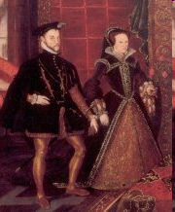
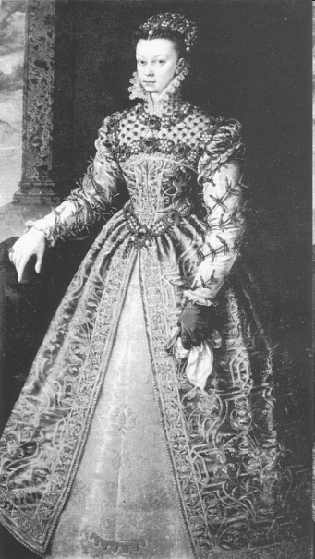
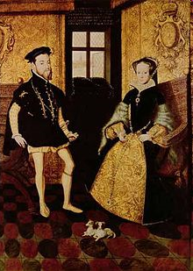
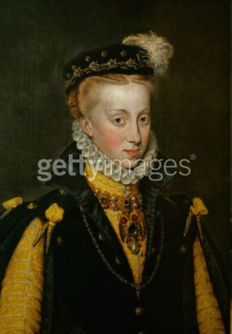
Tools to Extend Spanish Power
Marriage: Built alliances and pacified enemies
Maria – Alliance: Portugal
Mary Tudor – Alliance: England
Elizabeth Valois – Alliance: France
Anna – Alliance: Austria
War: Gained control of Portugal
Wealth: Silver and gold from colonies in the Americas fueled the Spanish economy and ensured Spanish power

Slide 8
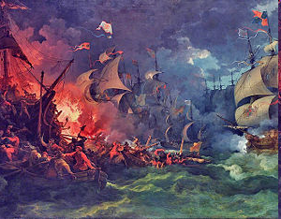
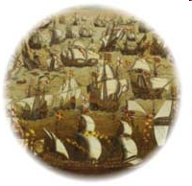
Spanish Armada
Queen Elizabeth’s speech
By the end of the 1580s, Philip II saw England’s Queen Elizabeth I as his chief Protestant enemy – she also supported the Dutch against Spain and encouraged English captains to plunder Spanish ships and loot Spanish cities in the Americas
1588: Philip II prepared a huge armada, or fleet of warships, to invade England – but the lighter, faster English ships defeated the Spanish Armada in the English Channel
This marked the beginning of the end of Spanish power

Slide 9
Key Terms
Philip II reigned as ABSOLUTE MONARCH – a ruler with complete authority over the government and the lives of the people
Asserted that he ruled by DIVINE RIGHT – the belief that authority to rule came directly from God (Philip II was a devout Catholic)
Philip II prepared the Spanish ARMADA – a fleet of ships – to carry a Spanish invasion force to England

Slide 10
Philip II’s Accomplishments
Expanded Spanish influence
Thanks in part to gold and silver from the Spanish colonies in America, he made Spain the foremost power in Europe
Strengthened the Catholic Church (defended the Catholic Counter-Reformation)
Made his own power absolute

Slide 11
Philip II’s Historical Significance/Legacy
Under Philip II, Spain reached the peak of its power
Established the first trans-Pacific trade route between America and Asia
Commenced settlements in the Philippines (the Philippines was named after him)

Slide 12
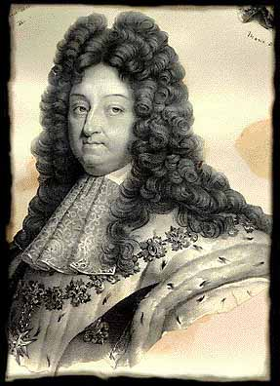
France
Louis XIV
(r. 1643-1715)

Slide 13
Key Terms
Huguenots
St. Bartholomew’s Day Massacre
Henry IV
Edict of Nantes
Cardinal Richelieu
Sun = symbol of absolute power
Intendant
Versailles
Balance of power

Slide 14
Background: France’s Wars of Religion (1560s-1590s)
Religious wars between the Catholic majority and the French Protestants, called Huguenots, tore France apart
St. Bartholomew’s Day Massacre = worst incident; Catholic royals slaughtered 3,000 Huguenots
This symbolized the complete breakdown of order in France

Slide 15
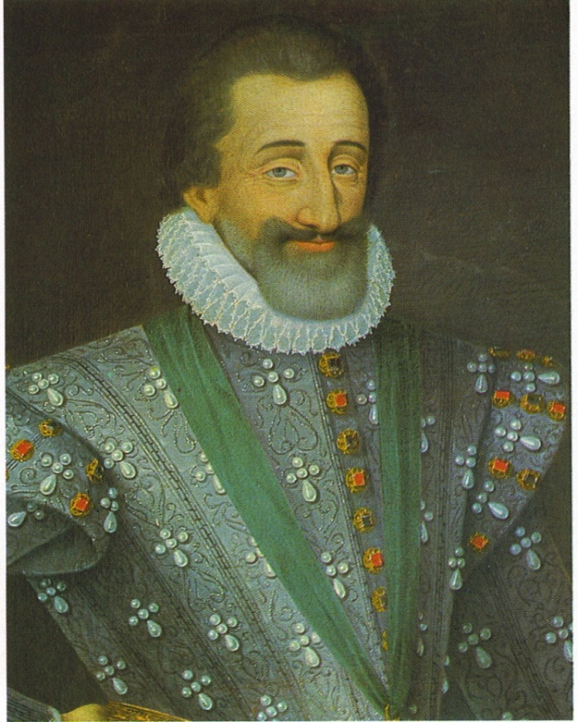
Background: Henry IV
1589: Henry IV, a Huguenot prince, inherited the French throne
For four years he fought against fierce Catholic opposition
To end the conflict, he converted to Catholicism
To protect Protestants, however, he issued the Edict of Nantes (1598), which granted the Huguenots religious toleration and other freedoms

Slide 16
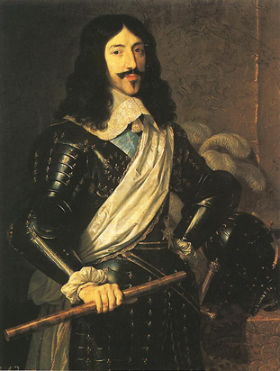
Louis XIII
Son of Henry IV
Inherited throne at age 9
Cardinal Richelieu appointed chief administer
Focused on strengthening the central government (extending royal power)
Sought to destroy the Huguenots and the nobles, two groups that did not bow to royal authority
Handpicked his successor, Cardinal Mazarin

Slide 17
Louis XIV
Son of Louis XIII
Inherited throne at age 5
Believed in his divine right to rule
Took the sun as the symbol of his absolute power: just as the sun stands at the center of the solar system, so the Sun King stands at the center of the nation
The Estates General, the medieval council made up of representatives of all French social classes, didn’t meet once during Louis XIV’s reign and therefore played no role in checking royal power

Slide 18
Louis XIV’s Policies
Expanded the bureaucracy and appointed intendants, royal officials who collected taxes, from the middle classes
Cemented his ties with the middle classes
Checked the power of nobles and Church
Recruited soldiers
French army became strongest in Europe
Army was used to enforce his policies at home and abroad
Use mercantilist policies to bolster the economy
New lands cleared for farming, encouraged mining and other basic industries, and built up luxury trades
Imposed high tariffs on imported goods to protect French manufacturers

Slide 19
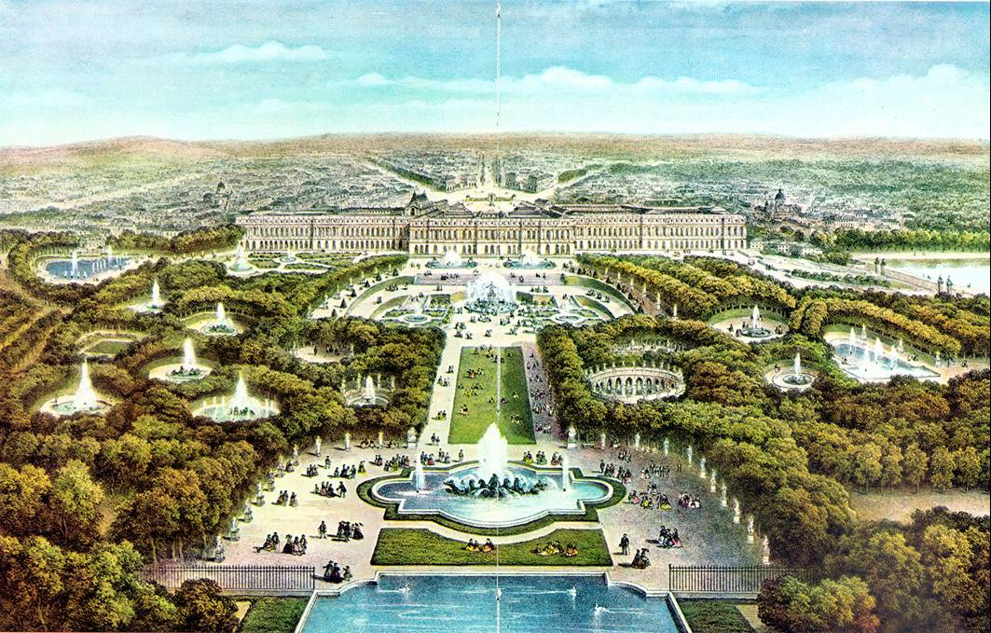
Versailles Palace of Versailles video
Louis XIV spared no expense to make this the most magnificent building in Europe
Was the perfect symbol of the Sun King’s wealth and power
Served as the Louis XIV’s home and the seat of the government
Each day began in the King’s bedroom with a major ritual known as the levee, or rising
High-ranking nobles competed for the honor of holding the royal washbin or hand the king his diamond-buckled shoes
Purpose: These nobles were a threat to the power of the monarchy; thus, by luring nobles to Versailles, Louis XIV turned them into courtiers angling for privileges rather than rivals battling for power

Slide 20
Weakening France’s Economy
How did Louis XIV’s actions weaken France’s economy?
Waging war to expand France’s borders drained his treasury (other European nations wanted to maintain the balance of power = a distribution of military and economic power among European nations to prevent any one country from dominating the region)
Expelling Huguenots, whom Louis XIV saw as a threat to religious and political unity, removed some of his most productive subjects

Slide 21
Louis XIV’s Accomplishments
Strengthened royal power, the army, the economy, and the arts to make France the leading power of Europe
Prevented dissent from within by keeping the nobles busy in the king’s court instead of battling for power (levee)
Versailles became a symbol of royal power and wealth

Slide 22
Louis XIV’s Historical Significance/Legacy
Louis XIV’s efforts (political, military, and cultural achievements) placed France in a dominant position in Europe
His efforts didn’t, however, bring prosperity to the common people of France – his numerous wars and extravagant palaces effectively bankrupted the nation

Slide 23
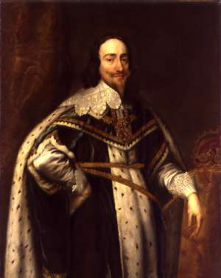
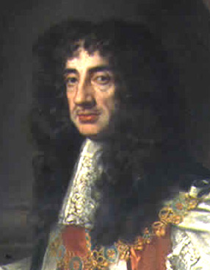
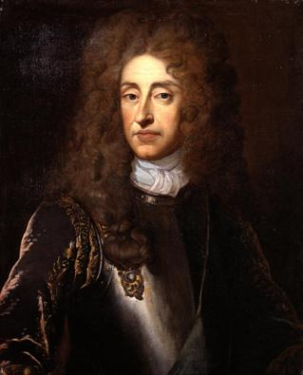
England
Charles I, Charles II, James II
(r. 1625-1649) (r. 1660-1685) (r. 1685-1688)

Slide 24
Key Terms
Early Stuarts: Charles I
English Civil War
Cavaliers
Roundheads
Oliver Cromwell & the Commonwealth
Restoration Stuarts: Charles II & James II
Restoration
Glorious Revolution
William & Mary
English Bill of Rights
Limited monarchy
Constitutional government

Slide 25
Essential Understanding
Political democracy rests on the principle that government derives power from the consent of the governed (the people). The foundations of English rights include the jury trial, the Magna Carta, and common law.
The English Civil War and the Glorious Revolution prompted further development of the rights of Englishmen.

Slide 26
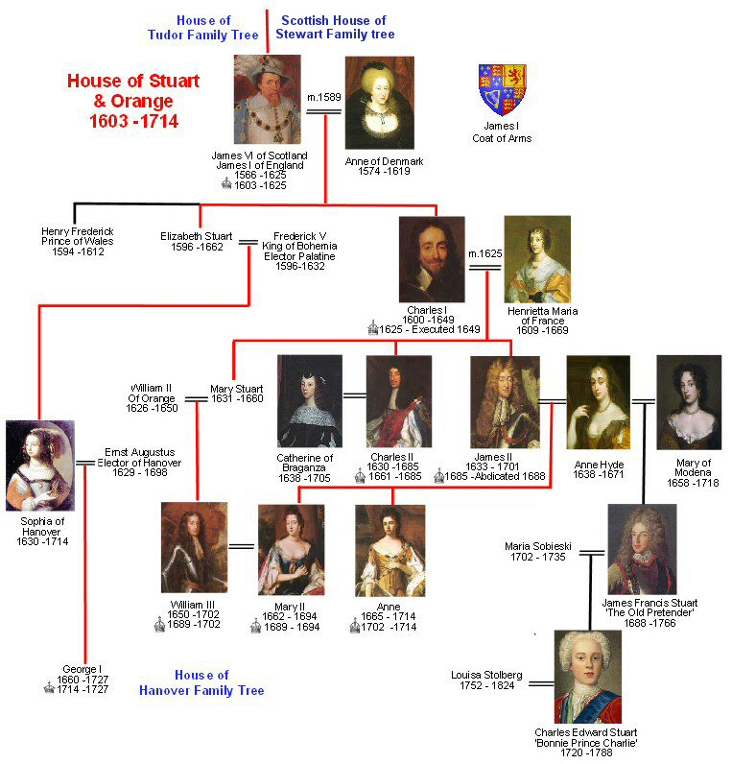

Slide 27
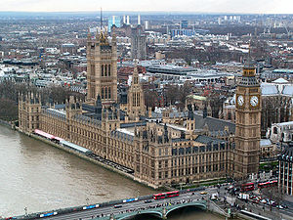
Monarchy vs. Parliament
Parliament: England’s legislative body
House of Lords which represented the nobility
House of Commons (the lower house) which represented everyone else
Parliament controlled the finances!
The Tudor’s dealt with Parliament well - the Stuarts did not!
Palace of Westminster

Slide 28
Tudors vs. Stuarts
Tudor monarchs believed in divine right but recognized the value of good relations with Parliament
Stuart monarchs weren’t as popular as the Tudors or as skilled in dealing with Parliament – they inherited problems that Henry and Elizabeth had long suppressed, resulting in a century of revolution that pitted the Stuart monarchs against Parliament

Slide 29
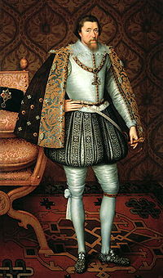
James I - King of England
James VI- King of Scotland became James I King of England
Reigned 1603-1625
He believed in the divine right of kings - kings receive their power from God and are responsible only to God
1611 - King James version of the Bible

Slide 30
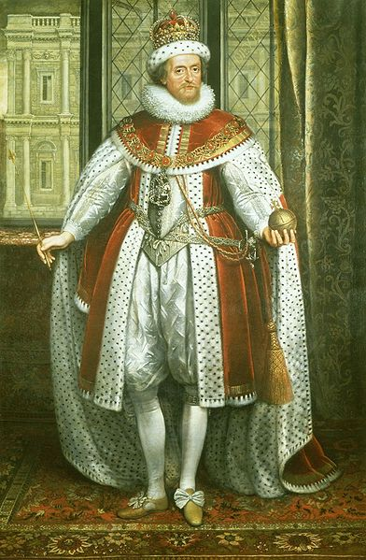
James I’s Accomplishments & Historical Significance
Often offended the Puritans in Parliament (Elizabeth flattered them to get her way)
Expanded English international trade and influence was actively pursued through the East India Company
The Thirty Years' War (1618–1648) was one of the most destructive conflicts in European history – began during his reign
James handed down to his son, Charles I a fatal belief in the divine right of kings, combined with a disdain for Parliament
These beliefs and attitudes led to the English Civil War and the execution of Charles I

Slide 31
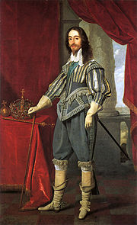
Charles I
Son of James I
Reigned 1625-1649
Married to a devout French Catholic
When he did not get what he wanted from Parliament he dissolved it in 1625

Slide 32
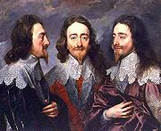
Charles I
Money came from taxing the people
Decrease in popularity
He had to call Parliament
Parliament took this opportunity to impose limits on the monarchs’ power
"Charles I, King of England,
the "Triple Portrait" by Anthony van Dyck

Slide 33
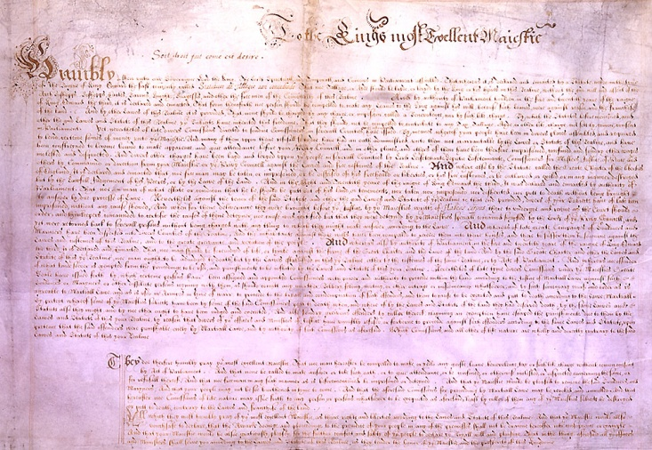
Petition of Right - 1628
The King would not:
imprison subjects without due cause
levy taxes without Parliament’s consent
house soldiers in private homes
impose martial law in peacetime
After agreeing to the petition, Charles I ignored it because it limited his power
The petition was important: it set forth the idea that the law was higher than the king

Slide 34
Think Through History
Explain how the Petition of Right contradicted the idea of absolute monarchy.
An absolute sovereign was supposed to be above everyone; the Petition of Right said that the law and Parliament could limit the power of the English monarch.

Slide 35
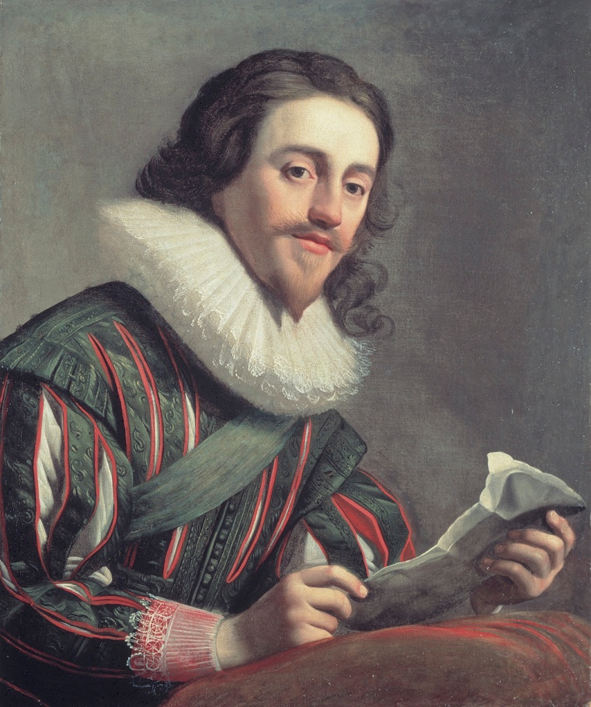
Charles I
1629 – 1640 Charles I dissolved Parliament and ruled personally
Charles tried to arrest Parliament’s leaders in January 1642 –they escaped
A mob of Londoners raged outside the palace
Charles fled London and raised an army in the north of England, where people were loyal to him

Slide 36
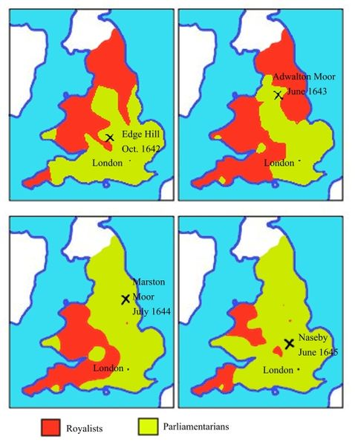
English Civil War: 1642-1649
Cavaliers: Supporters of the king or Royalists versus
Roundheads: Puritan supporters of Parliament
Oliver Cromwell, military genius, lead the New Model Army (Parliament)
His army was made up chiefly of extreme Puritans known as the Independents, who believed they were doing battle for God
Parliament won!

Slide 37
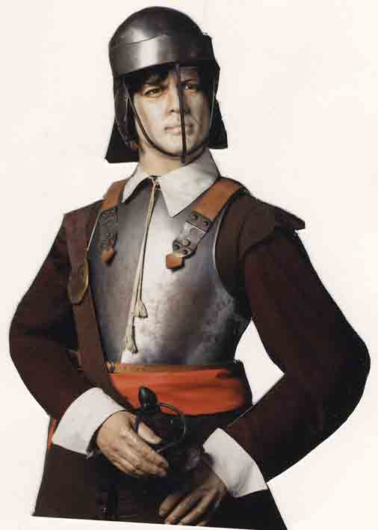
Royalists Cavaliers
Parliamentarians Roundheads
House of Lords
N & W England
Aristocracy
Large landowners
Church officials
More rural
House of Commons
S & E England
Puritans
Merchants
Townspeople
More urban

Slide 38
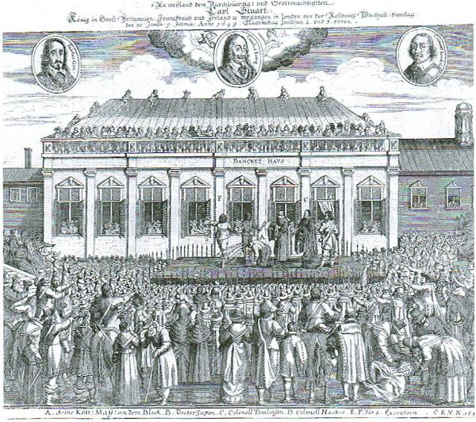
Death of King Charles I - 1649
Cromwell and the Puritans brought Charles to trial for treason. They found him guilty and sentenced him to death.
The execution of Charles was revolutionary. Kings had often been overthrown, killed in battle, or put to death in secret – but never before had a reigning monarch faced a public trial and execution by his own people.

Slide 39
Charles I’s Accomplishments & Historical Significance
Petition of Right imposed limits on the monarch’s power
Back and forth with Parliament led to the English Civil War (dissolving, then calling, then trying to arrest Parliament)
Executed for treason – the first time a reigning monarch faced a public trial and execution by his own people

Slide 40
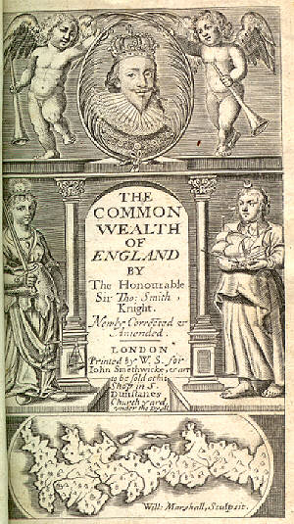
Commonwealth of England 1649-1653
Cromwell ruled with Rump Parliament
Rump Parliament abolished the monarchy and the House of Lords, and declared England a republic, or commonwealth
1653 - Cromwell dismissed Parliament (too difficult to work with) and set up a military dictatorship

Slide 41
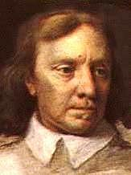
The Protectorate 1654-1660
Cromwell “Lord Protector”
Ruled until his death in 1658
He was buried in Westminster Abbey
When the Royalists returned to power his corpse was dug up, hung in chains, and beheaded

Slide 42
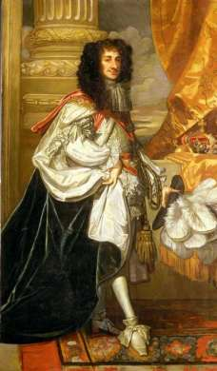
Restoration of the Stuarts
Parliament then restored the monarchy
Charles II took the throne from 1660 -1685
Under the restored Stuart monarchy, Parliament kept much of the power it had gained
It restored the Church of England as the state religion and restricted some rights of Catholics and Puritans

Slide 43
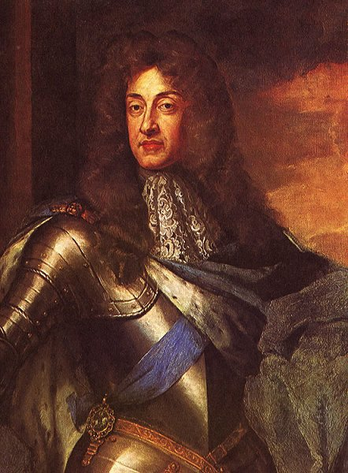
James II
1685 - James II (the younger brother of Charles II) became king when Charles II died
Devout and openly Catholic
James named Catholics to high positions in the government, armed forces, and universities
Conflict over religion again brewed

Slide 44
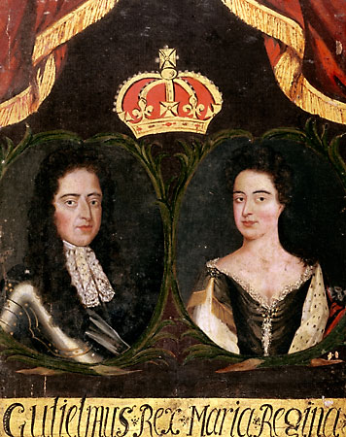
Glorious Revolution 1688
Parliament did not want James II’s Catholic son to assume the throne
The Dutch leader, William of Orange, a Protestant and husband of James’s daughter Mary, was invited to rule England
James II and his family fled, so with almost no violence, England underwent its “Glorious Revolution”

Slide 45
Charles II’s & James II’s Accomplishments & Historical Significance
Under the restoration Stuarts (Charles II and James II), Parliament kept much of the power it gained during the time of Cromwell and the Commonwealth
Conflict over religion remained a serious issue:
Stuarts = Catholic
Parliament = Church of England (Anglican)
Parliament invited William and Mary to rule England, which led to the Glorious Revolution

Slide 46
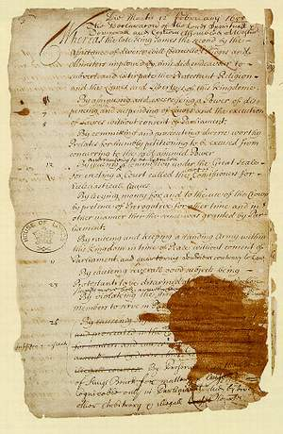
The Bill of Rights 1689
The Bill of Rights set the foundation for a constitutional monarchy
Helped create a government based on the rule of law and a freely elected Parliament
Parliament’s right to make laws and levy taxes
Standing armies could be raised only with Parliament’s consent
Right of citizens to bear arms
Right to a jury trial

Slide 47
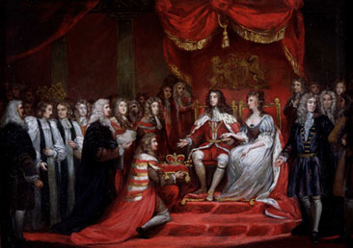
William and Mary Mary r.1689-94 and William r.1689-1702
Required to accept the Bill of Rights in order to rule - which they did
They are the only monarchs in British history to have reigned jointly

Slide 48
Bill of Rights
Main provisions:
The King could not suspend the operation of laws.
The King could not interfere with the ordinary course of justice.
No taxes levied or standard army maintained in peacetime without Parliament’s consent.
Freedom of speech in Parliament.
Sessions of Parliament would be held frequently.
Subjects had the right of bail, petition, and freedom from excessive fines and cruel and unusual punishment.
The monarch must be a Protestant.
Freedom from arbitrary arrest.
Censorship of the press was dropped.
Religious toleration.

Slide 49
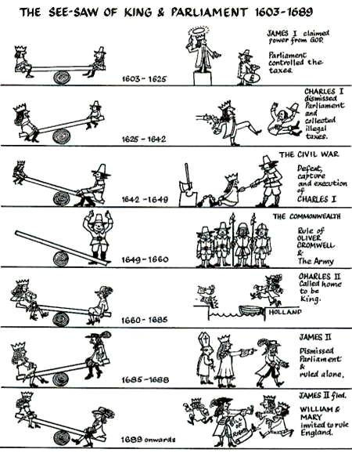

Slide 50
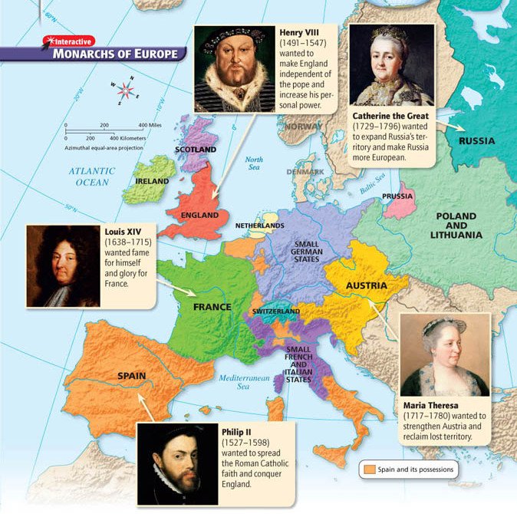

Slide 51
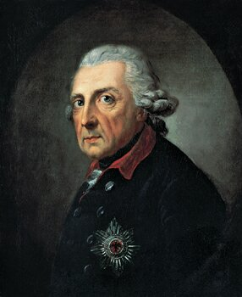
Prussia
Frederick II the Great
(r. 1740-1786)

Slide 52
Key Terms
Holy Roman Empire (HRE)
Thirty Years’ War
Ferdinand
Defenestration of Prague
Mercenaries
Depopulation
Peace of Westphalia
Prussia
Frederick William I
Frederick II
Seven Years’ War

Slide 53
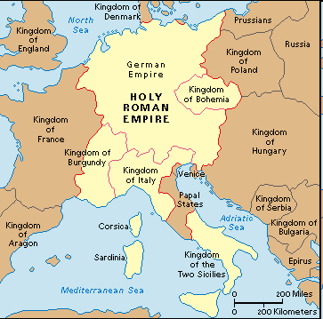
Holy Roman Empire
Patchwork of hundreds of small, separate states
Ruled by emperor who had little power over the many rival princes
This power vacuum contributed to the outbreak of the Thirty Years’ War, along with religious division between the Protestant north and the Catholic south

Slide 54
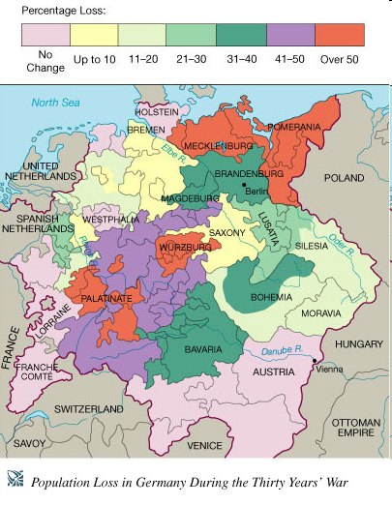
Thirty Years’ War (1618-1648)
Series of wars
Began in Bohemia (present-day Czech Republic) in the German states
Ferdinand, the Catholic king of Bohemia, wanted to suppress Protestants and assert royal power over nobles
Defenestration of Prague = a few rebellious Protestant noblemen tossed two royal officials out of a castle window
This act sparked a local revolt, which widened into a European war

Slide 55
Results of the Thirty Years’ War
Roving armies of ‘mercenaries’ (soldiers for hire) burned villages, destroyed crops, and killed without mercy
↓
Famine and disease
↓
Depopulation (as many as one third of the people in the German states may have died as a result of the war)

Slide 56
Peace of Westphalia (1648)
Series of treaties seeking to bring about a general European peace and to settle other international problems
France won extra territory along Spanish and German borders
German lands divided into more than 360 separate states – each still acknowledged the Holy Roman emperor but each had their own government, currency, church, armed forces, and foreign policy (again, the German states were not united)

Slide 57
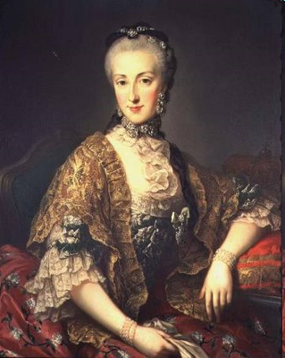
Maria Theresa & the War of the Austrian Succession
Daughter and successor of the Austrian emperor, Charles VI
No woman had ruled Hapsburg lands in her own name
Frederick II of Prussia seized the Hapsburg province of Silesia, which sparked the 8-year War of the Austrian Succession
With support from Britain and Russia, Maria Theresa preserved her empire and strengthened Hapsburg power by reorganizing the bureaucracy and improving tax collection (Britain and Russia didn’t want Prussia to upset the balance of power by gaining new lands)

Slide 58
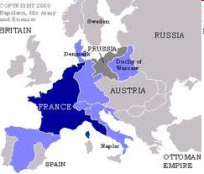
Prussia
While Austria was molding a strong Catholic state, a region called Prussia emerged as a new Protestant power
The Hohenzollern rulers set up an efficient central bureaucracy

Slide 59
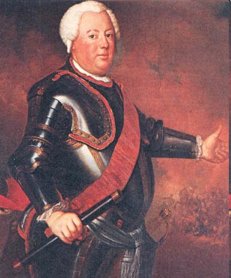
Frederick William I (r. 1713-1740)
Frederick William I gained the loyalty of Prussian nobles by giving them positions in the government and army, which reduced their independence and increased his own control
He also placed great emphasis on military values and forged one of the best-trained armies in Europe
Frederick William made sure that from a young age, his son Frederick was trained in the art of war

Slide 60
Frederick II the Great (r. 1740-1786)
Frederick II’s harsh military training had an effect – he wasted no time using his army when he came to power in 1740
Seized Silesia and sparked the War of the Austrian Succession
Brilliantly used his army in several other wars, forcing all to recognize Prussia as a great power and earning himself the title of ‘Frederick the Great’
By 1750, the great European powers included Austria, Prussia, France, Britain, and Russia
These nations formed various alliances to maintain the balance of power
Two basic rivalries persisted: Prussia vs. Austria and Britain vs. France
These rivalries sometimes resulted in worldwide conflict
Seven Years’ War (1756-1763)
Fought on four continents
Austria, Prussia, France, Britain, and Russia fought in Europe
Britain and France also fought in Africa and India
In North America, the war is known as the French and Indian War: Native American groups took sides with the French or the British
The Treaty of Paris ending these wars gave Britain a huge empire, thus changing Europe’s balance of power for the next hundred years
Also, Prussia came out of the war stronger than it went in

Slide 61
Frederick II the Great’s Accomplishments
Further consolidated power in Prussia
Seized Silesia in Austria, thus extending Prussia’s territory
Built a strong army and used that army to build a strong state (forced other nations to recognize Prussia as a great power)
“Prussia is not a state which possesses an army, but an army which possesses a state”

Slide 62
Frederick II the Great’s Historical Significance/Legacy
Brought Prussia from a state of general weakness to that of great power and wealth
Military successes and domestic reform brought land and prosperity to Prussia
He was an absolute ruler but he lived under the principle that he was the ‘first servant of the state’ – he always ruled under the guidance of what was most beneficial for Prussia, and expected his people to possess the same devotion

Slide 63
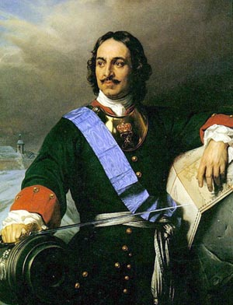
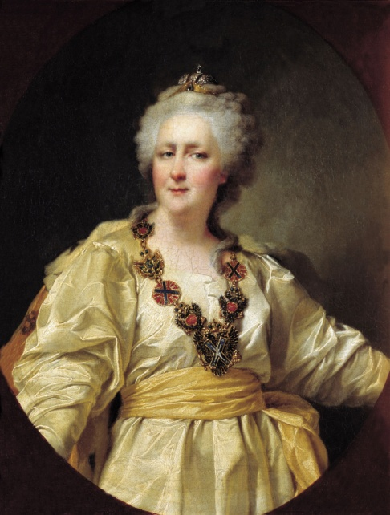
Russia
Peter I the Great
(r. 1682-1725)
&
Catherine II the Great
(r. 1762-1796)

Slide 64
Key Terms
Tsar/Czar = Russian word for Caesar; male monarch or emperor, especially in Russia prior to 1917
Westernization = the adoption of Western ideas, technology, and culture
Autocratic = ruling with unlimited authority
Warm-water port = one that would be free of ice all year round
St. Petersburg = symbol of Peter’s effort to Westernize Russia
Russo-Turkish War = Russia defeated the Ottoman Empire and gained access to a warm-water port on the Baltic Sea
Partition = divide up

Slide 65
Russia in the 1600s
Russia was primarily a medieval state, untouched by the Renaissance and Reformation and largely isolated from Western Europe
The “Time of Troubles” had plunged the country into a period of disorder and foreign invasions
The reign of the first Romanov czar in 1613 restored some order, but it wasn’t until Peter I the Great came to power that Russia got back on the road to becoming a great modern power

Slide 66
Peter I the Great
Took the throne at age 10 (1682)
Took control of the government in 1689
Traveled to the West in 1697 to learn about Western ways for himself – brought technical experts, teachers, and soldiers he recruited back to Russia
Peter I then embarked on a policy of westernization = the adoption of Western ideas, technology, and culture
Persuading Russia people to change their way of life was difficult
To impose his will, Peter I became the most autocratic of Europe’s absolute monarchs, meaning that he ruled with unlimited authority

Slide 67
Peter I’s Goals
Strengthen the military
Expand Russian borders
Centralize royal power
Westernize Russia
Actions to Accomplish his Goals:
Brought all Russian institutions under his control
Forced the boyars (landowning nobles) to serve the state in civilian or military positions while allowing them to maintain control over their land (which forced peasants into serfdom)
Forced changes in social customs and pushed reforms (imported technology, improved education, etc.)

Slide 68
Modernizing Russia
Using autocratic methods, Peter I pushed through social and economic reforms
Imported Western technology
Improved education
Improved waterways and canals
Developed mining and textile manufacturing
Backed new trading companies
To pay for these reforms, Peter I adopted mercantilist policies, such as encouraging exports
Peter I had no mercy for any who resisted the new order – those who revolted were tortured and executed

Slide 69
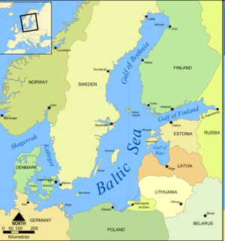
Warm-Water Port
Russia’s seaports, located along the Arctic Ocean, were frozen over during the winter. To increase Russia’s ability to trade with the West, Peter desperately wanted a warm-water port – one that would be free of ice all year round. Peter I tried to gain access to a warm-water port in the Black Sea but was unable to defeat the Ottoman Empire.

Slide 70
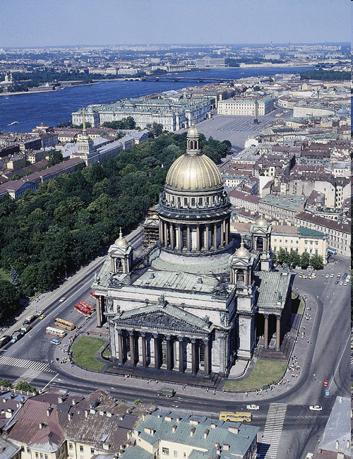
Expanding Russia’s Borders
The Great Northern War (1700-1709)
Against Sweden (dominated the Baltic region)
Russia suffered humiliating defeats – but after rebuilding the army, Peter I defeated the Swedes and won territory along the Baltic Sea
Used land to build a new capital = St. Petersburg
‘Window on the West’ – Italian architects designed palaces, etc.
Became a symbol of Peter’s effort to forge a modern Russia

Slide 71
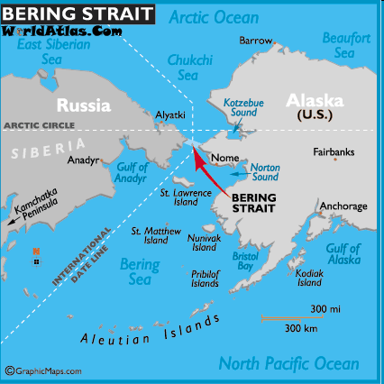
Trails to the Pacific
Expanded empire to the east by traveling across the plains and rivers of Siberia
Signed a treaty with China that recognized Russia’s claim to lands north of China
Hired a Danish explorer, who discovered the Bering Strait (made Russia the largest country in the world)

Slide 72
Peter I the Great’s Accomplishments
Using autocratic methods, Peter the Great:
Strengthened Russia’s military
Expanded Russian territory (defeated Sweden and created a new capital in St. Petersburg)
Ended Russia’s long period of isolation
Centralized royal power
Pushed through social and economic reforms to Westernize Russia

Slide 73
Catherine the Great
Capable and ruthless absolute monarch
Reorganized the provincial government
Codified laws
Began state-sponsored education for both boys and girls
Embraced Western ideas and worked to bring Russia fully into European cultural and political life
Allowed boyars to increase their hold on peasants, thus forcing even more peasants into serfdom. When the peasants rebelled, Catherine took firm action to repress them.
Waged the Russo-Turkish War against the Ottoman Empire, which gained her a warm-water port on the Black Sea in 1774

Slide 74
The Partitions of Poland
1770s – Russia, Prussia, and Austria hungrily eyed Poland
To avoid fighting one another, the three countries agreed in 1772 to partition, or divide up, Poland (not until 1919 would a free Polish state reappear)

Slide 75
Catherine the Great’s Accomplishments
Further Westernized Russia
Defeated the Ottoman Empire in the Russo-Turkish War and gained a warm-water port on the Black Sea

Slide 76
Peter the Great & Catherine the Great – Historical Significance/Legacy
Used terror to enforce absolute power
Westernized Russia
Expanded Russia’s borders through war, treaties, and exploration
Policies contributed to the growth of serfdom, which served only to widen the gap between Russia and the West (exactly the opposite of what Peter and Catherine wanted to do)

Slide 77
Looking Ahead
By the mid-1700s, absolute monarchs ruled four of the five leading countries in Europe – Britain, with its strong Parliament, was the only exception
As these five nations competed with one another, they often ending up fighting to maintain a balance of power
At the same time, new ideas were in the air – radical changes would soon shatter the French monarch, upset the balance of power, and revolutionize European societies

